Slide 1
Chef Fundamentals - Windows
training@getchef.com
Copyright (C) 2014 Chef Software, Inc.

Slide 2
Introductions
Notes:
Instructor introduction
* Name, email
* Previous job roles/background
* Current job role
* Experience with Chef
Hand out your business card

Slide 3
Instructor Introduction
Alex Vinyar
Automation Consultant with Chef
Previous job roles/background
Automator at Microsoft, Xbox, Expedia
Experience with Chef and/or config management
All kinds of automation in the windows world
Favorite Text Editor
Sublime for all things Chef Notepad++ for Powershell

Slide 4
Instructor Introduction
Name: John Fitzpatrick
Current job role: Curriculum Development/Trainer at Chef
Previous job roles/background: Before Chef I spent 3 years on Cloud Management at RightScale, and before that working in mobile internet at Openwave
Experience with Chef/Config Management: Two years experience with Chef initially at RightScale
Favorite Text Editor: SublimeText

Slide 5
Instructor Introduction
Name: Nathen Harvey
Current job role:
Previous job roles/background:
Experience with Chef/Config Management:
Favorite Text Editor:

Slide 6
Instructor Introduction
Name: Elon Bar-Evan
Current job role:
Previous job roles/background:
Experience with Chef/Config Management:
Favorite Text Editor:

Slide 7
Instructor Introduction
Name: Sean Carolan
Current job role: Chef Consultant
Previous job roles/background: In my previous life I was a Unix system administrator for EA (Electronic Arts). Before that I was also a sysadmin at Peoplefluent, an HR SaaS company.
Experience with Chef/Config Management: I used CFengine for about four years, then moved up to Puppet for about three years, and am now a happy Chef user. I have worked with several Fortune 500 companies helping them automate their infrastructure with Chef.
Favorite Text Editor: Vim, pimped out with about two dozen plugins

Slide 8
Instructor Introduction
Name: Michael Goetz
Current Job Role: Automation Consulting Engineer
Previous Job Roles/Background: Technical Architect, Build/Release Engineer, Technical Project Manager
Experience with Chef/Config Management: 3+ years with Chef, Maven & Ant (yes, as CM tools)
Favorite Text Editor: Sublime Text

Slide 9
Instructor Introduction
Name: Julian Dunn
Current Job Role: Consulting Engineer with Chef
Previous Experience: 15 years first as a software developer, then in operations
Previous Experience with Chef: My last company used Chef and they let me make lots of mistakes while learning it
Favorite Text Editor: vi

Slide 10
Instructor Introduction
# finger $(whoami)
Login: gmiranda Name: George Miranda
Directory: /home/gmiranda Shell: /bin/bash
EDITOR: /usr/bin/vim
On since Mon 14 Apr 1997 18:01 (GMT) on tty1 from :0
No mail on gmiranda@opscode.com
Plan:
twitter: gmiranda23
github: gmiranda23
irc: gmiranda23 (irc.freenode.net - #chef)
*.*: gmiranda23

Slide 11
Instructor Introduction
Name: Mandi Walls
Current Role: Technical Practice Manager
Previous: Consultant at Opscode/Chef since Nov 2011. Sysadmin running large websites for AOL before that - www.aol.com, moviefone.com, games.com
Experience with Chef: Using Chef since April 2011
Favorite Text Editor: vim

Slide 12
Instructor Introduction
Name: Stephen Lauck
Current job role: Consultant
Previous job roles/background: Rails Developer / Chef Developer
Experience with Chef/Config Management: Almost 4 years Chef dev experience
Favorite Text Editor: Emacs Baby! ( and some Sublime )

Slide 13
Instructor Introduction
Name: Dan Robinson
Current job role: Solutions Engineer, Consulting
Previous job roles/background: Consulting Engineer with Opsware/HP for 5 years prior to joining Chef, working with HP Server Automation. Background also includes various consulting and engineering roles in email security, interactive television, and Internet services
Experience with Chef/Config Management: 1.5 years working with (and working at) Chef
Favorite Text Editor: SublimeText

Slide 14
Instructor Introduction

Slide 15
Introduce Yourselves
Name
Current job role
Previous job roles/background
Experience with Chef and/or config management
Favorite Text Editor
Notes:
Student introduction
* Name
* Current job role
* Previous job roles/background
* Experience with Chef
* Favorite Text Editor

Slide 16
Course Objectives and Style

Slide 17
Course Objectives
Upon completion of this course you will be able to
Automate common infrastructure tasks with Chef
Describe Chef’s architecture
Describe Chef’s various tools
Apply Chef’s primitives to solve your problems

Slide 18
How to learn Chef
You bring the domain expertise about your business and problems
Chef provides a framework for solving those problems
Our job is to work together to teach you how to express solutions to your problems with Chef
Notes:
Hammer home that the students know how to run their infrastructure
YOU are the best person capable of automating your environment
Chef training is about understanding the framework Chef can provide to solving those problems
* STUDENT KNOWLEDGE + CHEF TRAINING = VICTORY

Slide 19
Chef is a Language
Learning Chef is like learning the basics of a language
80% fluency will be reached very quickly
The remaining 20% just takes practice
The best way to learn Chef is to use Chef
Notes:
We will get you fluent
We will do it in a way that maps to what experts do
We will teach you how to find and use the resources that will make you an expert in time

Slide 20
Training is really a discussion
We will be doing things the hard way
We’re going to do a lot of typing
You can’t be:
Absent
Late
Left Behind
We will troubleshoot and fix bugs on the spot
The result is you reaching fluency fast
Notes:
We are going to do things the hard way - which gets you to fluency fast. It’s only the “hard” way because it doesn’t cut corners.
1. You will go through each exercise. You can’t be absent, or late, or left behind.
2. You will type in each line of code by hand
3. We will make it run, and fix any bugs when they happen
We will introduce concepts when you type them, and we will repeat them as we go.
Copy-pasting or transferring files from another student will undermine your success - ban it :)
The result is you will know how to actually use Chef.

Slide 21
Training is really a discussion
I’ll post objectives at the beginning of a section
Ask questions when they come to you
Ask for help when you need it
You’ll get the slides after class
Notes:
I get asked at every class, “will we get the slides” so I thought it prudent to address it here. Why not hand them out at the beginning? To make people type things and learn by muscle memory.

Slide 22
Fundamentals
This course covers the fundamentals of Chef
We likely will not have time to discuss the latest trends in the Chef ecosystem
Any discussion items that are too far off topic will be captured
We'll return to these items as time permits

Slide 23

Stages of Learning - Shuhari
Shuhari - first learn, then detach, and finally transcend
shu - "obey" - traditional wisdom
ha - "detach" - break with tradition
ri - "separate" - transcend
Notes:
http://en.wikipedia.org/wiki/Shuhari
"It is known that, when we learn or train in something, we pass through the stages of shu, ha, and ri. These stages are explained as follows. In shu, we repeat the forms and discipline ourselves so that our bodies absorb the forms that our forbearers created. We remain faithful to the forms with no deviation. Next, in the stage of ha, once we have disciplined ourselves to acquire the forms and movements, we make innovations. In this process the forms may be broken and discarded. Finally, in ri, we completely depart from the forms, open the door to creative technique, and arrive in a place where we act in accordance with what our heart/mind desires, unhindered while not overstepping laws."

Slide 24
Agenda

Slide 25
Topics
Overview of Chef
Workstation Setup
Organization Setup
Test Node Setup
Writing your first cookbook
Dissecting your first Chef run
Introducing the Node object
Attributes, Templates, and Cookbook Dependencies
Notes:
We’re going to go through an overview of all the concepts you are going to learn.
Make a note of how much of the focus is on writing cookbooks.

Slide 26
Topics
Template Variables, Notifications, and Controlling Idempotency
Data bags, search
Roles
Environments
Using community cookbooks
Further Resources

Slide 27
Breaks!
We’ll take a break between each section, or every hour, whichever comes first
We’ll obviously break for lunch :)
Notes:
Take 5 minute breaks frequently
We have a lot of content to go through.
Take a 15 minute break after every few sections or 2 hours (whichever comes first)
Take a working (~30 minute) lunch break after the first round of writing Cookbooks
Lunch time lecture: Using Community Resources (talk through community cookbooks and the wiki). Break for 15 mins after lunch session (cleanup etc)
Take the last break right after Refactoring IIS (deserves its own break before and after)

Slide 28
Overview of Chef

Slide 29
Lesson Objectives
After completing the lesson, you will be able to
Describe how Chef thinks about Infrastructure Automation
Define the following terms:
Node
Resource
Recipe
Cookbook
Run List
Roles
Search
Notes:
If the class has folks who already know some Chef, this will be a review. The course will go into detail on each topic - so if you have specific questions about a part of Chef, or a best practice, best to hold it until later. Talk relationships and high level.
Takes ~45 minutes, and prepare them for this being the last lecture for a while.

Slide 30

Complexity
Notes:
As sysadmins, developers, service providers, we have a lot of complexity to manage. This could be a small 4 node application, right up to an application with 1000's nodes

Slide 31
Items of Manipulation (Resources)
Networking
Files
Directories
Symlinks
Mounts
Registry Key
Powershell Script
Users
Groups
Packages
Services
Filesystems

Slide 32
A tale of growth...
Application
Notes:
You finally got the app running by managing a bunch of those resources

Slide 33
Add a database
Application
Application Database
Notes:
Apps are cool, but storing data is cooler

Slide 34
Make database redundant
Application
App Databases
Notes:
Of course, we want to have redundant HA database servers

Slide 35
Application server redundancy
App Servers
App Databases
Notes:
We need more app servers, redundancy right?

Slide 36
Add a load balancer
App LB
App Servers
App Databases
Notes:
We need a load balancer in front of all these app servers

Slide 37
Webscale!
App LBs
App Servers
App Databases
Notes:
Scaling out the app layer, redundant LB

Slide 38
Now we need a caching layer
App LBs
App Servers
App DB Cache
App DBs
Notes:
Posted on slashdot, hacker news or techcrunch! We must construct additional pylons

Slide 39
Infrastructure has a Topology
App LBs
App Servers
App DB Cache
App DBs
Notes:
an Infrastructure has a Topology. Maybe you don’t want to do it that way.

Slide 40
Your Infrastructure is a Snowflake
Round Robin DNS
App Servers
App DB Cache
Floating IP?
App DBs
Notes:
How should I know. It’s your application.
Your application is unique, and so is your infrastructure.
They evolve symbiotically.

Slide 41

Complexity Increases Quickly
App LBs
Cache
App Servers
< Shiny!
DB Cache
DB slaves
Are we monitoring??
DBs
Notes:
This complexity comes in the form of:
Resolving technical debt
Business requirements
Shiny object syndrome

Slide 42
...and change happens!
App LBs
Cache
App Servers
DB Cache
DB slaves
DBs
Notes:
It’s not just about growing your infrastructure.
Your infrastructure will also need to change over time.

Slide 43

...and change happens!
Add a Central Log Host
App LBs
Cache
App Servers
DB Cache
DB slaves
Central Log Host
DBs
Notes:
Add a central log host

Slide 44

...and change happens!
Add a Central Log Host
Update syslog.conf on all Nodes
App LBs
Cache
App Servers
DB Cache
DB slaves
Central Log Host
DBs
Notes:
Now you need to change syslog.conf on all nodes in your infrastructure to log all kernel messages to the central log host

Slide 45

Chef Solves This Problem
But you already guessed that, didn’t you?

Slide 46
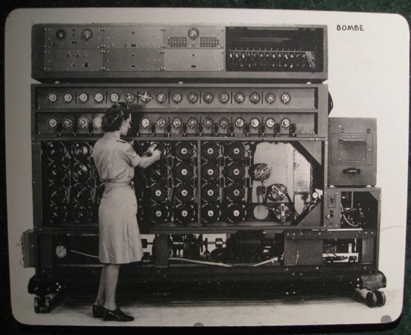
Chef is Infrastructure as Code
Programmatically provision and configure components
http://www.flickr.com/photos/louisb/4555295187/
Notes:
-- Repeatability
-- Documentation

Slide 47
Chef is Infrastructure as Code
Treat like any other code base
http://www.flickr.com/photos/louisb/4555295187/
Notes:
-- Repeatability
-- Documentation

Slide 48
Chef is Infrastructure as Code
Reconstruct business from code repository, data backup, and compute resources
http://www.flickr.com/photos/louisb/4555295187/
Notes:
-- Repeatability
-- Documentation

Slide 49
Chef is Infrastructure as Code
Programmatically provision and configure components
Treat like any other code base
Reconstruct business from code repository, data backup, and compute resources
http://www.flickr.com/photos/louisb/4555295187/
Notes:
-- Repeatability
-- Documentation

Slide 50
Configuration Code
Chef ensures each Node complies with the policy
Policy is determined by the configurations in each Node’s run list
Reduce management complexity through abstraction
Store the configuration of your infrastructure in version control

Slide 51
Declarative Interface to Resources
You define the policy in your Chef configuration
Your policy states what state each resource should be in, but not how to get there
Chef-client will pull the policy from the Chef Server and enforce the policy on the Node

Slide 52
Managing Complexity
Organizations
Environments
Roles
Nodes
Recipes
Cookbooks
Search
Notes:
Chef gives us number of tools to help us manage this complexity

Slide 53

Organizations
My Infrastructure
Your Infrastructure
Their Infrastructure

Slide 54
Organizations
Completely independent tenants of Enterprise Chef
Share nothing with other organizations
May represent different
Companies
Business Units
Departments
Notes:
Organizations are independent tenants in Enterprise Chef

Slide 55
Environments
Development
Staging
Production
Notes:
Environments are used to manage stages in your application

Slide 56
Environments
Environments reflect your patterns and workflow, and can be used to model the life-stages of your applications
Development
Test
Staging
Production
etc.
Every Organization starts with a single environment!
Notes:
An environment is a container within an organization that can mimic structural hierarchy via custom attributes and cookbook restraints

Slide 57
Environments Define Policy
Environments may include data attributes necessary for configuring your infrastructure, e.g.
The URL of your payment service’s API
The location of your package repository
The version of the Chef configuration files that should be used

Slide 58
Roles
Load Balancers
Application Servers
DB Cache
Database
Notes:
Roles are a way of classifying the different types of server in your infrastructure

Slide 59
Roles
Roles represent the types of servers in your infrastructure
Load Balancer
Application Server
Database Cache
Database
Monitoring

Slide 60
Roles Define Policy
Roles may include an ordered list of Chef configuration files that should be applied
This list is called a Run List
Order is always important in the Run List
Roles may include data attributes necessary for configuring your infrastructure, for example:
The port that the application server listens on
A list of applications that should be deployed

Slide 61
Nodes
Notes:
You could have many nodes in your infrastructure, in any configuration.

Slide 62
Nodes
Nodes represent anything that needs configuration
Typically the servers in your infrastructure
Could be physical servers or virtual servers
May represent hardware that you own or compute instances in a public or private cloud
Could also be network hardware - switches, routers, etc…
Notes:
network device support for some vendors Arista, Juniper, Cisco

Slide 63
Node
Each Node will
Belong to one Organization
Belong to one Environment
Have zero or more Roles

Slide 64
Nodes Adhere to Policy
The chef-client application runs on each node, which
Gathers the current system configuration of the node
Downloads the desired system configuration policies from the Chef server for that node
Configures the node such that it adheres to those policies

Slide 65
Resources
A Resource represents a piece of the system and its desired state
A package that should be installed
A service that should be running
A file that should be generated
A scheduled job that should be configured
A user that should be managed
and more

Slide 66
Resources in Recipes
Resources are the fundamental building blocks of Chef configuration
Resources are gathered into Recipes
Recipes ensure the system is in the desired state

Slide 67
Recipes
Configuration files that describe resources and their desired state
Recipes can:
Install and configure software components
Manage files
Deploy applications
Execute other recipes
and more
Notes:
"Recipes are segments of code that do task X."

Slide 68
Example Recipe
windows_package 'Microsoft .NET Framework 4.0' do
action :install
source 'http://download.microsoft.com/download/dotNetFx40_Full_x86_x64.exe'
options '/quiet /norestart'
end
windows_registry 'HKLM\SYSTEM\CurrentControlSet\Control\Terminal Server' do
values 'FdenyTSConnections' => 0
end
service 'W3SVC' do
action [:disable,:stop]
end
Notes:
As opposed to Linux (packages, files, services), the holy trinity in the Windows world is more “packages, registry keys, services).
If you feel the class can grok it now - Take some time here to walk through the code.
The windows_package resource has a mock URL (MS URLs are dreadfully long). It takes options “/quiet and /restart”. The action is to install.
The windows_registry resource enables Remote Desktop and pokes a firewall hole.
The W3SVC is IIS.

Slide 69
Or this…
package "apache2"
template "/etc/apache2/apache2.conf" do
source "apache2.conf.erb"
owner "root"
group "root"
mode "0644"
variables(:allow_override => "All")
notifies :reload, "service[apache2]"
end
service "apache2" do
action [:enable,:start]
supports :reload => true
end
Notes:
Or Linux! Chef works on multiple platforms.
We will look at these resources more carefully
If you feel the class can grok it now - Take some time here to walk through the code. Describe what’s happening within each resource declaration. Show how notifications work. Cover sufficient detail that it is clear that each resource in a recipe will (or may):
* Describe the desired state of that resource (via the “action” keyword)
* Include a number of resource-specific attributes (owner, mode, supports, etc.)
* Interact with other resources through the notification mechanism.
* Will only take action if required. If a resource is out of policy, it will be repaired.
Go into as much detail as you like and as the students will consume.
“What questions do you have?”

Slide 70
Or This
package "net-snmp" do action :install end
template "/etc/snmpd.conf" do source "snmpd.conf.erb" owner "root" group "root" mode 0644 variables(:community_string => “not_public”)
notifies :restart, “service[snmpd]”
end
service "snmpd" do action [:enable,:start] end
Notes:
Or Linux! Chef works on multiple platforms.
We will look at these resources more carefully

Slide 71

Cookbooks
Recipes are stored in Cookbooks
Cookbooks contain recipes, templates, files, custom resources, etc
Code re-use and modularity
http://www.flickr.com/photos/shutterhacks/4474421855/
Notes:
LEAD IN: How are these recipes applied to a node? (RUN LIST!)
"Cookbooks are a collection of recipes, templates, attributes, providers resources that can be executed against a node to achieve convergence and idempotency"

Slide 72
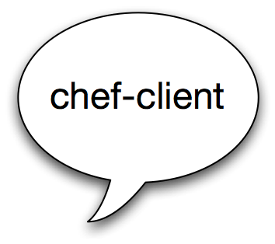
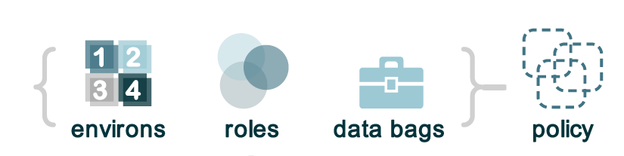


Run List
Enterprise Chef
What policy should I follow?
Node
Notes:
When the chef-server run on the node it asks the chef server what policy should I follow, or what is my run list

Slide 73
Run List
Enterprise Chef
What policy should I follow?
Node
"recipe[ntp::client]"
"recipe[users]"
"role[webserver]"
Notes:
Chef server looks at the run_list and sends the appropriate cookbooks to the node

Slide 74
Run List
Enterprise Chef
What policy should I follow?
"recipe[ntp::client]"
"recipe[users]"
"role[webserver]"
Notes:
Chef-client then executes the resources on the run list
All the heavy lifting is done on the node!! the server is quite light weight!

Slide 75
Run List Specifies Policy
The Run List is an ordered collection of policies that the Node should follow
Chef-client obtains the Run List from the Chef Server
Chef-client ensures the Node complies with the policy in the Run List

Slide 76

Search
Search for nodes with Roles
Find Topology Data
IP addresses
Hostnames
FQDNs
Much more..
http://www.flickr.com/photos/kathycsus/2686772625
Notes:
Chef Search is one of its killer features. It enables you to do a lot of heavy lifting easily.
Search for nodes by their roles, or other attributes (you assign, or assume via cookbooks).

Slide 77
Search for nodes
my_webservers = search("node","role:webserver”)
template "C:\Monitoring App\cfg\servers.list" do
source "servers.list.erb“
variables :my_webservers =>my_webservers.uniq
notifies :restart, "service[monitoring_svc]“
end
Notes:
We’re configuring a generic monitoring application...
We’re doing a search for nodes with the role of “webserver”, and adding them to a list of servers to be monitored. The monitoring service will then be restarted, prompting a re-read of the configuration file we just generated.
This is done every single time chef runs! Think Auto Healing!

Slide 78
Pass results into Templates
# List of web servers to monitor
<% @my_webservers.each do |member| -%>
server <%= member[:hostname] %> <%= member[:ipaddress] %>:>
<% end -%>

Slide 79
Pass results into Templates
# List of servers to monitor
<% @my_webservers.each do |member| -%>
server <%= member[:hostname] %> <%= member[:ipaddress] %>:>
<% end -%>

Slide 80
Pass results into Templates
# List of servers to monitor
<% @my_webservers.each do |member| -%>
server <%= member[:hostname] %> <%= member[:ipaddress] %>:>
<% end -%>
1

Slide 81
Search for Nodes - Recipe
pool_members = search("node","role:webserver")
template "C:\Monitoring App\cfg\servers.list" do
source "servers.list.erb"
variables :pool_members => pool_members.uniq
notifies :restart, “service[monitoring_svc]"
end

Slide 82
Search for Nodes - Recipe
pool_members = search("node","role:webserver")
template "/etc/haproxy/haproxy.cfg" do
source "haproxy-app_lb.cfg.erb"
owner "root"
group "root"
mode 0644
variables :pool_members => pool_members.uniq
notifies :restart, "service[haproxy]"
end
Notes:
This is an example of Search and template.
We are using HAProxy but you can pretend it’s a Netscaler or an F5

Slide 83
HAProxy Configuration
HA Proxy
Webservers
Notes:
Typical load balancer setup - you can pretend it’s a Netscaler or an F5
HA Proxy = High Availability proxy
Some info in case you never seen it: http://support.rightscale.com/06-FAQs/FAQ_0101_-_What_is_HAProxy_and_how_does_it_work%3F

Slide 84


HAProxy Load Balancer
pool_members = search("node","role:webserver")
Enterprise Chef
HA Proxy
Webservers
Notes:
story:
Chef runs on the proxy server

Slide 85
HAProxy Load Balancer
pool_members = search("node","role:webserver")
Enterprise Chef
Webservers?
HA Proxy
Webservers

Slide 86
HAProxy Load Balancer
pool_members = search("node","role:webserver")
Enterprise Chef
Webservers?
HA Proxy
Webservers

Slide 87
HAProxy Load Balancer
pool_members = search("node","role:webserver")
Enterprise Chef
Webservers?
HA Proxy
{
"web01" : {
"hostname" : "web01",
"ipaddress" : "10.1.1.1"
},
"web02" : {
"hostname" : "web02",
"ipaddress" : "10.1.1.2"
},
"web03" : {
"hostname" : "web03",
"ipaddress" : "10.1.1.3"
},
"web04" : {
"hostname" : "web04",
"ipaddress" : "10.1.1.4"
}
}
Webservers

Slide 88
HAProxy Load Balancer
pool_members = search("node","role:webserver")
Enterprise Chef
Webservers?
HA Proxy
{
"web01" : {
"hostname" : "web01",
"ipaddress" : "10.1.1.1"
},
"web02" : {
"hostname" : "web02",
"ipaddress" : "10.1.1.2"
},
"web03" : {
"hostname" : "web03",
"ipaddress" : "10.1.1.3"
},
"web04" : {
"hostname" : "web04",
"ipaddress" : "10.1.1.4"
}
}
Webservers

Slide 89
HAProxy Load Balancer
pool_members = search("node","role:webserver")
Enterprise Chef
Webservers?
pool_members
{
"web01" : {
"hostname" : "web01",
"ipaddress" : "10.1.1.1"
},
"web02" : {
"hostname" : "web02",
"ipaddress" : "10.1.1.2"
},
"web03" : {
"hostname" : "web03",
"ipaddress" : "10.1.1.3"
},
"web04" : {
"hostname" : "web04",
"ipaddress" : "10.1.1.4"
}
}
HA Proxy
{
"web01" : {
"hostname" : "web01",
"ipaddress" : "10.1.1.1"
},
"web02" : {
"hostname" : "web02",
"ipaddress" : "10.1.1.2"
},
"web03" : {
"hostname" : "web03",
"ipaddress" : "10.1.1.3"
},
"web04" : {
"hostname" : "web04",
"ipaddress" : "10.1.1.4"
}
}
Webservers
Notes:
Once the search comes back, we populate the pool_members variable

Slide 90
Search for Nodes
pool_members = search("node","role:webserver")
template "/etc/haproxy/haproxy.cfg" do
source "haproxy-app_lb.cfg.erb"
owner "root"
group "root"
mode 0644
variables :pool_members => pool_members.uniq
notifies :restart, "service[haproxy]"
end
Notes:
Execute a search against the Chef Server’s search index and store the results of that search in the “pool_member” variable.
Pass the unique pool_members to the template as a template variable named pool_members.

Slide 91
Pass results into Templates
# Set up application listeners here.
listen application 0.0.0.0:80
balance roundrobin
<% @pool_members.each do |member| -%>
server <%= member[:hostname] %> <%= member[:ipaddress] %>:> weight 1 maxconn 1 check
<% end -%>
<% if node["haproxy"]["enable_admin"] -%>
listen admin 0.0.0.0:22002
mode http
stats uri /
<% end -%>
Notes:
Take a minute to walk through the example:
Templates in Chef are .ERB - Embedded Ruby.
Embedded ruby templates allow combination of code and plain text.

Slide 92
HAProxy Configuration
<% @pool_members.each do |member| -%>
server <%= member[:hostname] %> <%= member[:ipaddress] %>:> weight 1 maxconn 1 check
<% end -%>
pool_members
{
"web01" : {
"hostname" : "web01",
"ipaddress" : "10.1.1.1"
},
"web02" : {
"hostname" : "web02",
"ipaddress" : "10.1.1.2"
},
"web03" : {
"hostname" : "web03",
"ipaddress" : "10.1.1.3"
},
"web04" : {
"hostname" : "web04",
"ipaddress" : "10.1.1.4"
}
}
HA Proxy
Webservers

Slide 93
HAProxy Configuration
<% @pool_members.each do |member| -%>
server <%= member[:hostname] %> <%= member[:ipaddress] %>:> weight 1 maxconn 1 check
<% end -%>
pool_members
{
"web01" : {
"hostname" : "web01",
"ipaddress" : "10.1.1.1"
},
"web02" : {
"hostname" : "web02",
"ipaddress" : "10.1.1.2"
},
"web03" : {
"hostname" : "web03",
"ipaddress" : "10.1.1.3"
},
"web04" : {
"hostname" : "web04",
"ipaddress" : "10.1.1.4"
}
}
HA Proxy
haproxy.cfg
server web01 10.1.1.1 weight 1 maxconn 1 check
server web02 10.1.1.2 weight 1 maxconn 1 check
server web03 10.1.1.3 weight 1 maxconn 1 check
server web04 10.1.1.4 weight 1 maxconn 1 check
Webservers

Slide 94
HAProxy Configuration
<% @pool_members.each do |member| -%>
server <%= member[:hostname] %> <%= member[:ipaddress] %>:> weight 1 maxconn 1 check
<% end -%>
pool_members
{
"web01" : {
"hostname" : "web01",
"ipaddress" : "10.1.1.1"
},
"web02" : {
"hostname" : "web02",
"ipaddress" : "10.1.1.2"
},
"web03" : {
"hostname" : "web03",
"ipaddress" : "10.1.1.3"
},
"web04" : {
"hostname" : "web04",
"ipaddress" : "10.1.1.4"
}
}
HA Proxy
haproxy.cfg
server web01 10.1.1.1 weight 1 maxconn 1 check
server web02 10.1.1.2 weight 1 maxconn 1 check
server web03 10.1.1.3 weight 1 maxconn 1 check
server web04 10.1.1.4 weight 1 maxconn 1 check
Webservers

Slide 95
HAProxy Configuration
<% @pool_members.each do |member| -%>
server <%= member[:hostname] %> <%= member[:ipaddress] %>:> weight 1 maxconn 1 check
<% end -%>
pool_members
{
"web01" : {
"hostname" : "web01",
"ipaddress" : "10.1.1.1"
},
"web02" : {
"hostname" : "web02",
"ipaddress" : "10.1.1.2"
},
"web03" : {
"hostname" : "web03",
"ipaddress" : "10.1.1.3"
},
"web04" : {
"hostname" : "web04",
"ipaddress" : "10.1.1.4"
}
}
HA Proxy
haproxy.cfg
server web01 10.1.1.1 weight 1 maxconn 1 check
server web02 10.1.1.2 weight 1 maxconn 1 check
server web03 10.1.1.3 weight 1 maxconn 1 check
server web04 10.1.1.4 weight 1 maxconn 1 check
Webservers

Slide 96
HAProxy Configuration
<% @pool_members.each do |member| -%>
server <%= member[:hostname] %> <%= member[:ipaddress] %>:> weight 1 maxconn 1 check
<% end -%>
pool_members
{
"web01" : {
"hostname" : "web01",
"ipaddress" : "10.1.1.1"
},
"web02" : {
"hostname" : "web02",
"ipaddress" : "10.1.1.2"
},
"web03" : {
"hostname" : "web03",
"ipaddress" : "10.1.1.3"
},
"web04" : {
"hostname" : "web04",
"ipaddress" : "10.1.1.4"
}
}
HA Proxy
haproxy.cfg
server web01 10.1.1.1 weight 1 maxconn 1 check
server web02 10.1.1.2 weight 1 maxconn 1 check
server web03 10.1.1.3 weight 1 maxconn 1 check
server web04 10.1.1.4 weight 1 maxconn 1 check
Webservers

Slide 97
So when this...
Solarwinds
Nagios
.NET on IIS
App Fabric - Caching Layer
Microsoft SQL Slaves
Microsoft SQL Server Master

Slide 98
...becomes this
Solarwinds
Solarwinds
Nagios
.NET on IIS
App Fabric - Caching Layer
Microsoft SQL Slaves
Microsoft SQL Server Master

Slide 99
...this can happen automatically
Solarwinds
Nagios
.NET on IIS
App Fabric - Caching Layer
Microsoft SQL Slaves
Microsoft SQL Server Master
Notes:
you may get some questions here (about instant notifications or frequency of chef runs, etc..)
The answer is probably push jobs.

Slide 100
Count the Resources
Load balancer config
Nagios host ping
Nagios host ssh
Nagios host HTTP
Nagios host app health
Solarwinds CPU
Solarwinds Memory
Solarwinds Disk
Solarwinds SNMP
DB Cache firewall
SQL Server firewall
SQL Server ACL
12+ resource changes for 1 node addition
Notes:
... this is the core of what Chef does.
Gives you tools to manage complexity while being flexible enough to evolve with your Infrastructure.

Slide 101
Manage Complexity
Determine the desired state of your infrastructure
Identify the Resources required to meet that state
Gather the Resources into Recipes
Compose a Run List from Recipes and Roles
Apply a Run List to each Node in your Environment
Your infrastructure adheres to the policy modeled in Chef

Slide 102
Configuration Drift
Configuration Drift happens when:
Your infrastructure requirements change
The configuration of a server falls out of policy
Chef makes it easy to manage
Model the new requirements in your Chef configuration files
Run the chef-client to enforce your policies
Notes:
I.e. Configuration Drift is when your code is out of date to your deployment needs.

Slide 103
Design Tenets of Chef
Whipuptitude - whipping things up quickly
Reasonability
Sane defaults
Flexibility
Manipulexity - ability to manipulate complex things
Notes:
What's reasonable for your environment may not be for mine.
On "sane defaults": sanity is in the eye of the beholder
Might add or mention
Principle of least surprise - TIMTOWTDI - There Is More Than One Way To Do It

Slide 104
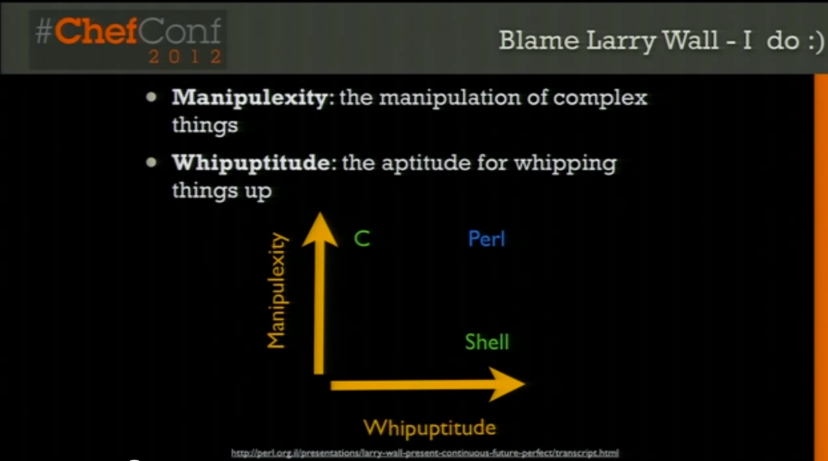
Design Tenets of Chef
Ruby
http://www.youtube.com/watch?v=bAWjqE5FCxI (8:40)
Notes:
From Larry Wall, creator of Perl
manipulexity: You can create anything in C - but not in 20 minutes you cant.
whipuptitude: Using shell script you’re done in 5 minutes - until you get to 1000 lines shell script
note: If you’ve never seen this video, you should watch it. It’ll give you a good idea of the company you’re working for, and for the students, it’ll give them an idea of the reason the tool exists, and how it came about.

Slide 105
Review Questions
What is a Node?
What is a Resource?
What is a Recipe? How is it different from a Cookbook?
What is a Run List?
What is a Role?
Notes:
A node is a server you want to configure
A resource is an item of manipulation, ie. a primitive thats contained in a recipe.
A recipe is collection of resources
What you want coming out of this section is that folks have a high level understanding of the parts of the system. The rest of training goes into more detail about all these topics in due time.
Take 5.

Slide 106
Workstation Setup
Getting started
Notes:
It’s all Windows from here...

Slide 107
Lesson Objectives
After completing the lesson, you will be able to
Login to Enterprise Chef
View your Organization in Enterprise Chef
Describe Knife, the Chef command line utility
Use Knife on your Workstation

Slide 108
Legend

Slide 109
Legend: Do I run that command on my workstation?
This is an example of a command to run on your workstation in Powershell
PS \> whoami
i-am-a-workstation
This is an example of a command to run on your target node.
Remote@PS\> whoami
i-am-a-chef-node
Notes:
This is a very frequent question in trainings.

Slide 110
Legend: Example Terminal Command and Output
PS \> ipconfig
Windows IP Configuration
Ethernet adapter Local Area Connection:
Connection-specific DNS Suffix . :
IPv4 Address. . . . . . . . . . . : 10.38.161.230
Subnet Mask . . . . . . . . . . . : 255.255.255.0
Default Gateway . . . . . . . . . : 10.38.161.1

Slide 111
Legend: Example of editing a file on your workstation
OPEN IN EDITOR:
hello_world.txt
Hi!
I am a friendly file.
SAVE FILE!

Slide 112
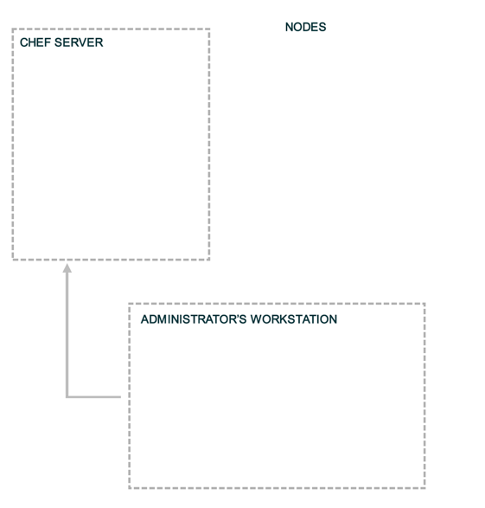
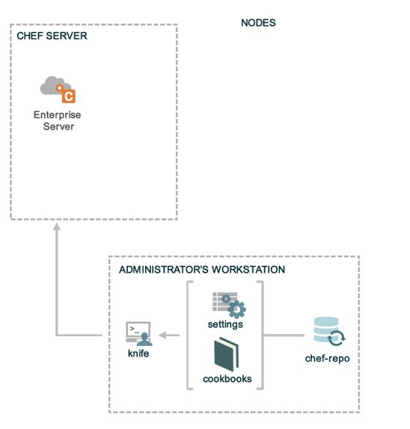
Landscape of a Chef-managed Infrastructure
?
?
?
Notes:
This diagram will be used throughout to help students remember which of the three components we’re talking about / working on.
Three main areas
1. Workstation
2. Enterprise Chef
3. Nodes in your infrastructure

Slide 113
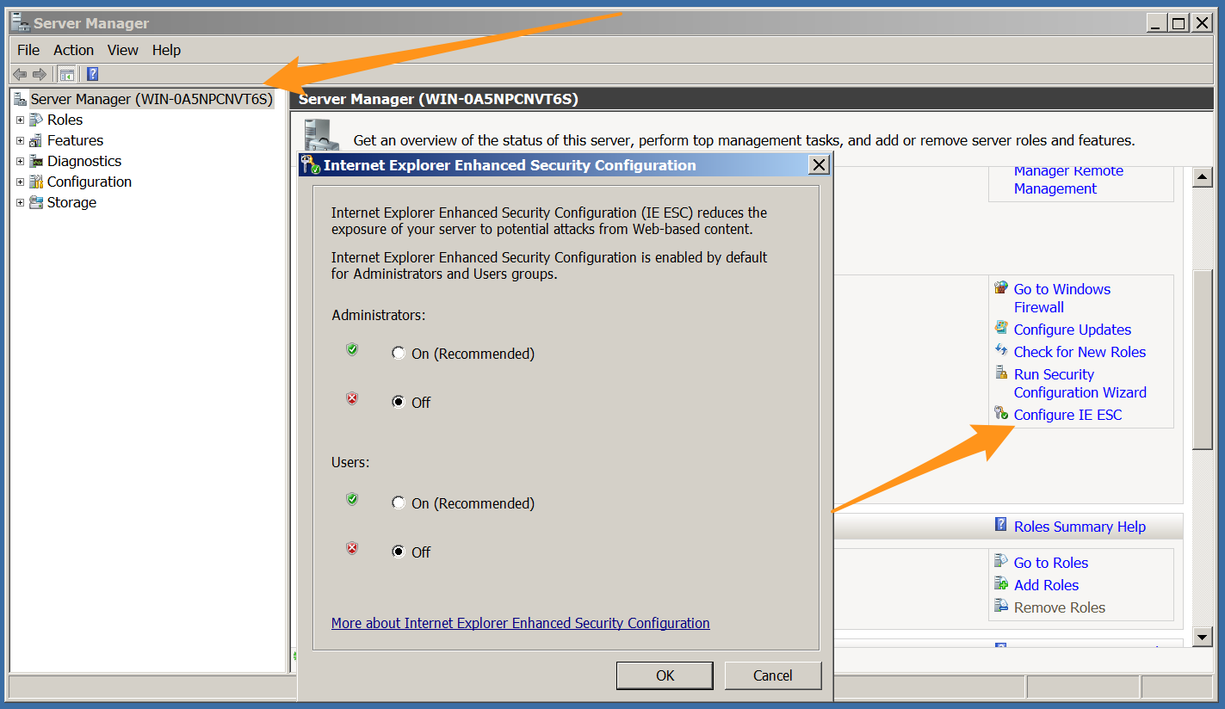
Exercise: Configure Management Station
We’re going to need to download a few items, so let’s turn off IE Enhanced Security Configuration in Server Manager to make our downloads easier:
Start > All Programs > Administrative Tools > Server Manager
Notes:
Note - this change is only needed if students are using freshly built 2008 or 2012 server as a host machine.
Otherwise, students will see multiple messages prompting them to Add a site to a list of safe sites. A student can be prompted multiple times for just one download, and after the sites are added, the student has to go back and download again. We’re turning this off to avoid the hassles.
The Server Manager icon can be found immediately to the right of the Start button. From the resulting screen, click “Configure IE ESC” (bottom right). Set both parameters to Off.
Also available via - Start > All Programs > Administrative Tools > Server Manager

Slide 114
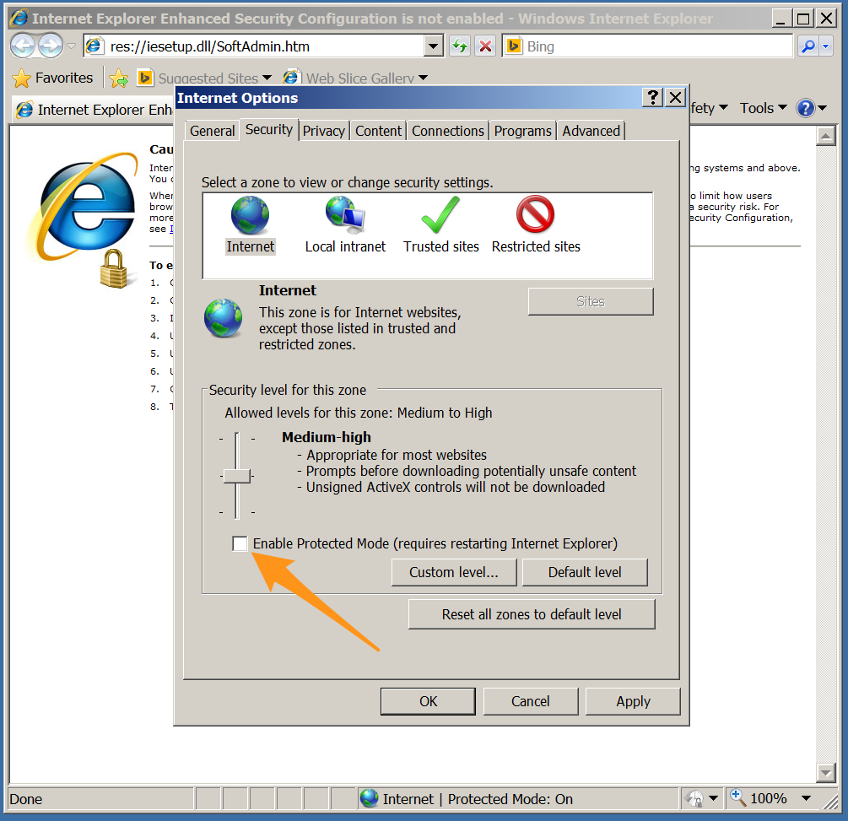
Exercise: Configure Management Station
Turn off Enabled Protected mode in IE (IE Options --> Tools --> Uncheck “Enable Protected mode”)

Slide 115
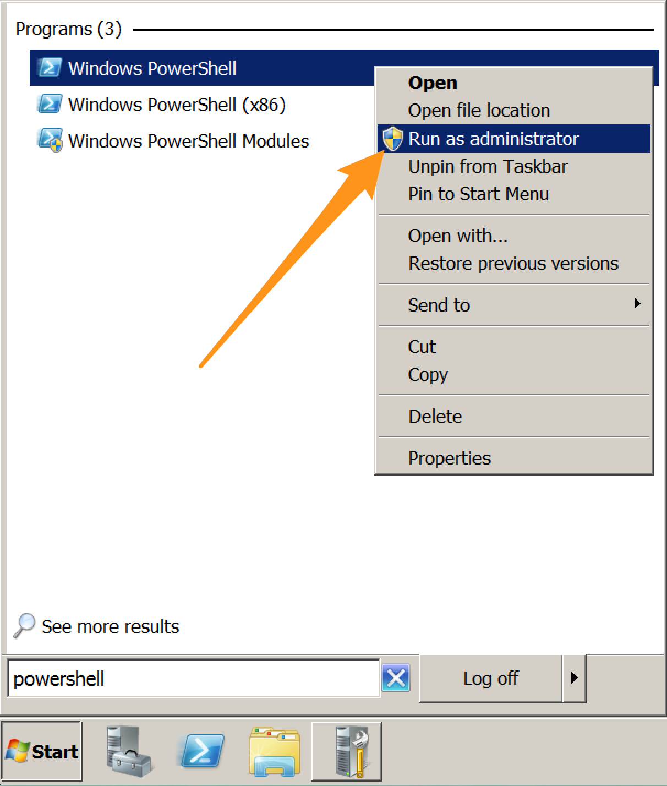
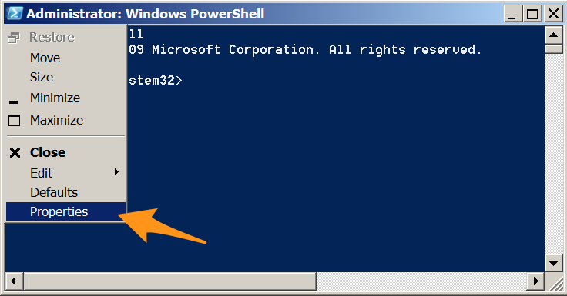
Configure PowerShell
Run PowerShell as Administrator and open Properties

Slide 116
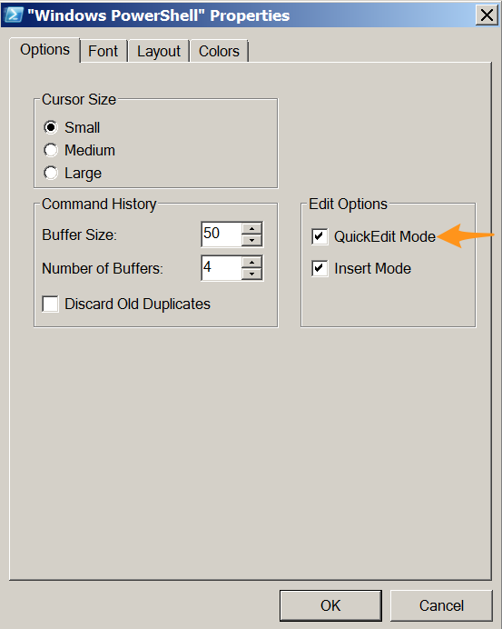
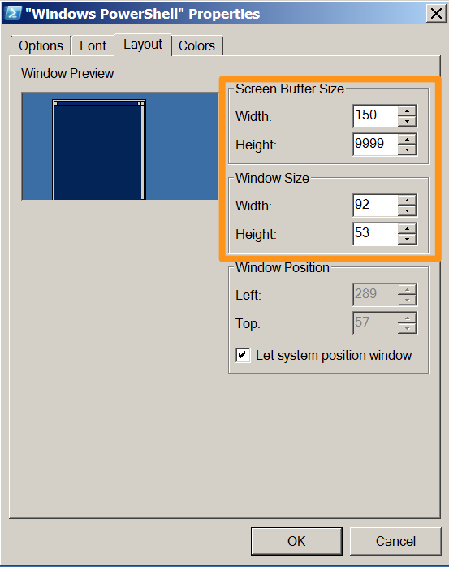
Configure PowerShell
Enable QuickEdit Mode
Set Height buffer to 9999

Slide 117
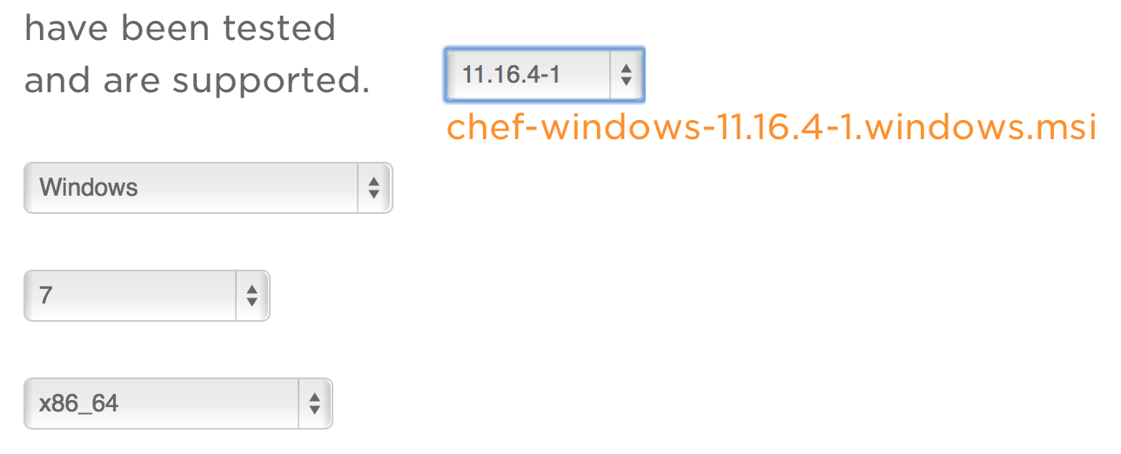
Workstation Setup
http://downloads.getchef.com/
Select Chef-Client
2008 (Windows 7) or 2012 (Windows 8)
i686 (32-bit) or x86_64 (64-bit)
Or browse to
https://www.getchef.com/chef/install.msi
Download and install this file
Notes:
Note: If IE encounters issues, use Chrome or Safari or download from CLI via next slide which is hidden

Slide 118
Manual download via Powershell
Open powershell as admin
Route 1 - Execute to install:
msiexec /passive /i https://www.getchef.com/chef/install.msi
Route 2 - Execute to download:
ImportSystemModules
Start-BitsTransfer "https://www.getchef.com/chef/install.msi" “c:\install2.msi"
Route 3 - Execute to download:
Invoke-WebRequest "https://www.getchef.com/chef/install.msi" “c:\install2.msi"
Notes:
route 1 - passive mode displays the progress bar /q is totally quiet. Should work universally
route 2 - download on powershell v2 (older win 7 and 2003/2008 boxes)
route 3 - powershell v3 and v4 (newer boxes, win8/2012)

Slide 119
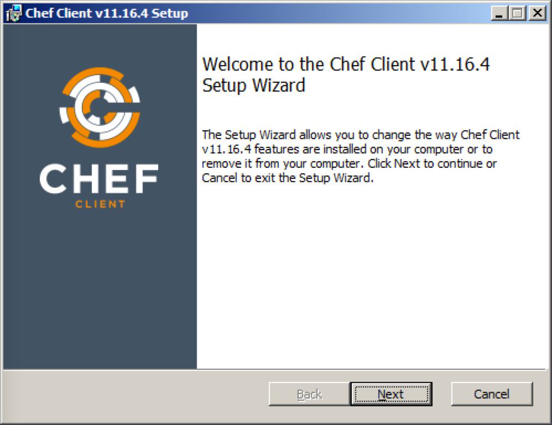
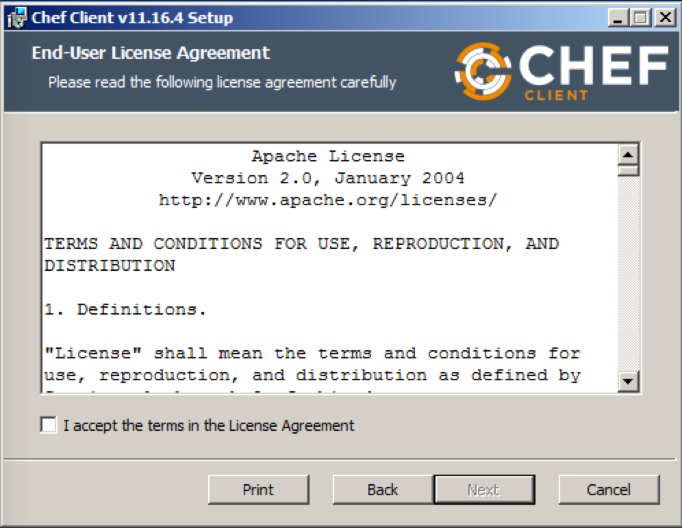
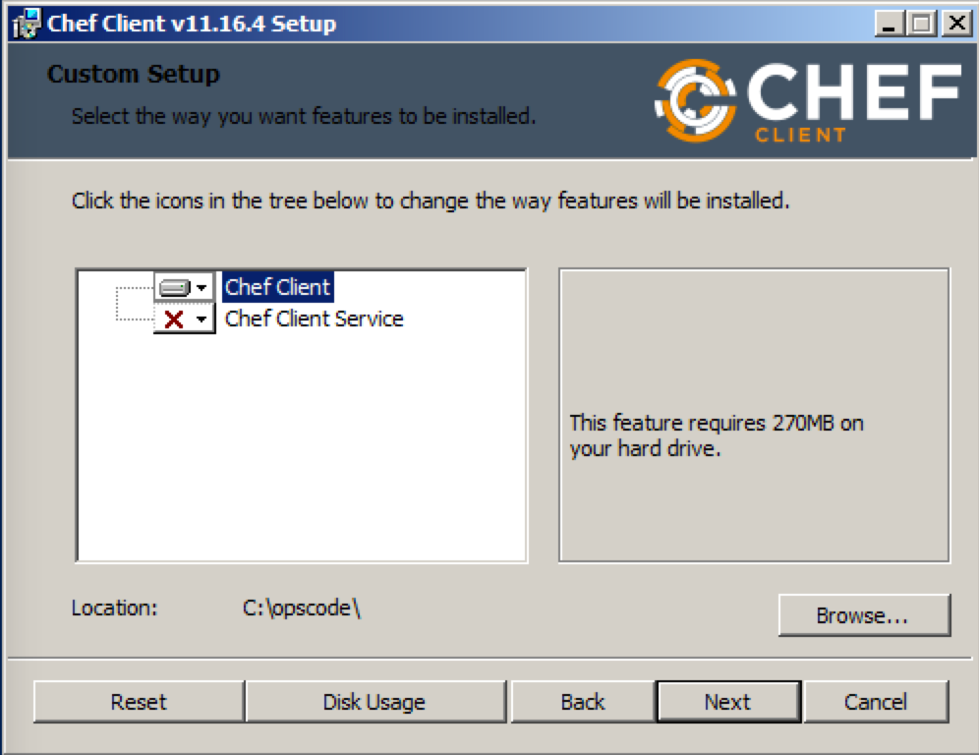
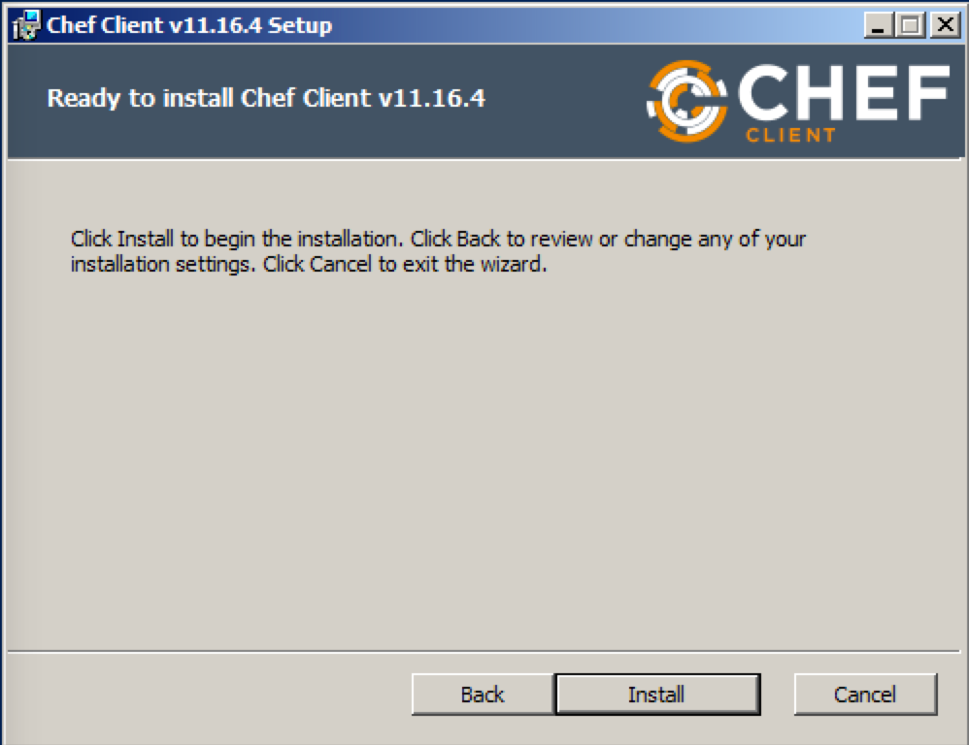
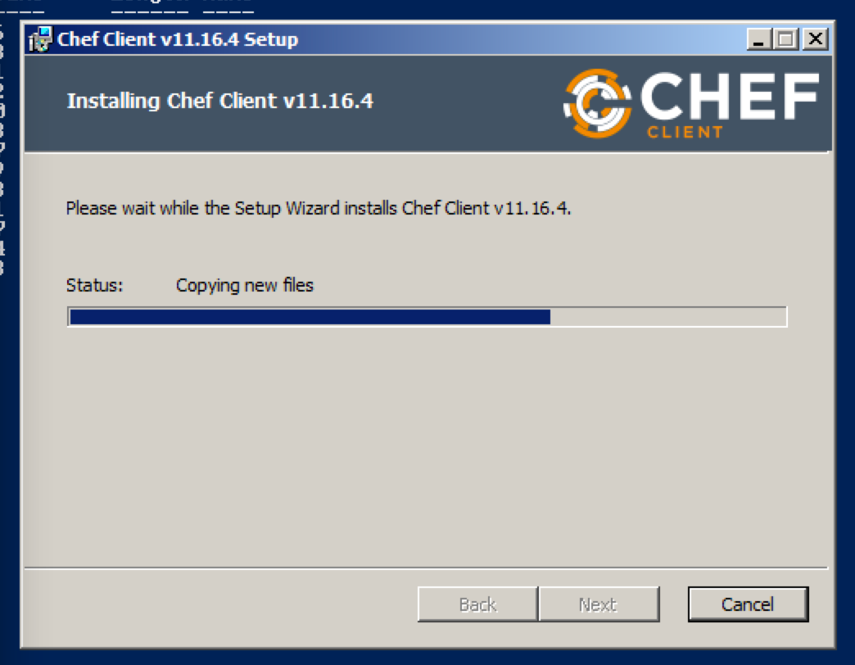
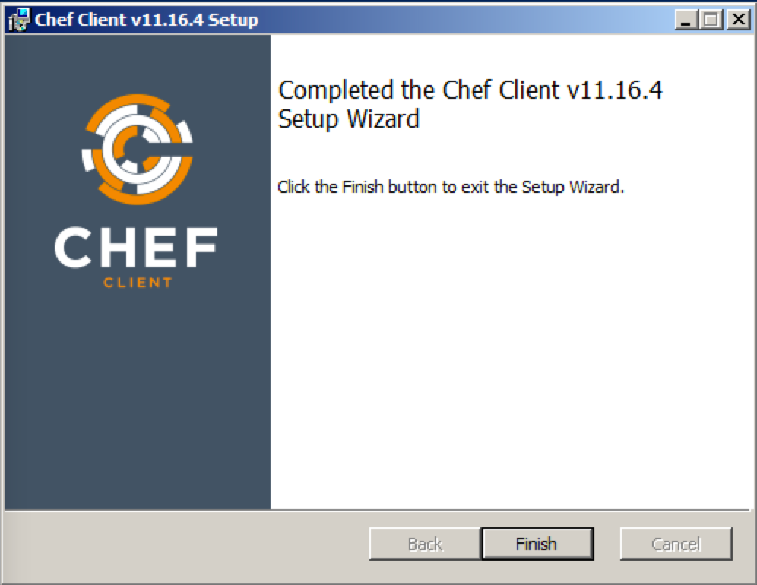
Install on Windows
Notes:
Screen shot of Windows installer

Slide 120
Workstation Setup - Mac OS X / Linux
$ curl -L http://www.opscode.com/chef/install.sh | sudo bash
% Total % Received % Xferd Average Speed Time Time Time Current Dload Upload Total Spent Left Speed100 6515 100 6515 0 0 20600 0 --:--:-- --:--:-- --:--:-- 31172Downloading Chef for ubuntu...Installing ChefSelecting previously unselected package chef.(Reading database ... 47446 files and directories currently installed.)Unpacking chef (from .../tmp.MqRJP6lz/chef__amd64.deb) ...Setting up chef (11.4.4-2.ubuntu.11.04) ...Thank you for installing Chef!Processing triggers for initramfs-tools ...update-initramfs: Generating /boot/initrd.img-3.2.0-48-virtual
Notes:
Alternatively, Chef may be programmatically installed via the install.sh script. This is the method used during chef bootstraps.

Slide 121
What just happened?
Chef and all of its dependencies installed via an operating system-specific package ("omnibus installer")
Installation includes
The Ruby language - used by Chef
knife - Command line tool for administrators
chef-client - Client application
ohai - System profiler
...and more
Notes:
A quick mention that we just used the omnibus installer which puts Chef and all of its dependencies on the workstation. The tools are installed under '/opt/chef' (linux/mac) or 'c:\opscode' (Windows).
Also mention that ‘gem install chef’ is also a valid installation method if students are already using rvm, rbevn, or chruby to manage their Ruby installations or if they’d prefer to use the system ruby (which should be at version 1.9 or better to use this method).
Opscode manages an open source project called "Omnibus". Use omnibus to create OS-specific packages.

Slide 122
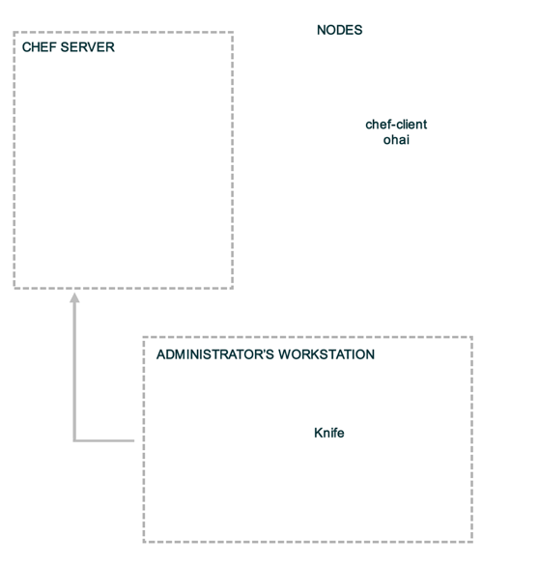
Workstation or Node?
?
chef-client
Oahi
?
chef-client
Oahi
?
chef-client
Oahi
knife
chef-client
Oahi
Notes:
We've just installed chef-client, knife, ohai and ruby along with any supporting ruby gems. This is exactly the same as gets installed on a node during bootstrap.
Difference is the node does not use knife, while the workstation client does not use chef-client - but each could be configured to perform either role! Ability to use knife is controlled by ‘master’ certificate - covered a few slides later.

Slide 123
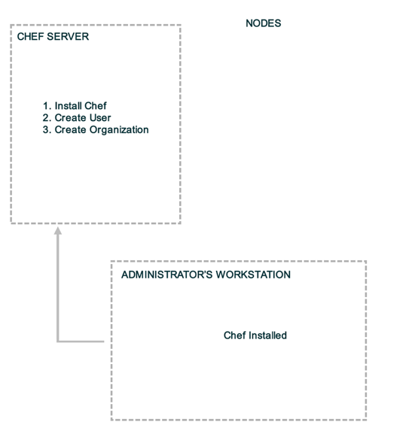
Landscape of a Chef-managed Infrastructure
?
?
?
Notes:
With Chef installed on the workstation, it’s now time to get the Chef Server setup.
We’ll be using Hosted Enterprise Chef for this class.

Slide 124
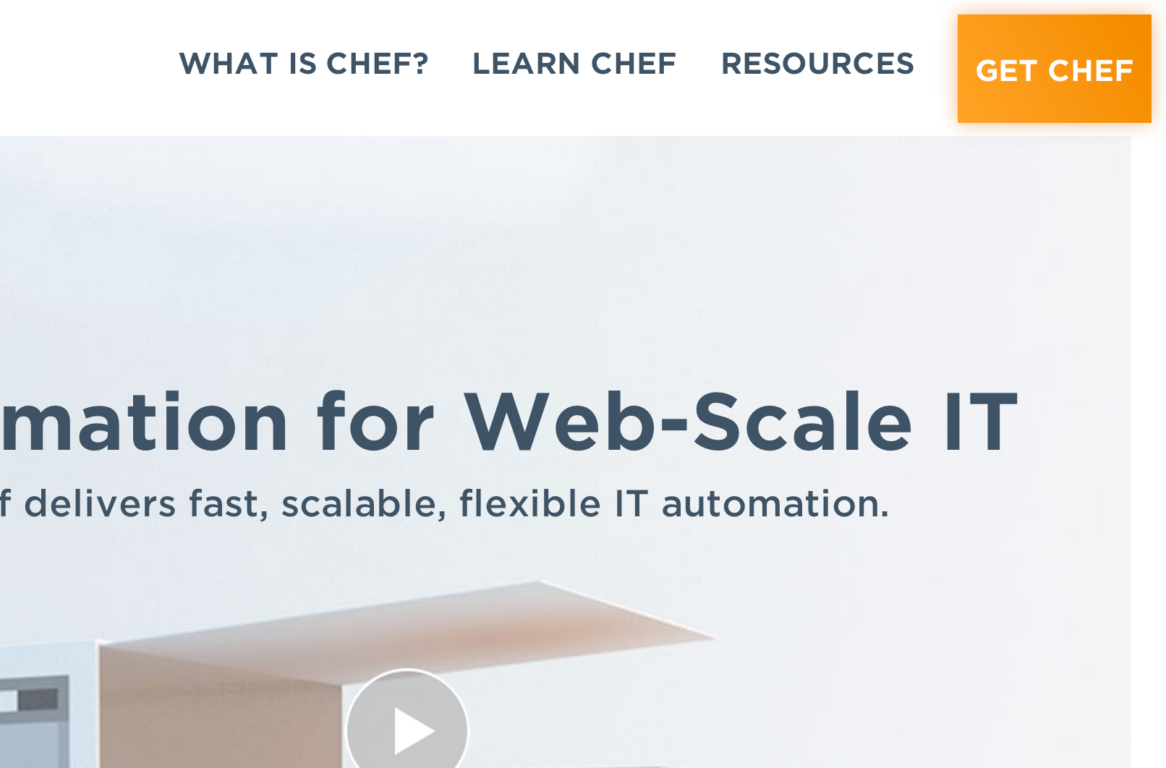
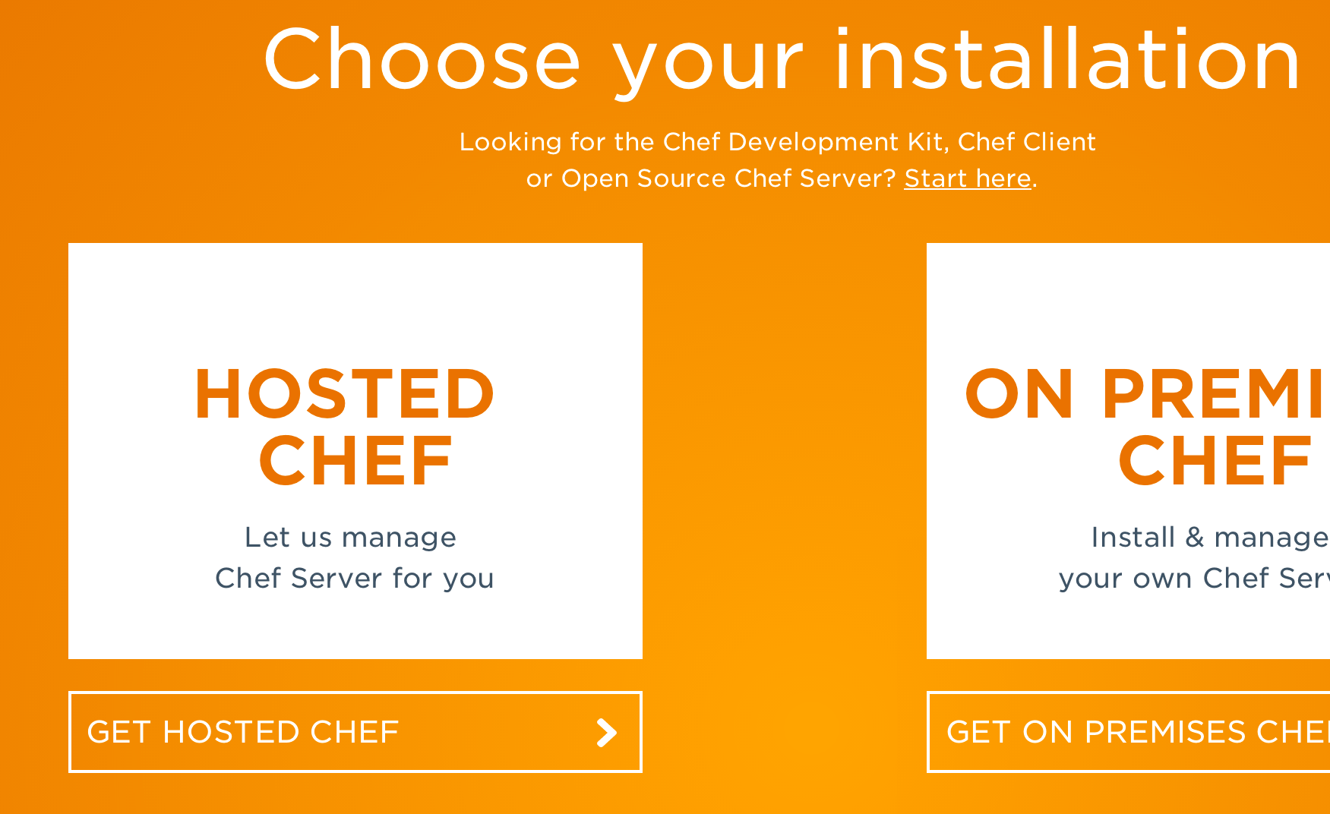
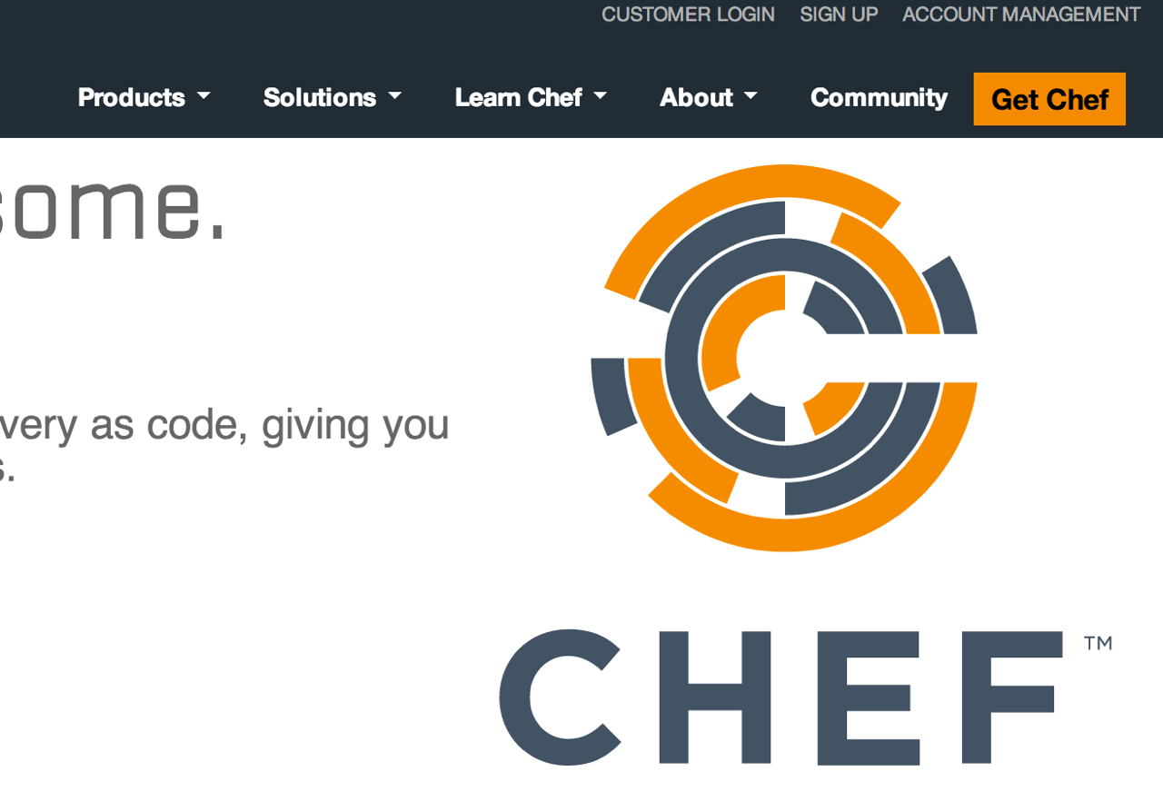
Your Chef Server for this class...
Hosted Enterprise Chef http://www.getchef.com

Slide 125
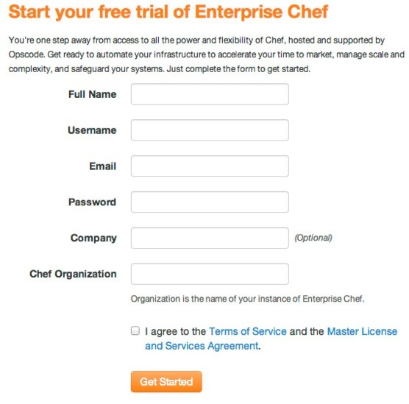
Create new account
Sign up for a new account
Chef Organization
provides multi-tenancy
name must be globally unique
Notes:
NOTE: Chef Organization must have a globally unique value.
NOTE: CREATE A NEW USER, EVEN IF YOU HAVE ONE ALREADY. The Starter Kit will re-create your user auth keypair.

Slide 126
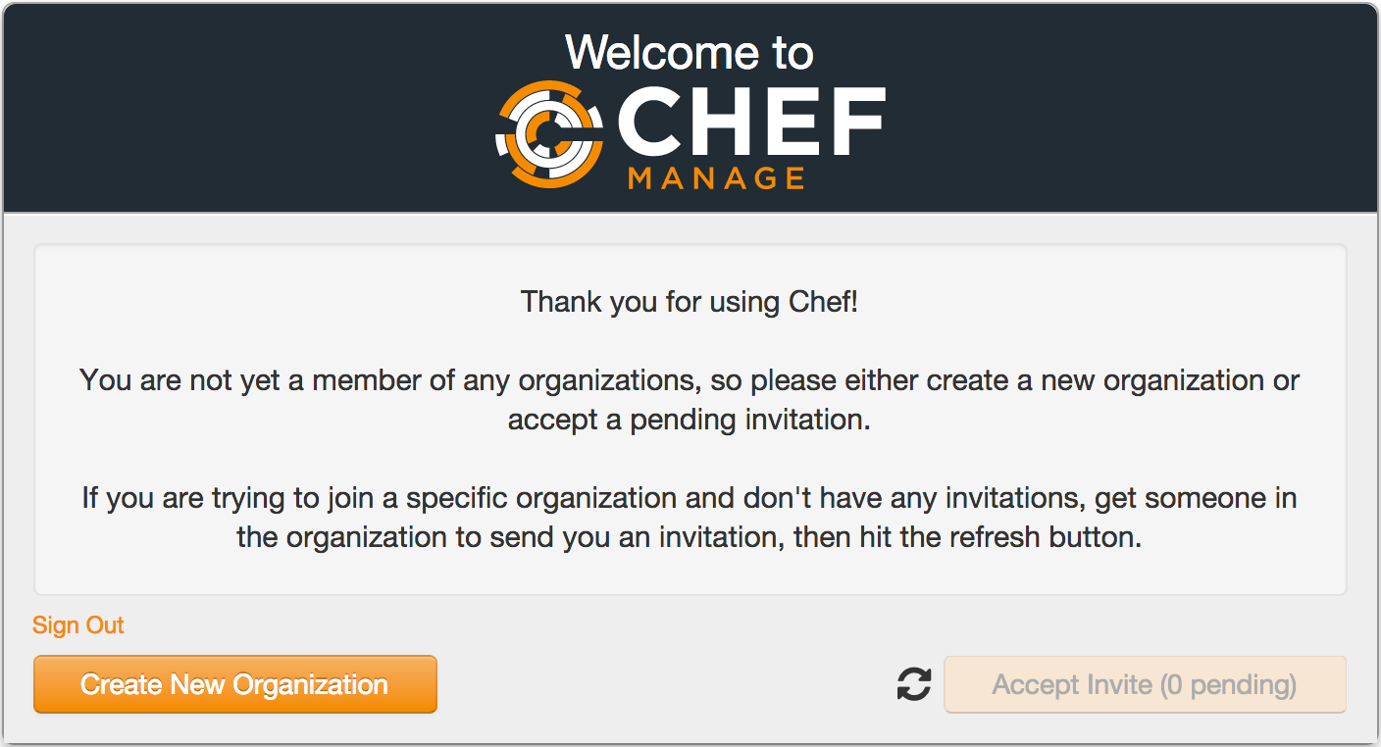
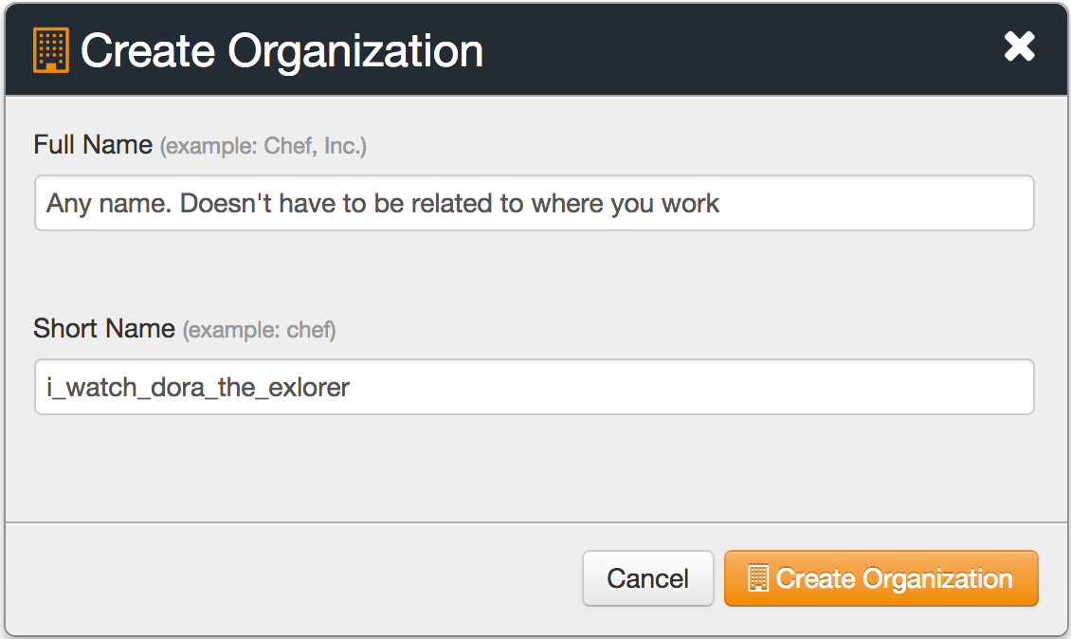
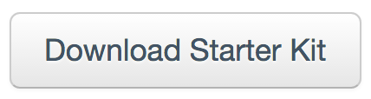
Create new Organization

Slide 127
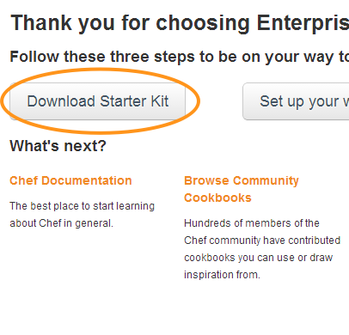
Download "Starter Kit" for your Org
You get a .zip file from clicking this
Unzip the zipfile - you’ll get a "chef-repo"
Put the "chef-repo" somewhere, e.g.:
C:\chef-repo (Win)
/Users/you/chef-repo (Mac)
/home/you/chef-repo (Linux)
We’ll look at it in detail shortly…
Notes:
NOTE: CREATE A NEW USER, EVEN IF YOU HAVE ONE ALREADY. The Starter Kit will re-create your user auth keypair.
Download the starter kit from the Chef Server
Make a decision about where to store the work from this class.
NOTE: Windows XP users should NOT have spaces in their directory- if they put it in a path with spaces (like C:\Documents and Settings\chef-repo), they will get errors when they try to upload cookbooks.
Unzip the zip file in that directory.
A chef-repo directory, or folder, is now available.
The 'Starter Kit' is a archive file (e.g. chef-starter.zip) that contains-) A sample chef repository with a sample 'starter' cookbook-) Configuration files allowing the workstation to talk to the chef serverWe'll look at this in detail later...

Slide 128
What is the Starter Kit?
The 'Starter Kit' is a archive file (e.g. chef-starter.zip) that contains
A sample chef repository with a sample 'starter' cookbook
Configuration files allowing the workstation to talk to the chef server using knife
We'll look at this in detail later...

Slide 129
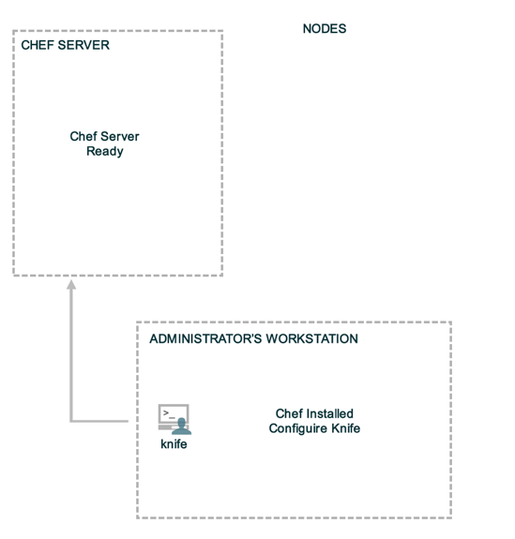
Landscape of a Chef-managed Infrastructure
?
?
?
Notes:
The next step is to configure knife to communicate with our Hosted Enterprise Chef organization. We’ll do so by downloading the starter kit.

Slide 130
A quick tour of the chef-repo
Every infrastructure managed with Chef has a Chef Repository ("chef-repo")
Type all commands in this class from the chef-repo directory
Let’s see what’s inside the chef-repo...

Slide 131
Verify that knife is working
PS\> cd SOMEDIR\chef-repo
PS \chef-repo>

Slide 132
A quick tour of the chef-repo
PS\> dir
Mode LastWriteTime Length Name
---- ------------- ------ ----
d---- 9/24/2013 11:09 PM .berkshelf
d---- 9/24/2013 11:09 PM .chef
d---- 9/24/2013 11:09 PM cookbooks
d---- 9/24/2013 11:09 PM roles
-a--- 9/24/2013 11:09 PM 495 .gitignore
-a--- 9/24/2013 11:09 PM 1433 Berksfile
-a--- 9/24/2013 11:09 PM 588 chefignore
-a--- 9/24/2013 11:09 PM 2292 README.md
-a--- 9/24/2013 11:09 PM 3572 Vagrantfile
Notes:
http://docs.opscode.com/essentials_repository.html
For reference

Slide 133
What’s inside the .chef directory?
PS\> dir .chef
ORGNAME-validator.pem
USERNAME.pem
knife.rb

Slide 134
What’s inside the .chef directory?
knife.rb is the configuration file for Knife.
The other two files are certificates for authentication with the Chef Server
We’ll talk more about that later.

Slide 135
Knife is the command-line tool for Chef
Knife provides an API interface between a local Chef repository and the Chef Server, and lets you manage:
Nodes
Cookbooks and recipes
Roles
Stores of JSON data (data bags), including encrypted data
Environments
Cloud resources, including provisioning
The installation of Chef on management workstations
Searching of indexed data on the Chef Server
Notes:
It is also where you will spend the bulk of your time when working with Chef. Knife is the primary user interface for working with Chef. As a bonus, it very closely mirrors how our actual APIs are structured - so working with knife also gets you familiar with our lower-level abstractions that you may wind up using as you grow.
* This class teaches best practices - and all the pro Chefs use the command line interface almost exclusively.

Slide 136
knife.rb
Default location
~/.chef/knife.rb (OSX)
c:\Users\You\.chef\knife.rb (Windows)
Use a project specific configuration
<project>/.chef/knife.rb of the current directory
chef-repo/.chef/knife.rb
http://docs.opscode.com/config_rb_knife.html
Notes:
knife will look for it’s configuration (knife.rb) in:
1. current working directory’s .chef/
2. current user’s home directory’s .chef/
3. /etc/chef/knife.rb
Community plugins to help manage knife.rb files:
* knife-block - https://github.com/greenandsecure/knife-block
* ChefVM - https://github.com/trobrock/chefvm
knife.rb should be built in such a way that it can be checked into version control and shared by a team. The docs site as one example of such a knife.rb http://docs.opscode.com/config_rb_knife.html#many-users-same-repo
http://docs.opscode.com/config_rb_knife.html for additional details

Slide 137
knife.rb
OPEN IN EDITOR:
chef-repo/.chef/knife.rb
current_dir = File.dirname(__FILE__)
log_level :info
log_location STDOUT
node_name "USERNAME"
client_key "#{current_dir}/USERNAME.pem"
validation_client_name "ORGNAME-validator"
validation_key "#{current_dir}/ORGNAME-validator.pem"
chef_server_url "https://api.opscode.com/organizations/ORGNAME"
cache_type 'BasicFile'
cache_options( :path => "#{ENV['HOME']}/.chef/checksums" )
cookbook_path ["#{current_dir}/../cookbooks"]
Notes:
<<Review Comment – Don't think this slide was in original Windows version – was it removed for a reason?

Slide 138
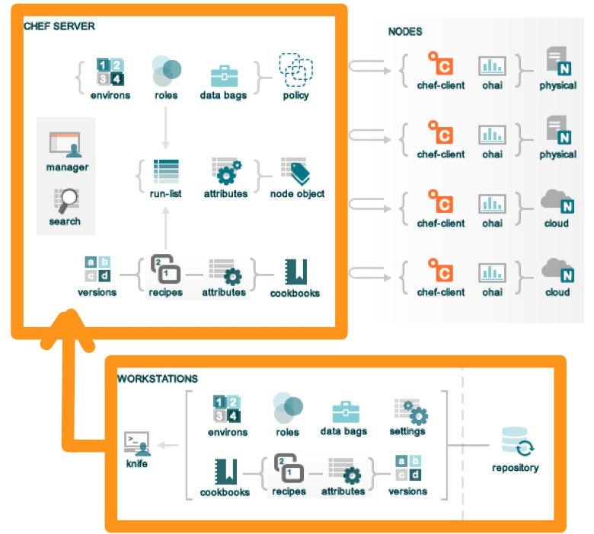
Verify Knife
PS \> knife --version
Chef: 11.16.4
Reopen PS for new path to take effect
Your version may be different, that’s ok!
PS \> knife client list
ORGNAME-validator
Notes:
May need to close out of PowerShell then reopen it for chef install changes to take effect & can use knife

Slide 139
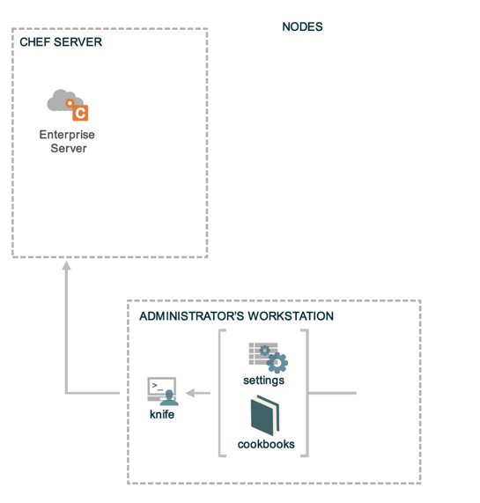
knife client list
Reads the chef_server_url from knife.rb
Invokes HTTP GET to #{chef_server_url}/clients
Displays the result
Notes:
What happens exactly when you execute it?
- To find out, run 'knife client list -VV'

Slide 140
Exercise: Run ‘knife help list’
PS \> knife help list
Available help topics are:
bootstrap
chef-shell
client
configure
cookbook
cookbook-site
data-bag
environment
exec
index
Knife
…
Notes:
Careful - this doesn’t work on Windows XP
Also, careful, help pages don’t work very well on Windows.

Slide 141
Exercise: Run ‘knife client list’
PS \> knife client list
ORGNAME-validator
Notes:
Make sure every student can successfully run ‘knife client list’, which means they are fully set up.
Dont go forward until everyone is successful.

Slide 142
A few knife tips
Commands are always structured as follows
knife
NOUN (client)
VERB (list)
You can get more help with
knife NOUN help
knife --help just shows options
Notes:
There are exceptions, but this is true for all the core primitives.
(this is true until it isn’t)
(exceptions are things like ssh, search, etc - although you could argue that the noun in question is the search index!)

Slide 143
Best Practice:
Use a text editor with a project drawer, or equivalent
Chef is about Infrastructure as Code
People who code for a living use text editors that are designed for the task
Vim, Emacs, Sublime Text, Notepad++, etc.
Notes:
Have a project drawer! Chef organizes code into folders, and using the command line to constantly open/close individual files is maddening
Here is where we see the diff in Ops vs. Devs :-)
Text editors: because that’s how you roll now. Either you are a glutton for punishment or you will realize these tools exist to make your life easier and you will use them.

Slide 144
Benefits of a good text editor
A good editor will
Show line numbers
Highlight syntax
Autocomplete commands
Allow you to open multiple files

Slide 145
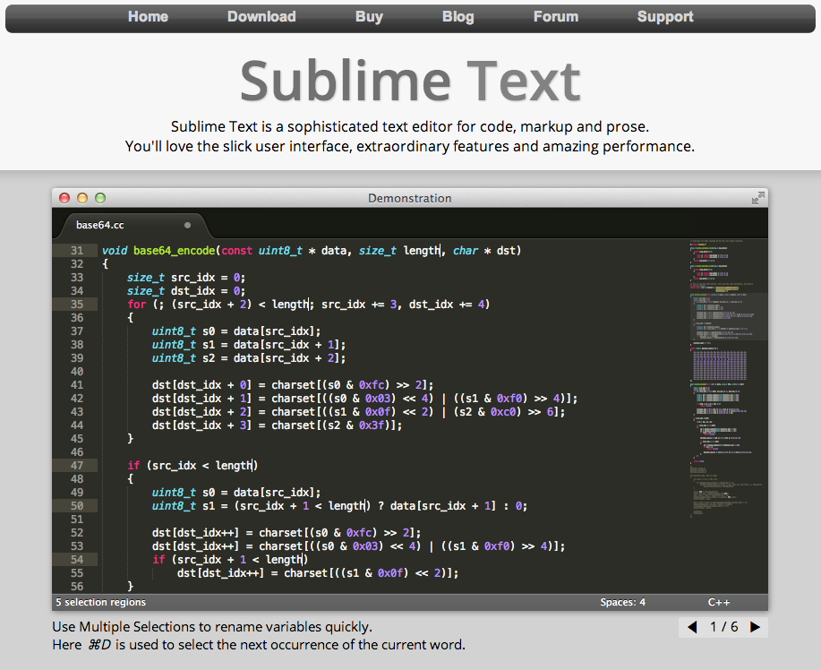
If you do not have a preferred text editor on your workstation already...
Download Sublime Text
Free trial, not time bound
Works on every platform
sublimetext.com
Notes:
Note: We have them open the 'starter kit' repo in Sublime when writing the Apache cookbook in upcoming section
Point out that Sublime Text is an unrelated tool although it has a chef plugin to help write chef code (autocomplete etc)
Common editors:
vim
emacs
nano
textmate
sublime
On windows, the best is wordpad, and you can find it at %ProgramFiles%\Windows NT\Accessories\WORDPAD.EXE
Windows folks using Notepad++: set wait via "multiInst" flag "%ProgramFiles%\blahblah\notepad++.exe -multiInst"

Slide 146
Set Knife’s Editor: Linux/Mac
OPEN IN EDITOR:
~/chef-repo/.chef/knife.rb
# Choose one of the following.
knife[:editor] = "/path/to/editor --flags"
Vim
"/usr/bin/vim"
Emacs
"/usr/bin/emacs"
Nano
"/usr/bin/nano"
Sublime Text
"/Applications/Sublime\\ Text\\ 2.app/Contents/SharedSupport/bin/subl -w"
Text Wrangler
"/Applications/TextWrangler.app/Contents/Helpers/edit -w"
SAVE FILE!
Notes:
This is an optional slide!
Of course, students can still set their EDITOR in environment variables and Knife will use that.

Slide 147
Set Knife’s Editor: Windows
OPEN IN EDITOR:
~/chef-repo/.chef/knife.rb
# Choose one of the following.
knife[:editor] = "C:\\path\\to\\editor.exe --flags"
Notepad++
"C:\\progra~2\\notepa~1\\notepad++.exe -nosession -multiInst"
Sublime Text
"C:\\progra~1\\sublim~1\\sublime_text.exe --wait"
Textpad
"C:\\progra~2\\textpa~1\\TextPad.exe"
Vim
"C:\\progra~2\\vim\\vim74\\gvim.exe"
SAVE FILE!
Notes:
This is an optional slide!
Most editors only ship as 32-bit versions hence Progra~2 (which maps to "Program Files (x86)")
The ones that don’t go in Progra~1 (which maps to "Program Files")

Slide 148

Using your favorite EDITOR
Linux/OSX/Unix
OPEN IN EDITOR:
~/.bash_profile
export EDITOR='/Applications/Sublime\ Text\ 2.app/Contents/SharedSupport/bin/subl -w'
SAVE FILE!
$ source ~/.bash_profile
Windows in cmd.exe
$ setx EDITOR "\"%ProgramFiles%\Sublime Text 2\sublime_text.exe\" --wait"
close cmd.exe and start a new cmd.exe session
Notes:
This is an optional slide!
Common editors:
vim
emacs
nano
textmate
sublime
On windows, the best is wordpad, and you can find it at %ProgramFiles%\Windows NT\Accessories\WORDPAD.EXE
Windows folks using Notepad++: set wait via "multiInst" flag "%ProgramFiles%\blahblah\notepad++.exe -multiInst"
In Windows, quit cmd.exe and start a new cmd.exe to get the EDITOR set. Verify with the 'env' command's output.

Slide 149
Checkpoint
?
?
?
Notes:
Chef Server is up and running
Knife is installed and configured on the workstation

Slide 150
What’s Next?
Notes:
This is an optional slide! Let students know that in ‘real life’ they would do it, but for the purpose of the class, we’re skipping it.
What is the next step towards managing our infrastructure as code?

Slide 151
Source Code Repository
Notes:
This is an optional slide! Let students know that in ‘real life’ they would do it, but for the purpose of the class, we’re skipping it.
We should now create a source code repository for our code.
No more My_script_01, My_script_02, My_script_03 - this isn't 1993

Slide 152
Initialize a git repository
$ git init
Initialized empty Git repository in /Users/opscode/chef-repo/.git/
Notes:
This is an optional slide!
If git is installed (it should be), initialize a git repository

Slide 153
Check git status
$ git status
# On branch master
#
# Initial commit
#
# Untracked files:
# (use "git add <file>..." to include in what will be committed)
#
# .berkshelf/
# .chef/
# .gitignore
# Berksfile
# README.md
# Vagrantfile
# chefignore
# cookbooks/
# roles/
nothing added to commit but untracked files present (use "git add" to track)
Notes:
This is an optional slide!
Check the status of the current git repository

Slide 154
Add all files to git
$ git add .
[~/chef-repo]$
Notes:
This is an optional slide!
Add all the files to the git repository.
There is no output

Slide 155
Add files to git
$ git commit -m "add the starter kit from Chef"
[master (root-commit) 2af68fb] add the starter kit from Chef
13 files changed, 360 insertions(+)
create mode 100644 .berkshelf/config.json
create mode 100644 .chef/knife.rb
create mode 100644 .gitignore
create mode 100644 Berksfile
create mode 100644 README.md
create mode 100644 Vagrantfile
create mode 100644 chefignore
create mode 100644 cookbooks/starter/attributes/default.rb
create mode 100644 cookbooks/starter/files/default/sample.txt
create mode 100644 cookbooks/starter/metadata.rb
create mode 100644 cookbooks/starter/recipes/default.rb
create mode 100644 cookbooks/starter/templates/default/sample.erb
create mode 100644 roles/starter.rb
Notes:
This is an optional slide!
Commit the files to the git repository

Slide 156
Checkpoint
Notes:
This is an optional slide!
Chef Server is up and running
Knife is installed and configured
Source Code repository has been created

Slide 157
Review Questions
What is the chef-repo?
What is knife?
What is name of the knife configuration file?
Where is the knife configuration file located?
What is your favorite text editor? :)
Notes:
-)
-) a tool for interacting with all things chef
-) knife.rb
-) <pwd>/.chef/knife.rb or ~/.chef/knife.rb or /etc/chef/knife.rb
-)

Slide 158
Organization Setup
Setup an Organization

Slide 159
Lesson Objectives
After completing the lesson, you will be able to
Explain the purpose of Organizations
Manage your Chef Organization
Invite users into your organization
Accept invitations into other organizations

Slide 160
Checkpoint
Notes:
<<WIP- too much repetition. If no objections I'll delete, if folks disagree I'll unhide.
Chef Server is up and running
Knife is installed and configured
Source Code repository has been created

Slide 161
Organizations
My Infrastructure
Your Infrastructure
Their Infrastructure

Slide 162
Organizations
Nothing is shared between Organizations - they're completely independent
May represent different
Companies
Business Units
Departments
Enterprise Chef provides multi-tenancy
Notes:
multi-tenancy is a differentiator between paid chef server 11 and free one.
With paid version you have ability to host multiple orbs on one server.
With free you have one org per server
Not a real thing with chef server 12

Slide 163
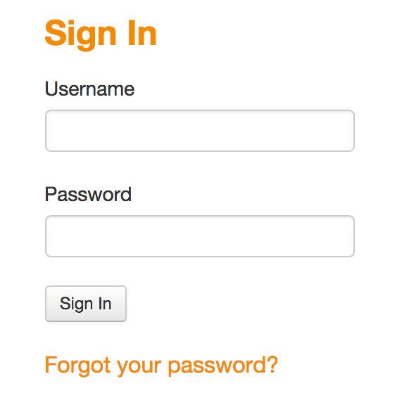
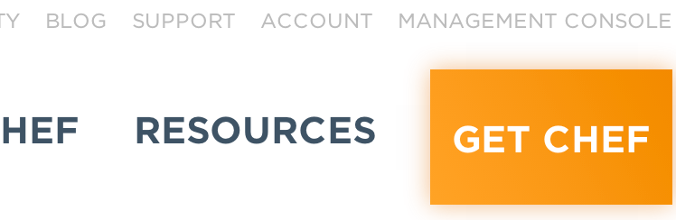
Manage Organizations
Login to your Hosted Enterprise Chef (getchef.com)
Select Management Console
Notes:
Login to Enterprise Chef to view your nodes

Slide 164
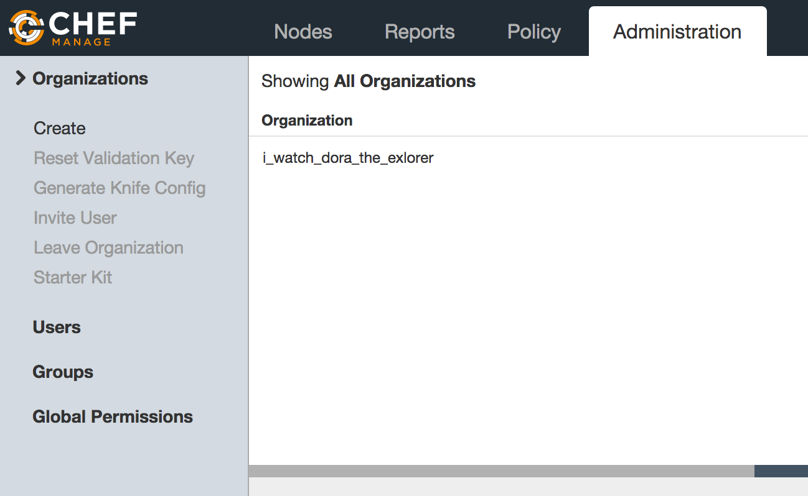
Organizations
Notes:
Click the Administrative tab to see the Organizations
The name of your organization was specified when signing up for Enterprise Chef.

Slide 165
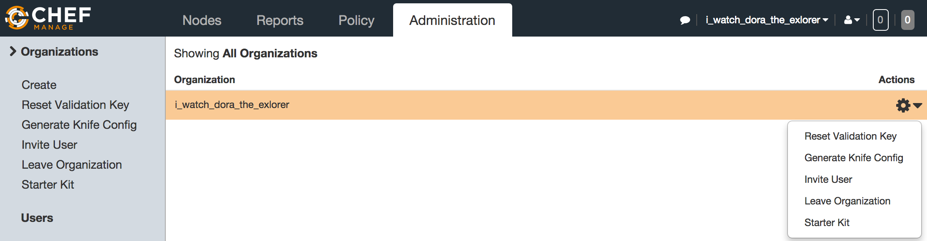
Manage Organizations
Reset Validation Key
Generate Knife Config
Leave Organization
Download the 'Starter Kit'
Notes:
From the Organizations page you can:
Reset the organization’s validation key
Generate a knife.rb
Leave the Organization
Recreate and download the starter kit

Slide 166
Manage Organizations
Each Organization may have multiple Users
Manage an Organization’s Users via the Enterprise Server interface
http://manage.getchef.com
Notes:
<<WIP: Need to check the newly released webui is at 'manage.opscode.com'.
<<WIP: Update this when url changes to http://manage.getchef.com'.

Slide 167
Exercise: Invite users into your org
The Problem: You need assistance from a colleague on one of your chef projects
Proposed Solution: Invite the colleague into your organization so they can log into the chef server with their own credentials, but can see your organization

Slide 168
Exercise: Invite Users into your Org
For this Lab Exercise you can team up with one other person in the class, then you will
Invite your classmate into your organization
Accept your classmate's invite into their org
Look around your classmate's organization while they look around yours
Finally remove your classmate's access from your account

Slide 169
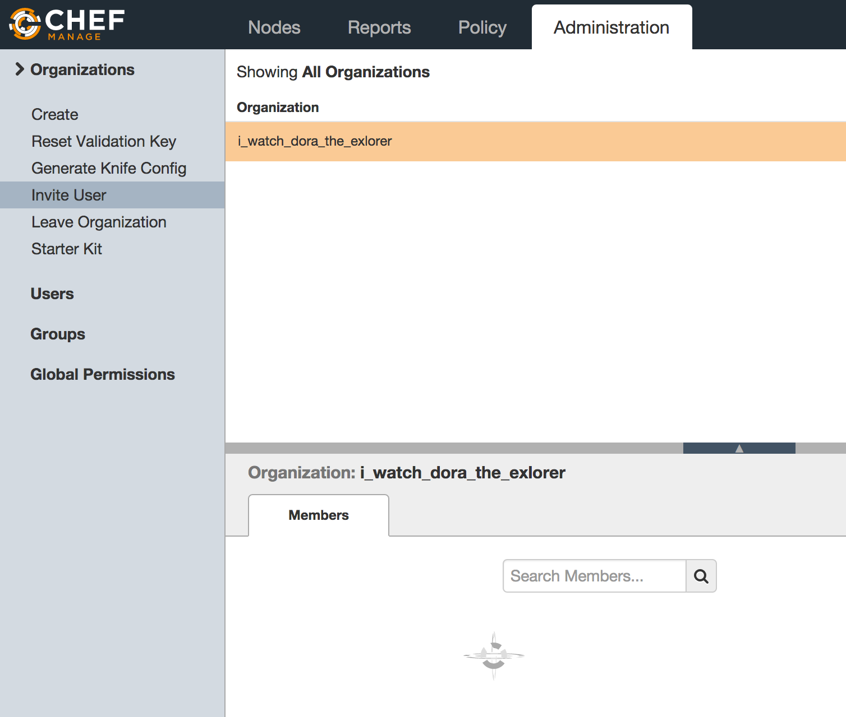
Exercise: Invite a classmate into your org
Navigate to http://manage.opscode.com
Click the "Administration" tab,
Select the appropriate Organization
Click "Invite User" from the left menu
Enter your classmate's 'Chef Username' and click Invite
Notes:
Note: they can get the username from the list of current members of the org.

Slide 170
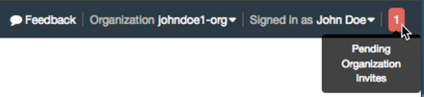
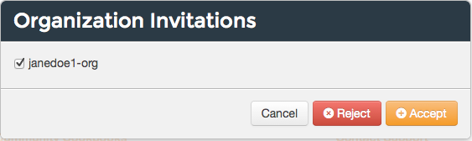
Exercise: Accept an invite
You will get a notification once your classmate has invited you into their account
Click the notification, select the Organization and click 'Accept'

Slide 171
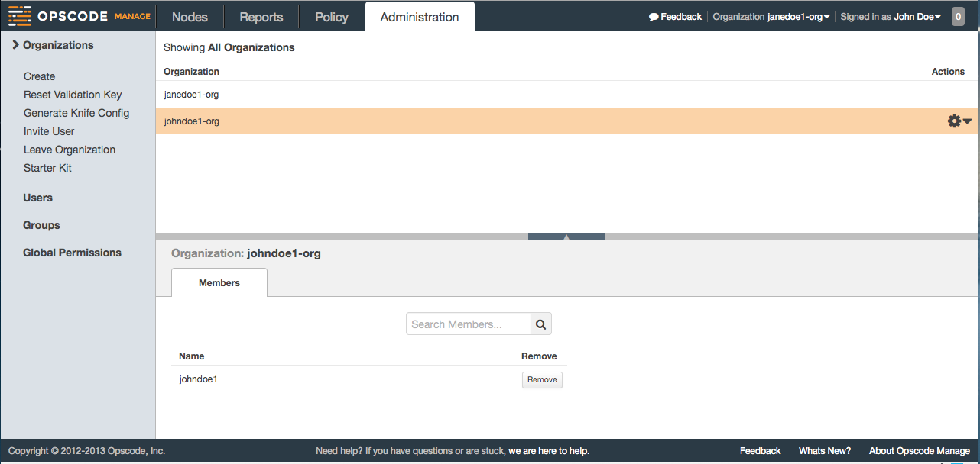

Exercise: View classmate's org
Select your classmate's organization from the drop down list and peruse their org

Slide 172
Exercise: Revoke access
Now either 'Leave Organization' you've been invited into, or remove your classmate from your organization

Slide 173
Review Questions
What is an Organization?
How do you regenerate the Starter Kit for your Organization?

Slide 174
Test Node Setup
Setup a node to manage

Slide 175
Lesson Objectives
After completing the lesson, you will be able to
Install chef-client on a node using "knife bootstrap"
Explain how knife bootstrap configures a node to use the Organization created in the previous section
Explain the basic configuration needed to run chef-client

Slide 176
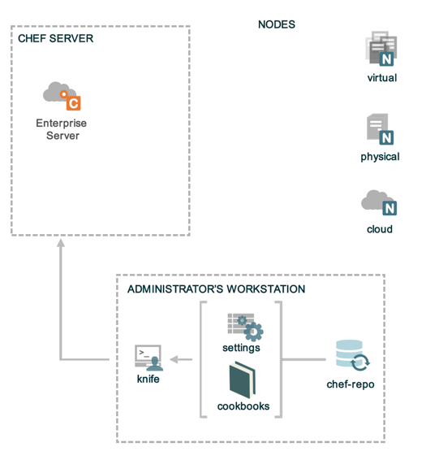
Nodes
Notes:
Chef Server is up and running
Knife is installed and configured
Source Code repository has been created

Slide 177
Install Windows plugin for Knife
PS \> gem install knife-windows
Successfully installed knife-windows 0.8.2
19 gems installed
Notes:
Lets Knife know about WinRM protocol
note: if download is SUPER slow, use next (hidden slide to add --no-rdoc --no-ri flags)
ON WINDOWS, TO CHECK WHICH GEM COMMAND IS BEING RESOLVED (if other ruby environs are present)
In CMD.exe – where gem
In PowerShell – get-command gem | fl *
If the wrong path is being discovered, either update the PATH environmental variable OR use the fully qualified path.

Slide 178
Install Windows plugin for Knife
PS \> gem install knife-windows --no-rdoc --no-ri
Successfully installed knife-windows 0.8.2
19 gems installed
--no-rdoc -- Generate RDoc documentation for the gem on install
--no-ri -- Generate RI documentation for the gem on install
Notes:
Lets Knife know about WinRM protocol
ON WINDOWS, TO CHECK WHICH GEM COMMAND IS BEING RESOLVED (if other ruby environs are present)
In CMD.exe – where gem
In PowerShell – get-command gem | fl *
If the wrong path is being discovered, either update the PATH environmental variable OR use the fully qualified path.

Slide 179
Nodes
Nodes represent the servers in your infrastructure
Could be physical servers or virtual servers
Hardware that you own
Compute instances in a public or private cloud
Could also be network hardware - switches, routers, printers, etc…
Notes:
network device support for some vendors - Arista, Juniper, Cisco

Slide 180
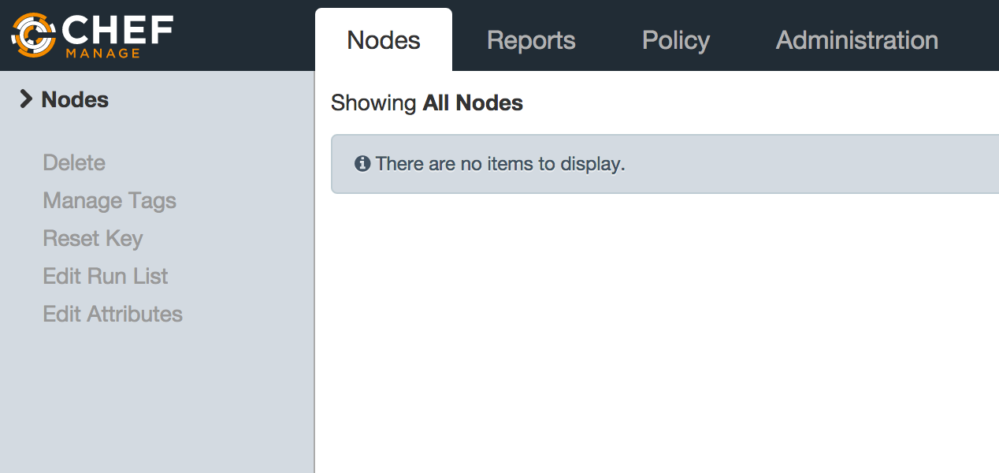
We Have No Nodes Yet
Notes:
Just to show there aren’t any nodes yet

Slide 181
Training Node
The labs require a node to be managed
We use the CloudShare training environment
Windows Server 2012 x64
2GB RAM
40GB HDD
Notes:
Use this if cloudshare or some other on-demand training lab / environment are unavailable.
Note: if there are terrible CloudShare issues, you can spin up AWS boxes using Generic 2008 or 2012 server with user_data.ps1. Generic Gist located here - you’ll have to modify username/password: https://gist.github.com/vinyar/d85c145e9dc471358aa6

Slide 182
Bring Your Own Node
Use your own Virtual Machine (VM) or Server
Required for the labs:
Windows 2012
1 GB RAM
25 GB Disk
Administrator level permissions

Slide 183

CloudShare Node
Class URL: <Class URL goes here>

Slide 184
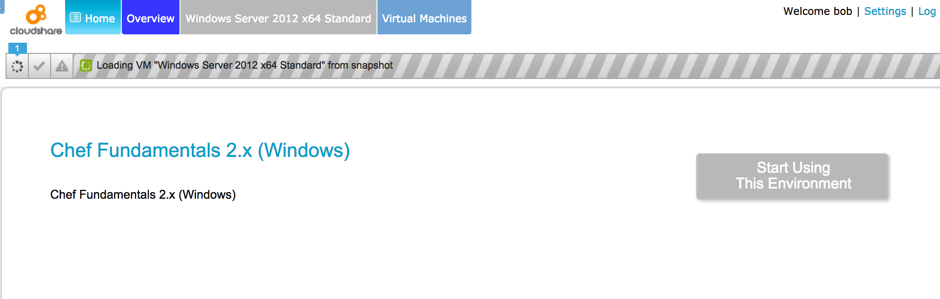
CloudShare Node
Register and login to CloudShare (see invite)
Start Using This Environment

Slide 185
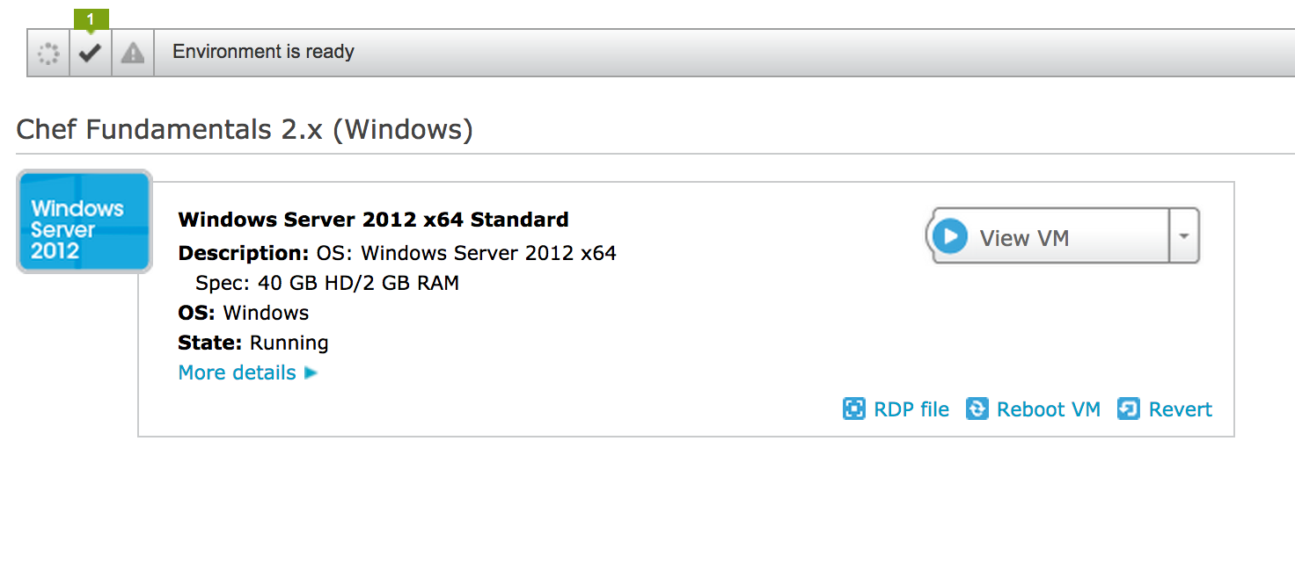
CloudShare Node

Slide 186
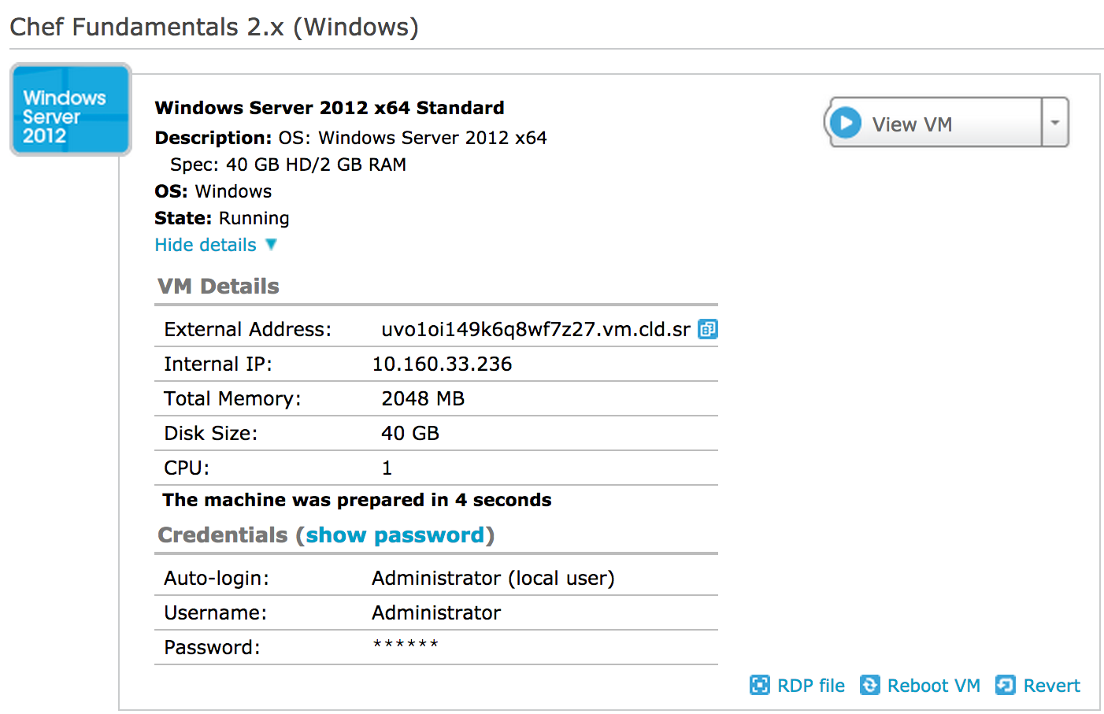
CloudShare Node
Notes:
Copy the External Address. This will be used to ssh into the server.

Slide 187
Checkpoint
At this point you should have
One virtual machine (VM) or server that you’ll use for the lab exercises
The IP address or public hostname
An application for establishing an RDP connection
'RDP' permissions on the VM

Slide 188
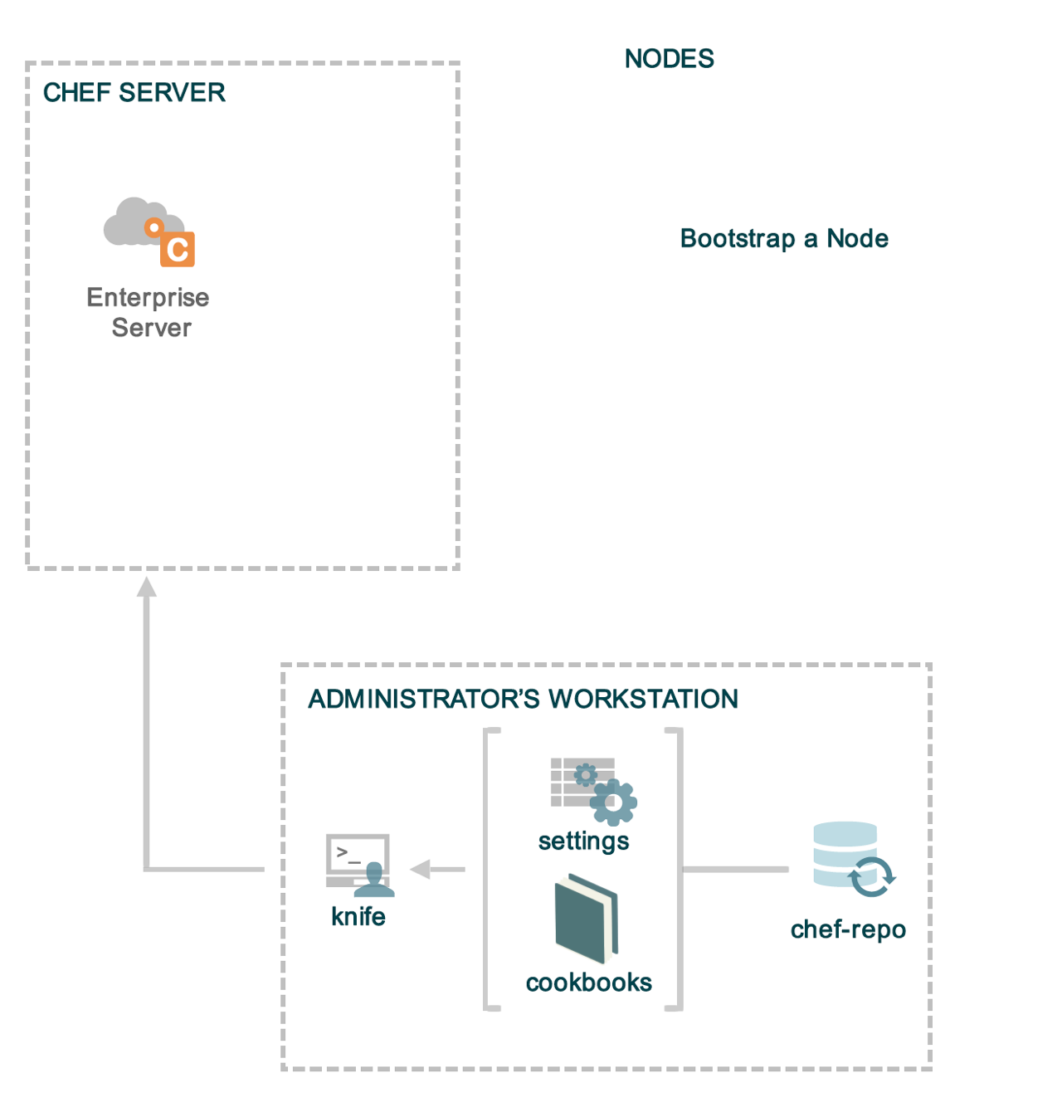
Checkpoint
Notes:
The bootstrap process installs chef-client on a target node so it can communicate with a chef server.
Chef Server is up and running
Knife is installed and configured
Source Code repository has been created

Slide 189
"Bootstrap" the Target Instance
PS \> knife bootstrap windows winrm <ETERNAL_ADDRESS> -x chef –P chef -N "node1"
Bootstrapping Chef on uvo1bv4gjw3ktiwifb3.vm.cld.sr
Enter your password:
uvo1bv4gjw3ktiwifb3.vm.cld.sr "Rendering "C:\Users\chef\AppData\Local\Temp\bootstrap-2000-139299860
uvo1bv4gjw3ktiwifb3.vm.cld.sr "Rendering "C:\Users\chef\AppData\Local\Temp\bootstrap-2000-139299860
uvo1bv4gjw3ktiwifb3.vm.cld.sr "Rendering "C:\Users\chef\AppData\Local\Temp\bootstrap-2000-139299860
uvo1bv4gjw3ktiwifb3.vm.cld.sr "Rendering "C:\Users\chef\AppData\Local\Temp\bootstrap-2000-139299860
uvo1bv4gjw3ktiwifb3.vm.cld.sr "Rendering "C:\Users\chef\AppData\Local\Temp\bootstrap-2000-139299860
uvo1bv4gjw3ktiwifb3.vm.cld.sr "Rendering "C:\Users\chef\AppData\Local\Temp\bootstrap-2000-139299860
uvo1bv4gjw3ktiwifb3.vm.cld.sr "Rendering "C:\Users\chef\AppData\Local\Temp\bootstrap-2000-139299860
uvo1bv4gjw3ktiwifb3.vm.cld.sr "Rendering "C:\Users\chef\AppData\Local\Temp\bootstrap-2000-139299860
uvo1bv4gjw3ktiwifb3.vm.cld.sr "Rendering "C:\Users\chef\AppData\Local\Temp\bootstrap-2000-139299860
uvo1bv4gjw3ktiwifb3.vm.cld.sr "Rendering "C:\Users\chef\AppData\Local\Temp\bootstrap-2000-139299860
uvo1bv4gjw3ktiwifb3.vm.cld.sr "Rendering "C:\Users\chef\AppData\Local\Temp\bootstrap-2000-139299860
uvo1bv4gjw3ktiwifb3.vm.cld.sr "Rendering "C:\Users\chef\AppData\Local\Temp\bootstrap-2000-139299860
uvo1bv4gjw3ktiwifb3.vm.cld.sr "Rendering "C:\Users\chef\AppData\Local\Temp\bootstrap-2000-139299860
uvo1bv4gjw3ktiwifb3.vm.cld.sr Checking for existing directory "C:\chef"...
uvo1bv4gjw3ktiwifb3.vm.cld.sr Existing directory not found, creating.
uvo1bv4gjw3ktiwifb3.vm.cld.sr
uvo1bv4gjw3ktiwifb3.vm.cld.sr C:\Users\chef>(
…
Notes:
This command should be entered on a single line.
(using the EC2 fqdn sucks. Have your students name the node.)
The IPADDRESS is your VM's IP.
It will take a few minutes for this command to run, so let's talk about what it is doing.

Slide 190








PS \> knife bootstrap windows winrm <ETERNAL_ADDRESS> -x chef –P chef -N “node1”
WinRM
managed node (VM)
local workstation
chef-client
chef_server_url
validation_client_name
validation_key
bash -c '
install chef
configure client
run chef'
Opscode Hosted Chef
Notes:
What does this bootstrap command do?
1. Connect to the VM via SSH, using the specified user (opscode) and password (opscode)
2. Renders the specified template (chef-full) with the chef_server_url, validation_client_name for the Chef Server and the contents of the validation_key from the knife.rb file.
3. We have the Opscode Hosted Chef server defined as the server url.
4. The template is executed as a script under sudo on the VM, the script: installs chef-full package, configures the system to connect to the server, and runs chef-client with the specified run list (-r '[..]').

Slide 191
knife bootstrap
Chef Server
Workstation
Node

Slide 192
knife bootstrap
knife bootstrap windows winrm HOSTNAME -x …
Chef Server
Workstation
Node

Slide 193

knife bootstrap
knife bootstrap windows winrm HOSTNAME -x …
Chef Server
Workstation
chef_server_url
validation_client_name
validation_client_key
ssh / scp
Node

Slide 194

knife bootstrap
knife bootstrap windows winrm HOSTNAME -x …
Chef Server
Workstation
chef_server_url
validation_client_name
validation_client_key
ssh / scp
install chef-client
configure chef-client
run chef-client
Node

Slide 195

knife bootstrap
knife bootstrap windows winrm HOSTNAME -x …
Chef Server
Workstation
register node
save node details
chef_server_url
validation_client_name
validation_client_key
ssh / scp
install chef-client
configure chef-client
run chef-client
Node

Slide 196

knife bootstrap
knife bootstrap windows winrm HOSTNAME -x …
Chef Server
Workstation
register node
save node details
chef_server_url
validation_client_name
validation_client_key
ssh / scp
install chef-client
configure chef-client
run chef-client
Node

Slide 197
knife bootstrap
knife bootstrap windows winrm HOSTNAME -x …
Chef Server
Workstation
register node
save node details
chef_server_url
validation_client_name
validation_client_key
ssh / scp
install chef-client
configure chef-client
run chef-client
Node

Slide 198
What just happened?
Chef and all of its dependencies installed via an operating system-specific package ("omnibus installer")
Installation includes
The Ruby language - used by Chef
knife - Command line tool for administrators
chef-client - Client application
ohai - System profiler
...and more
Notes:
A quick mention that we just used the omnibus installer which puts Chef and all of its dependencies on the workstation. The tools are installed under /opt/chef (linux/mac) or C:\opscode (Windows).
Also mention that ‘gem install chef’ is also a valid installation method if students are already using rvm, rbevn, or chruby to manage their Ruby installations or if they’d prefer to use the system ruby (which should be at version 1.9 or better to use this method).
Opscode manages an open source project called "Omnibus". Use omnibus to create OS-specific packages.

Slide 199
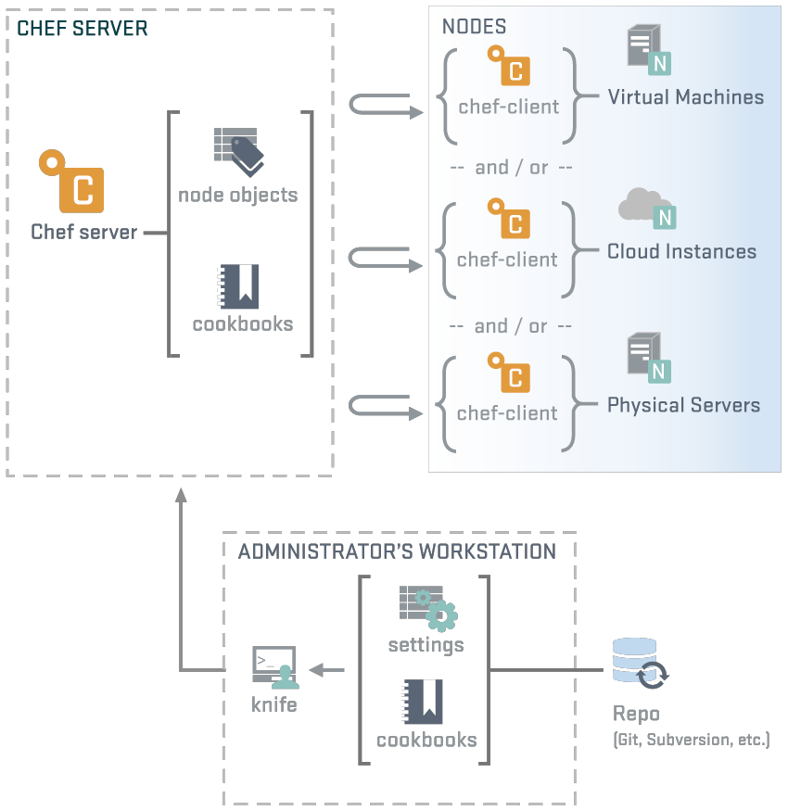
Review - Workstation or Node?
NODES
chef-client
ohai
knife
Notes:
We've just installed chef-client, knife, ohai and ruby along with any supporting ruby gems. This is exactly the same as gets installed on a node during bootstrap. Difference is the node does not use knife, while the workstation client does not use chef-client - but each could be configured to perform either role!
Also, knife workstation has your ‘god’ .pem key, and node only has validator.pem and client.pem

Slide 200
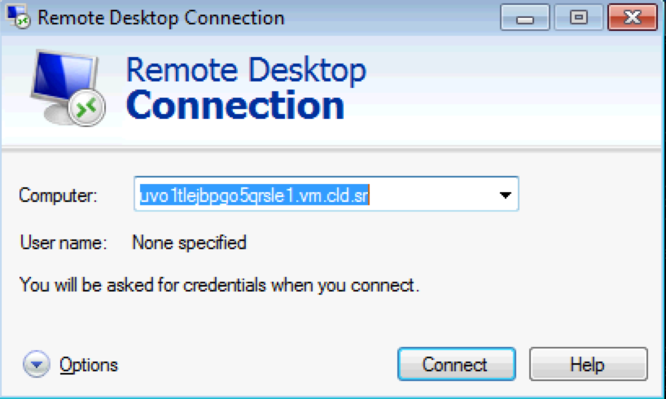
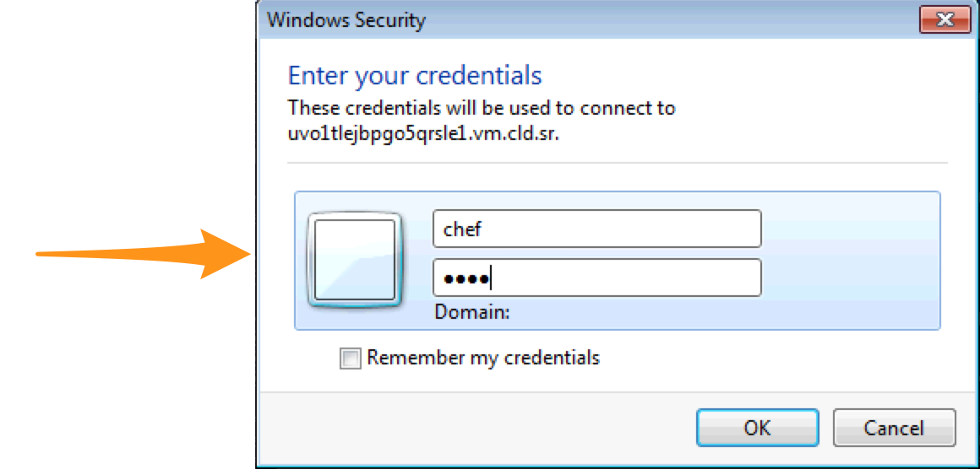
Verify Your Target Instance’s Chef-Client is Configured Properly
Use Remote Desktop to connect to the host.
User: chef Password: chef

Slide 201

Verify Your Target Instance’s Chef-Client is Configured Properly
Open an Administrator Powershell on the VM

Slide 202
Verify Your Target Instance’s Chef-Client is Configured Properly
remote@PS \> dir c:\chef
Directory: C:\chef
Mode LastWriteTime Length Name
---- ------------- ------ ----
d---- 10/7/2013 3:41 PM cache
-a--- 10/4/2013 7:18 PM 1702 client.pem
-a--- 10/4/2013 7:17 PM 434 client.rb
-a--- 10/4/2013 7:17 PM 17 first-boot.json
-a--- 10/4/2013 7:17 PM 1706 validation.pem
-a--- 10/4/2013 7:16 PM 161 wget.ps1
-a--- 10/4/2013 7:16 PM 1273 wget.vbs

Slide 203
Examine C:\chef\client.rb
remote@PS \> gc c:\chef\client.rb
log_level :info
log_location STDOUT
chef_server_url "https://api.opscode.com/organizations/ORGNAME"
validation_client_name ORGNAME-validator"
client_key "c:/chef/client.pem"
validation_key "c:/chef/validation.pem"
file_cache_path "c:/chef/cache"
file_backup_path "c:/chef/backup"
cache_options ({:path => "c:/chef/cache/checksums", :skip_expires => true})
node_name "node1"
Notes:
n

Slide 204
Verify the log level on your test node
remote@PS \> gc c:\chef\client.rb
log_level :info
log_location STDOUT
chef_server_url "https://api.opscode.com/organizations/ORGNAME"
validation_client_name ORGNAME-validator"
client_key "c:/chef/client.pem"
validation_key "c:/chef/validation.pem"
file_cache_path "c:/chef/cache"
file_backup_path "c:/chef/backup"
cache_options ({:path => "c:/chef/cache/checksums", :skip_expires => true})
node_name "node1"
Notes:
as of chef 11.16.4 this was set automatically. If change is needed use wordpad (NOT notepad). From command line: start wordpad c:\chef\client.rb

Slide 205
Verify the log level on your test node
Open in editor (wordpad) c:\chef\client.rb
log_level :info
log_location STDOUT
chef_server_url "https://api.opscode.com/organizations/ORGNAME"
validation_client_name "ORGNAME-validator"
node_name "node1"
Ensure the default log level for chef-client is :info
More configuration options can be found on the docs site: http://docs.opscode.com/config_rb_client.html
Notes:
Don’t need to do this slide on Windows because knife-windows is so old, it sets log_level to :info automatically
We change the log_level so that later sessions have more detailed log outputs. The automatic setting for logging since Chef 11 has minimal output that hides some of the lesson information. If you are using Chef 10, then the log level will be :info by default.

Slide 206
Examine C:\chef\first-boot.json
remote@PS \> gc c:\chef\first-boot.json
{"run_list":[]}
You can bootstrap nodes with recipes/run lists right away
Disaster recovery!

Slide 207

View Node on Chef Server
Login to your Hosted Enterprise Chef
via Management Council
or https://manage.getchef.com
Notes:
Login to Enterprise Chef to view your nodes

Slide 208

View Node on Chef Server
Click the 'Details' tab

Slide 209

View Node on Chef Server
Click the 'Attributes' tab

Slide 210
Node
The node is registered with Chef Server
The Chef Server displays information about the node
This information comes from Ohai - we'll see Ohai later.....
Notes:
We'll be looking at ohai in a later section...

Slide 211

Checkpoint
Notes:
Chef Server is up and running
Knife is installed and configured
Source Code repository has been created

Slide 212
Review Questions
Where is the chef-client configuration file?
What is the command to run chef?
What does a knife bootstrap do?
Notes:
-) /etc/chef
-) chef-client
-) Installs the chef-client on a target system so that it can run as a chef-client and communicate with a server.

Slide 213
Chef Resources and Recipes
Writing an IIS demo cookbook

Slide 214
Lesson Objectives
After completing the lesson, you will be able to
Describe in detail what a cookbook is
Create a new cookbook
Explain what a recipe is
Describe how to use the powershell_script, service, and cookbook_file resources
Upload a cookbook to the Chef Server
Explain what a run list is, and how to set it for a node via knife
Explain the output of a chef-client run
Notes:
I always mention - before we start - to not actually write your own Apache cookbook and to use the community one. We get to that section later, but explain that we’re just doing this as an exercise.

Slide 215
What is a cookbook?
A cookbook is like a “package” for Chef recipes.
It contains all the recipes, files, templates, libraries, etc. required to configure a portion of your infrastructure
Typically they map 1:1 to a piece of software or functionality.
Notes:
Example: “apache”, “mysql”, “mongodb”, “tomcat”, “jboss” - all of these things are software style cookbooks, and they would contain all the different ways you work with each. (A “mysql client”, “mysql server”, “mysql slave”, etc.)
Functional cookbooks might be something like “users”, “security”, etc.
We are going to write a lot of cookbooks - so you’re going to get comfortable with them.

Slide 216
The Problem and the Success Criteria
The Problem: We need a web server configured to serve up our home page.
Success Criteria: We can see the homepage in a web browser.

Slide 217
Required steps
Install IIS
Start the service, and make sure it will start when the machine boots
Write out the home page
Please note in this course we're teaching Chef primitives, not web server management
This is probably not the IIS configuration you would use in production

Slide 218
Exercise: Create a new Cookbook
PS \> knife cookbook create iis_demo
** Creating cookbook iis_demo
** Creating README for cookbook: iis_demo
** Creating CHANGELOG for cookbook: iis_demo
** Creating metadata for cookbook: iis_demo

Slide 219
Exercise: Explore the cookbook
PS \> dir cookbooks\iis_demo
Mode LastWriteTime Length Name
---- ------------- ------ ----
d---- 9/5/2013 1:52 PM attributes
d---- 9/5/2013 1:52 PM definitions
d---- 9/5/2013 1:52 PM files
d---- 9/5/2013 1:52 PM libraries
d---- 9/5/2013 1:52 PM providers
d---- 9/5/2013 1:52 PM recipes
d---- 9/5/2013 1:52 PM resources
d---- 9/5/2013 1:52 PM templates
-a--- 9/5/2013 1:52 PM 472 CHANGELOG.md
-a--- 9/5/2013 1:52 PM 287 metadata.rb
-a--- 9/5/2013 1:52 PM 1531 README.md

Slide 220

Exercise: Open a project drawer if you're using Sublime Text
If you're using Sublime, then File>Open the chef-repo directory you created earlier
Access the cookbook files from the left menu
Notes:
If they have their environment set up correctly, they should be able to do "subl ." to open sublime at their current location
Say something like "If you're using Sublime, then....", If they're not using it then gloss over it. In
You can access all files in the cookbook from the left menu
i.e.:C:\Users\you\chef-repo (Win)/Users/you/chef-repo (Mac)/home/you/chef-repo (Linux)

Slide 221
Edit the default recipe
OPEN IN EDITOR:
cookbooks\iis_demo\recipes\default.rb
#
# Cookbook Name:: iis_demo
# Recipe:: default
#
# Copyright 2013, YOUR_COMPANY_NAME
#
# All rights reserved - Do Not Redistribute
#

Slide 222
Chef Resources
package "haproxy" do
action :install
end
template "/etc/haproxy/haproxy.cfg" do
source "haproxy.cfg.erb"
owner "root"
group "root"
mode "0644"
notifies :restart, "service[haproxy]"
end
service "haproxy" do
supports :restart => :true
action [:enable, :start]
end
Notes:
Let's take a moment to discuss the structure of a Chef resource.
This is a Linux example, but it’s generic enough for Windows. The only real difference would be that “package” would be “windows_package” in your students’ world.
Point out that resource parameters live between the “DO..END”.

Slide 223
Chef Resources
Have a type
package "haproxy" do
action :install
end
template "/etc/haproxy/haproxy.cfg" do
source "haproxy.cfg.erb"
owner "root"
group "root"
mode "0644"
notifies :restart, "service[haproxy]"
end
service "haproxy" do
supports :restart => :true
action [:enable, :start]
end
Notes:
Lets take a moment and talk about resources…

Slide 224
Chef Resources
Have a type
Have a name
package "haproxy" do
action :install
end
template "/etc/haproxy/haproxy.cfg" do
source "haproxy.cfg.erb"
owner "root"
group "root"
mode "0644"
notifies :restart, "service[haproxy]"
end
service "haproxy" do
supports :restart => :true
action [:enable, :start]
end

Slide 225
Chef Resources
Have a type
Have a name
Have parameters
package "haproxy" do
action :install
end
template "/etc/haproxy/haproxy.cfg" do
source "haproxy.cfg.erb"
owner "root"
group "root"
mode "0644"
notifies :restart, "service[haproxy]"
end
service "haproxy" do
supports :restart => :true
action [:enable, :start]
end

Slide 226
Chef Resources
Have a type
Have a name
Have parameters
Take action to put the resource into the desired state
package "haproxy" do
action :install
end
template "/etc/haproxy/haproxy.cfg" do
source "haproxy.cfg.erb"
owner "root"
group "root"
mode "0644"
notifies :restart, "service[haproxy]"
end
service "haproxy" do
supports :restart => :true
action [:enable, :start]
end

Slide 227
Chef Resources
Have a type
Have a name
Have parameters
Take action to put the resource into the desired state
Can send notifications to other resources
package "haproxy" do
action :install
end
template "/etc/haproxy/haproxy.cfg" do
source "haproxy.cfg.erb"
owner "root"
group "root"
mode "0644"
notifies :restart, "service[haproxy]"
end
service "haproxy" do
supports :restart => :true
action [:enable, :start]
end

Slide 228
Exercise: Add a powershell resource to install IIS
OPEN IN EDITOR: cookbooks\iis_demo\recipes\default.rb
#
# Cookbook Name:: iis_demo
# Recipe:: default
#
# Copyright 2013, YOUR_COMPANY_NAME
#
# All rights reserved - Do Not Redistribute
#
powershell_script "Install IIS" do
code "add-windowsfeature Web-Server"
action :run
end
SAVE FILE!
Notes:
Four concepts while they are typing:
1: Strings in ruby are enclosed in single or double quotes. Most of the time in Chef, you will use Double quotes.
2: :stop and :delete are Symbols - symbols in ruby are strings that live in only one place in memory. (No matter how many times you type :install, it refers to the same place.) In our material, anywhere we use a symbol, it is required - you can’t replace it with a string.
3: Arrays are noted by square brackets. This one has two items -- “:stop” and “:delete”. The first item has a trailing comma, the last item does not.
4: Idiomatic ruby uses two SPACES for indentation. Sublime defaults to four. At the end of the day, whitespace is whitespace.

Slide 229
So the resource we just wrote...
powershell_script "Install IIS" do
code "add-windowsfeature Web-Server"
action :run
end

Slide 230
So the resource we just wrote...
Is a powershell_script resource
powershell_script "Install IIS" do
code "add-windowsfeature Web-Server"
action :run
end

Slide 231
So the resource we just wrote...
Is a powershell_script resource
Whose name is Install IIS
powershell_script "Install IIS" do
code "add-windowsfeature Web-Server"
action :run
end

Slide 232
So the resource we just wrote...
Is a powershell_script resource
Whose name is Install IIS
With code parameter
powershell_script "Install IIS" do
code "add-windowsfeature Web-Server"
action :run
end

Slide 233
So the resource we just wrote...
Is a powershell_script resource
Whose name is Install IIS
With code parameter
With a run action
powershell_script "Install IIS" do
code "add-windowsfeature Web-Server"
action :run
end
Notes:
Things with : in front of them (:run) are symbols in ruby - if anyone asks.

Slide 234
Exercise: Add a service resource to ensure the service is started and enabled
OPEN IN EDITOR:
cookbooks\iis_demo\recipes\default.rb
...
# All rights reserved - Do Not Redistribute
#
powershell_script "Install IIS" do
code "add-windowsfeature Web-Server”
action :run
end
service "w3svc" do
action [ :enable, :start ]
end
SAVE FILE!

Slide 235
So the resource we just wrote...
service "w3svc" do
action [ :enable, :start ]
end
Notes:
You can have more than one action, and they are evaluated in order. So we first will make sure this service is running, and that it is enabled at boot

Slide 236
So the resource we just wrote...
Is a service resource
service "w3svc" do
action [ :enable, :start ]
end

Slide 237
So the resource we just wrote...
Is a service resource
Whose name is w3svc
service "w3svc" do
action [ :enable, :start ]
end

Slide 238
So the resource we just wrote...
Is a service resource
Whose name is w3svc
With two actions: start and enable
service "w3svc" do
action [ :enable, :start ]
end

Slide 239
Notice we didn’t say how to restart the service
Resources are declarative - that means we say what we want to have happen, rather than how
Resources take action through Providers - providers perform the how
Chef determines the platform the node is running to determine the correct provider for a resource
Notes:
Declarative resources inspect the system state, and do whatever they need to do to make the system conform with the declared state.
Chef automatically knows that we should use “apt” on ubuntu, “yum” on red hat by looking up the correct PROVIDER based on the platform.

Slide 240

Service Resource
service “w3svc” …
{
Providers are determined
by node's platform
startsrc - aix
update-rc.d - debian
rc-update - gentoo
launchctl - osx
svcadm - solaris
Notes:
<<Review Comment: Can we have a Windows example for here?
We write "package git", Chef knows which one of these commands to run.
'pacman' is a facet of Arch Linux, & 'pkg_add' is from openBSD & freeBSD

Slide 241
Package Resource
package "git"
{
Providers are determined
by node's platform
yum install git
apt-get install git
pacman sync git
pkg_add -r git
Notes:
<<Review Comment: Can we have a Windows example for here?
took commands out of service resource provider

Slide 242
But How does it *really* work?
Chef is Open Source - All of the source code is on GitHub
Don’t be afraid to Explore
It’s just msiexec under the hood
def install_package(name, version)
...
shell_out!("msiexec /qn /i \”#{@new_resource.source}\" …)
...
end
Source: https://github.com/opscode/chef/blob/master/lib/chef/provider/package/windows/msi.rb
Notes:
This is an optional slide!
<<WIP: Should this
package_name = "#{name}=#{version}"be this
package_name = "#{name}-#{version}"
<<WIP: Should we introduce a concept of "behind the scenes", where we cover this kind of really techy stuff, nil:NilClass etc
We don't actually write this code in our recipes.

Slide 243
Provider Example
def install_package(name, version)
package_name = "#{name}=#{version}"
package_name = name if @is_virtual_package
run_command_with_systems_locale(
:command => "apt-get -q -y
#{expand_options(@new_resource.options)}
install #{package_name}",
:environment => {
"DEBIAN_FRONTEND" => "noninteractive"
}
)
end
Notes:
ref0009
<<Review Comment: Added for card https://trello.com/c/rmrSiVUD
<<WIP: Maybe include another provider also, e.g. 'yum'. Also need a verbal explanation of whats going on here in the instructor notes - is it too deep?
This is an optional slide!
<<WIP: Should this
package_name = "#{name}=#{version}"
be this
package_name = "#{name}-#{version}"
<<WIP: Should we introduce a concept of "behind the scenes", where we cover this kind of really techy stuff, nil:NilClass etc
We don't actually write this code in our recipes.

Slide 244
Exercise: Add a cookbook_file resource to copy the home page in place
OPEN IN EDITOR:
cookbooks\iis_demo\recipes\default.rb
...
service "w3svc" do
action [ :enable, :start ]
end
cookbook_file 'c:\inetpub\wwwroot\Default.htm' do
source "Default.htm"
rights :read, "Everyone"
end
SAVE FILE!
Notes:
We are leaving the action off intentionally, in case anyone asks.

Slide 245
So the resource we just wrote...
cookbook_file 'c:\inetpub\wwwroot\Default.htm' do
source "Default.htm"
rights :read, "Everyone"
end
Notes:
Hammer home this stuff, because later in the deck, we are going to force them to write resources without the syntax on the right at all.

Slide 246
So the resource we just wrote...
cookbook_file 'c:\inetpub\wwwroot\Default.htm' do
source "Default.htm"
rights :read, "Everyone"
end
Is a cookbook_file resource
Notes:
Hammer home this stuff, because later in the deck, we are going to force them to write resources without the syntax on the right at all.

Slide 247
So the resource we just wrote...
cookbook_file 'c:\inetpub\wwwroot\Default.htm' do
source "Default.htm"
rights :read, "Everyone"
end
Is a cookbook_file resource
Whose name is c:\inetpub\wwwroot\Default.htm
Notes:
Hammer home this stuff, because later in the deck, we are going to force them to write resources without the syntax on the right at all.

Slide 248
So the resource we just wrote...
cookbook_file 'c:\inetpub\wwwroot\Default.htm' do
source "Default.htm"
rights :read, "Everyone"
end
Is a cookbook_file resource
Whose name is c:\inetpub\wwwroot\Default.htm
With two parameters:
source of Default.htm
rights of :read,”Everyone"
Notes:
Hammer home this stuff, because later in the deck, we are going to force them to write resources without the syntax on the right at all.

Slide 249
Best Practice: Omit the action if it is the default
cookbook_file 'c:\inetpub\wwwroot\Default.htm' do
source "Default.htm"
rights :read, "Everyone"
end
Has no action!
If you omit the action in Chef, we default to the most common positive action.
In this case, it is the :create action.
Notes:
<<Review Comment: It was decide for noobs they should always include the default action. Could mention in class its default action can be omitted, but should’t say it’s a best practice for now

Slide 250
Order Matters
Resources are executed in order
Body Level One
Body Level Two
Body Level Three
Body Level Four
Body Level Five
powershell_script "Install IIS" do
code "add-windowsfeature Web-Server”
action :run
end
service "w3svc" do
action [ :enable, :start ]
end
cookbook_file ‘c:\inetpub\wwwroot\Default.htm’ do
source "Default.htm"
rights :read, "Everyone"
end
1st
2nd
3rd
Notes:
Order matters because the operating system was designed to be managed by hand
Think about adding a user, where the user ids are dynamically generated - if they aren’t added in the same order, you can’t guarantee that the system will be the same.

Slide 251
Full contents of the IIS_demo recipe
# Cookbook Name:: iis_demo # Recipe:: default # # Copyright 2013, YOUR_COMPANY_NAME # # All rights reserved - Do Not Redistribute #
powershell_script "Install IIS" do
code "add-windowsfeature Web-Server"
action :run
end
service "w3svc" do
action [ :enable, :start ]
end
cookbook_file 'c:\inetpub\wwwroot\Default.htm' do
source "Default.htm"
rights :read, "Everyone"
end
Notes:
Note: do/end, no squiggly brackets -- idiomatic leave off unnecessary bits
https://gist.github.com/vinyar/6705367
for entire correct version
NOTE: Ensure its this
cookbook_file ‘c:\inetpub\wwwroot\Default.htm’ do
And NOT this
cookbook_file “c:\inetpub\wwwroot\Default.htm” do

Slide 252
Question!
Using what we have learned so far, can we make the recipe shorter?
Notes:
Answer: omit the action on the package resource.
Don’t have them do it - just point it out. :)

Slide 253
Best Practice: Omit the default action
If the only action you need from a resource is the default action - omit it from the recipe
powershell_script "Install IIS" do
code "add-windowsfeature Web-Server"
action :run
end
Notes:
powershell_script doesn’t need action :run
In Ruby, it is common to not type characters you don’t need.
In Chef, we carry that forward - since the rule is that we default to the most common positive action, we don’t type it if we don’t have to.
The rule of least surprise!

Slide 254
Exercise: Add Default.htm to your cookbook’s files/default directory
OPEN IN EDITOR:
cookbooks\iis_demo\files\default\Default.htm
<html>
<body>
<h1>Hello, world!</h1>
</body>
</html>
SAVE FILE!
Notes:
Reflect on the fact that, yeah, we’re not a class about HTML - but we are doing things the hard way, and part of that is getting used to putting files in the right places in cookbooks, and typing them in. If they’ve never written HTML before, congratulate them on their first web site. :)

Slide 255
What’s with the ‘default’ subdirectory?
Chef allows you to select the most appropriate file (or template) within a cookbook depending on the node's platform
Host node name (foo.bar.com)
platform-version (windows-6.3)
platform-major (windows-6)
platform
default
99% of the time, you will just use default
Notes:
<< TODO: Find a recipe that actually uses this.

Slide 256
Exercise: Upload the cookbook
PS \> knife cookbook upload iis_demo
Uploading iis_demo [0.1.0]
Uploaded 1 cookbook.
Notes:
This checks for syntax errors, bundles the cookbook up, and uploads it to the chef server for distribution to the chef clients.
If they have syntax errors in the recipe, it will get caught here.
If you get a ‘ruby’ error on Windows, you need to make the Chef repo live in a path without spaces in it. (Seriously.)

Slide 257
Recipe Naming
Recipes are referenced using the notation ‘cookbook::recipe’, where ‘recipe’ is the name of the ‘.rb’ file in the “cookbook/recipe” directory
The “default.rb” recipe for a given cookbook may be referred to just by the name of the cookbook (e.g. ‘iis_demo’)
However, if we added another recipe to this cookbook named “createsite.rb”, we would refer to it as ‘iis_demo::createsite’
Notes:
403

Slide 258
The Run List
The Run List is the ordered set of recipes and roles that the Chef Client will execute on a node
Recipes are specified by “recipe[name]”
Roles are specified by “role[name]”
Notes:
We talk about Roles sometime in day two, for now , just get the reference out

Slide 259
Exercise: Add iis_demo recipe to node’s run list
$ knife node run_list add node1 'recipe[iis_demo]'
node1:
run_list: recipe[iis_demo]
Notes:
This is a Microsoft bug - we are working with them, but the process is VERY slow
bug here: https://tickets.opscode.com/browse/CHEF-2486
The workaround is to either
a: escape ‘ with ` (tac in upper left on keyboard) -> `’recipe[iis_demo]`’
b: use cmd and single quotes -> ’recipe[iis_demo]’
c: ‘role[base],' - add a comma inside single quotes.

Slide 260
Exercise: Run the chef-client on your test node
remote@PS\> chef-client
Starting Chef Client, version 11.10.4
[2014-02-24T05:37:54-08:00] INFO: *** Chef 11.10.4 ***
[2014-02-24T05:37:54-08:00] INFO: Chef-client pid: 260
[2014-02-24T05:38:09-08:00] INFO: Run List is [recipe[iis_demo]]
[2014-02-24T05:38:09-08:00] INFO: Run List expands to [iis_demo]
[2014-02-24T05:38:09-08:00] INFO: Starting Chef Run for node1
[2014-02-24T05:38:09-08:00] INFO: Running start handlers
[2014-02-24T05:38:09-08:00] INFO: Start handlers complete.
resolving cookbooks for run list: ["iis_demo"]
[2014-02-24T05:38:10-08:00] INFO: Loading cookbooks [iis_demo]
Synchronizing Cookbooks:
[2014-02-24T05:38:10-08:00] INFO: Storing updated cookbooks/iis_demo/recipes/default.rb in the cache.
…
Notes:
Typical errors:
* The file is not in the ‘default’ subdirectory
* The name of the package or service is wrong
* The site was created during a previous Chef run that eventually aborted due to an error. To resolve the error, remove c:\inetpub\wwwroot\test (and it’s contents), remove the test web site using the IIS manager, and clear the Chef cache
CLI IIS manager
c:\Windows\System32\inetsrv\appcmd.exe stop site site.name:/”Test Web Site”
c:\Windows\System32\inetsrv\appcmd.exe start site site.name:/”Test Web Site”

Slide 261

Exercise: Verify that the home page works
Open a web browser
Type in the URL for your test node
Notes:
If it’s not working at all - check the firewall rules. You can disable them. If you can’t reach your test node from your workstation, use ‘curl http://localhost’ from the command line on the test node.

Slide 262
Congratulate yourself!
You have just written your first Chef cookbook!
(clap!)
Notes:
Note that they have just used packages, services, and templates: three resources which are the trinity of config mgmt!

Slide 263

Take 5
http://bestpaperz.com/ct/8810952-funny-coffee-owl-wallpaper.html

Slide 264
Reading the output of a chef-client run
Starting Chef Client, version 11.16.4
[2014-11-23T08:09:34-08:00] INFO: *** Chef 11.16.4 ***
[2014-11-23T08:09:34-08:00] INFO: Chef-client pid: 4996
[2014-11-23T08:09:44-08:00] INFO: Run List is [recipe[iis_demo]]
[2014-11-23T08:09:44-08:00] INFO: Run List expands to [iis_demo]
[2014-11-23T08:09:44-08:00] INFO: Starting Chef Run for node1
[2014-11-23T08:09:44-08:00] INFO: Running start handlers
[2014-11-23T08:09:44-08:00] INFO: Start handlers complete.
The run list is shown
The expanded Run List is the complete list, after nested roles are expanded
Notes:
We tell you the nodes run list, as set on the object itself We tell you what the nodes run list *expands* to, which comes in to play when roles are nested
We cover expansion in much more depth later.

Slide 265
Reading the output of a chef-client run
Converging 3 resources
Recipe: iis_demo::default
* powershell_script[Install IIS] action run[2014-02-24T06:08:29-08:00]
INFO: Processing powershell_script[Install IIS]
action run (iis_demo::default line 9)
Success Restart Needed Exit Code Feature Result
------- -------------- --------- --------------
True No Success {Common HTTP Features, Default Document, D...
WARNING: Windows automatic updating is not enabled. To ensure that your newly-installed role or feature is automatically updated, turn on Windows Update.
[2014-02-24T06:09:16-08:00] INFO: powershell_script[Install IIS] ran successfully
powershell_script is not idempotent
Add-WindowsFeature is!
Notes:
Talk about the Processing lines - this means we are evaluating this resource for the “install” action. You will see these lines for every resource.

Slide 266
Reading the output of a chef-client run
* service[w3svc] action enable
[2014-02-24T06:25:33-08:00]
INFO: Processing service[w3svc] action enable (iis_demo::default line 14)
(up to date)
* service[w3svc] action start
[2014-02-24T06:25:33-08:00]
INFO: Processing service[w3svc] action start (iis_demo::default line 14)
(up to date)
Service is idempotent.
No changes have been made
Notes:
Talk about the Processing lines - this means we are evaluating this resource for the “install” action. You will see these lines for every resource.

Slide 267
Reading the output of a chef-client run
* cookbook_file[c:\inetpub\wwwroot\Default.htm] action create
[2014-02-24T06:25:33-08:00] INFO: Processing cookbook_file[c:\inetpub\wwwroot\Default.htm] action create (iis_demo::default line 18)
[2014-02-24T06:25:33-08:00] INFO: cookbook_file[c:\inetpub\wwwroot\Default.htm] created file c:\inetpub\wwwroot\Default.htm
- create new file c:\inetpub\wwwroot\Default.htm[2014-02-24T06:25:33-08:00] INFO: cookbook_file[c:\inetpub\wwwroot\Default.htm] updated file contents c:\inetpub\wwwroot\Default.htm
- update content in file c:\inetpub\wwwroot\Default.htm from none to 231d53
--- c:\inetpub\wwwroot\Default.htm 2014-02-24 06:25:33.000000000 -0800
+++ C:/Users/chef/AppData/Local/Temp/4/Default.htm20140224-1896-13q72ev 2014-02-24 06:25:33.000000000 -0800
@@ -1 +1,7 @@
+<html>
+ <body>
+ <h1>Hello, world!</h1>
+ </body>
+</html>
+[2014-02-24T06:25:33-08:00] INFO: cookbook_file[c:\inetpub\wwwroot\Default.htm] permissions changed to [Everyone/flags:0/mask:80000000]
- change dacl
Check for an Default.htm file
If there is already one in place, backup the file
A diff of the written file is shown with the modified lines called out
Set permissions on the file
Notes:
Make note that we back up files we change If a student asks about what happens if they have local changes, have them modify index.html, and run it again - and we put it back
If nobody asks, bring it up, and have someone do it. Once you manage something with Chef, it is managed - period.
If anyone fights with you, the story is easy - if you want to be able to make any kind of sane statement about whether your servers are correct, you can’t have managed and un-managed changes. You might fix a single machine by hand, but the final fix goes back into Chef.

Slide 268
Reading the output of a chef-client run
[2014-02-24T06:25:34-08:00] INFO: Chef Run complete in 17.432572377 seconds
[2014-02-24T06:25:34-08:00] INFO: Running report handlers
[2014-02-24T06:25:34-08:00] INFO: Report handlers complete
Chef Client finished, 2 resources updated
Time to complete the Chef run is displayed
Report and exception handlers are now run
Notes:
We don’t really get to reports and exception handlers - the gist is, you use them to send statistics about the run to all sorts of places - email, splunk, etc.

Slide 269
Idempotence
Actions on resources in Chef are designed to be idempotent
In practical terms, this means they only change the state of the system if they have to
If a resource in Chef is properly configured, we move on to the next resource
Notes:
Idempotence, in math, means an operation can be applied multiple times without changing the result. 1 x 1 = 1 is an idempotent operation of multiplication.
Good example is:
echo ‘bla’ > file1.txt - is idempotent
convergent: if context of file1.txt is ‘bla’ do nothing,
else echo ‘bla’ > file1.txt
Now imagine if you have to install a package on 50’000 servers. Forcing package to always install will do the job. However -“is package already installed” is way cheaper at scale.

Slide 270
Idempotence
Actions on resources in Chef are designed to be idempotent
I.e. they can be applied multiple times but the end result is still the same - like multiplying by 1 in math!
Or in mathematical terms, F(F(x))=F(x) ∀x
Chef is a "desired state configuration" system - if a resource is already configured, no action is taken. This is called convergence
Notes:
(slide for ‘math nerds’) - notes
<<WIP/Review Comment: On page 5 of the book "Test-Driven Infrastructure with Chef", Convergence is explained as "Services should take responsibility for their own state being in line with policy; over time the overall system will tend to correctness." - does this mean the same thing as the last bullet here??
Idempotence, in math, means an operation can be applied multiple times without changing the result. 1 x 1 = 1 is an idempotent operation of multiplication.
F(F(x))=F(x) ∀x is read as "the F of the F of x equals the F of x for all x" - Mathematicians will understand, and they'll 'get' chef!
Chef is a "desired state configuration" system and that if the current state == desired state, it won't do anything.
Relevant bits from the Hipchat discussion on this slide -
Adam Jacobs - Function idempotemce says that if the function gets the same inputs, it provides the same outputs. That works
Sean OMeara: ^ the word idempotent means one thing and one thing exactly.
Sean OMeara: convergent is the test-and-repair bit... which is (usually) idempotent
“Convergence goes beyond idempotence. Doing something once only is not enough. It has to end in the correct state.”– Mark Burgess

Slide 271
Exercise: Re-run the Chef Client
remote@PS\> chef-client
Converging 3 resources
Recipe: iis_demo::default
* powershell_script[Install IIS] action run[2014-02-24T06:42:15-08:00] INFO: Processing powershell_script[Install IIS]
action run (iis_demo::default line 9)
Success Restart Needed Exit Code Feature Result
------- -------------- --------- --------------
True No NoChangeNeeded {}
[2014-02-24T06:42:16-08:00] INFO: powershell_script[Install IIS] ran successfully
- execute "powershell.exe" -NoLogo -NonInteractive -NoProfile -ExecutionPolicy RemoteSigned -InputFormat None -File
"C:/Users/chef/AppData/Local/Temp/4/chef-script20140224-4608-1fwjxog.ps1"
* service[w3svc] action enable[2014-02-24T06:42:16-08:00] INFO: Processing service[w3svc] action enable (iis_demo::default line 14)
(up to date)
* service[w3svc] action start[2014-02-24T06:42:16-08:00] INFO: Processing service[w3svc] action start (iis_demo::default line 14)
(up to date)
* cookbook_file[c:\inetpub\wwwroot\Default.htm] action create[2014-02-24T06:42:16-08:00] INFO: Processing cookbook_file[c:\inetpub\wwwroot\Default.htm] action create (iis_demo::default line 18)
(up to date)
[2014-02-24T06:42:17-08:00] INFO: Chef Run complete in 3.416521 seconds
…
Notes:
Note that it didn’t do anything - idempotency at its best.

Slide 272
Recap - So resources are grouped into recipes
package "httpd" do
action :install
end
service "httpd" do
action [ :enable, :start ]
end
cookbook_file "/var/www/html/index.html" do
source "index.html"
mode "0644"
end
resource one
resource two
resource three
Notes:
ref0013
<<WIP: Review comment from BETA review folks: Too much repetition

Slide 273

Recap - So resources are grouped into recipes
package "httpd" do
action :install
end
service "httpd" do
action [ :enable, :start ]
end
cookbook_file "/var/www/html/index.html" do
source "index.html"
mode "0644"
end
intention
Notes:
ref0014
<<WIP: Review comment from BETA review folks: Too much repetition

Slide 274
Recap - So resources are grouped into recipes
powershell_script “Install IIS" do
action :run
code "add-windowsfeature Web-Server"
end
service "w3svc" do
action [ :enable, :start ]
end
cookbook_file 'c:\inetpub\wwwroot\Default.htm' do
source "Default.htm"
rights :read, "Everyone"
end
recipe[iis_demo::default]

Slide 275
Cookbooks contain recipes and supporting files
...
├── cookbooks
│ ├── iis_demo
│ │ ├── recipes
│ │ │ ├── default.rb
│ │ │ └── server.rb
│ │ ├── files
│ │ │ └── default
│ │ │ └── index.html
│ │ ├── metadata.rb
│ │ ├── attributes
│ │ │ └── default
...
Recipes
Supporting File

Slide 276


Cookbooks are installed as artifacts on Chef Server
Enterprise Chef
(org)
iis_demo v0.1.0
ntp v0.2.0
openssh v2.4.7

Slide 277

Nodes have run_lists made of recipes
Enterprise Chef
(org)
recipe[ntp::client]
recipe[openssh::server]
recipe[iis_demo::server]

Slide 278
Questions
What makes up a cookbook?
How do you create a new cookbook?
What is a recipe?
What is a resource?
How do you upload a cookbook to the Chef Server?
What is a run list?

Slide 279
Dissecting your first chef-client run
The Anatomy of a Chef run

Slide 280
Lesson Objectives
After completing the lesson, you will be able to
List all the steps taken by a chef-client during a run
Explain the basic security model of Chef
Explain the concepts of the Resource Collection

Slide 281












chef-client
build node
authenticate
Ohai!
node_name
platform
platform_version
converge
load cookbooks
sync cookbooks
expanded run list
(recipes)
Yes
node.save
notification
handlers
success?
No
exception
Notes:
skipped in favor of broken up slides.

Slide 282
Private Keys
Chef Server requires keys to authenticate.
client.pem - private key for API client
validation.pem - private key for ORGNAME-validator
Next, let’s see how those are used...
Notes:
skipped in favor of broken up slides.
You can "cat" these if you want :).
There are two .pem private key files on the system. The client.pem was created during the authentication cycle we just discussed. It is the private key for *this* node. The public key is stored on the Chef server.
The validation.pem is the private key for the validation client, also called the organization key. The validation.pem file can be deleted.

Slide 283






No
No
/etc/chef/client.pem?
/etc/chef/validation.pem?
401!
Yes
Request API Client
Yes
Sign Requests
client.pem
Notes:
skipped in favor of broken up slides.
Take a minute to talk about how chef does authentication:
* We digitally sign each request with a private key
* We verify that signature
* We protect against replay attacks as well
* There is no central store for Private Keys - meaning you have to keep them safe. It also means no attacker can compromise your security credentials centrally.
Lets take a detailed look at the authentication cycle. When Chef client starts, it first looks for /etc/chef/client.pem.
1. If the client.pem exists, chef will use it to sign requests with the chef server API.
2. If the client.pem does not exist, chef looks for /etc/chef/validation.pem, the validation_key.
3. If the validation key does not exist, then chef exits, or if the key does not match for the validation API client, chef reports a 401 and exits.
4. If the validation key exists, and it matches for the validation API client, chef requests a new API client for this node_name and writes this to /etc/chef/client.pem
5. Chef will use the newly created client to sign requests with the chef server API for all further requests.
If key lost: must delete node & regenerate

Slide 284

chef-client
Notes:
1. Chef client starts up.
2. Chef builds the node object, where it runs ohai to find out the node_name (fqdn) and the node's platform/platform_version
3. Chef authenticates with the server as the node_name, using the API client key. We'll cover the authentication cycle in detail shortly.
4. All the cookbooks required for the node's expanded run list are synchronized to the node.
5. All the cookbooks Ruby components are loaded, recipes are included as well.
6. Node is converged, which is when it configures the resources contained in the recipes.
7. Was the convergence successful? If so, the node is saved.
8. If not the run ends with an exception and a message is printed about the error, and the stack trace file path is included in this.
9. Any notification handlers are run, which can do different things depending on whether the run was successful or not, such as send email or connect to an external service like IRC or Campfire.

Slide 285


chef-client
build node
Notes:
1. Chef client starts up.
2. Chef builds the node object, where it runs ohai to find out the node_name (fqdn) and the node's platform/platform_version
3. Chef authenticates with the server as the node_name, using the API client key. We'll cover the authentication cycle in detail shortly.
4. All the cookbooks required for the node's expanded run list are synchronized to the node.
5. All the cookbooks Ruby components are loaded, recipes are included as well.
6. Node is converged, which is when it configures the resources contained in the recipes.
7. Was the convergence successful? If so, the node is saved.
8. If not the run ends with an exception and a message is printed about the error, and the stack trace file path is included in this.
9. Any notification handlers are run, which can do different things depending on whether the run was successful or not, such as send email or connect to an external service like IRC or Campfire.

Slide 286

chef-client
build node
Ohai!
node_name
platform
platform_version
Notes:
1. Chef client starts up.
2. Chef builds the node object, where it runs ohai to find out the node_name (fqdn) and the node's platform/platform_version
3. Chef authenticates with the server as the node_name, using the API client key. We'll cover the authentication cycle in detail shortly.
4. All the cookbooks required for the node's expanded run list are synchronized to the node.
5. All the cookbooks Ruby components are loaded, recipes are included as well.
6. Node is converged, which is when it configures the resources contained in the recipes.
7. Was the convergence successful? If so, the node is saved.
8. If not the run ends with an exception and a message is printed about the error, and the stack trace file path is included in this.
9. Any notification handlers are run, which can do different things depending on whether the run was successful or not, such as send email or connect to an external service like IRC or Campfire.

Slide 287
chef-client
build node
authenticate
Notes:
1. Chef client starts up.
2. Chef builds the node object, where it runs ohai to find out the node_name (fqdn) and the node's platform/platform_version
3. Chef authenticates with the server as the node_name, using the API client key. We'll cover the authentication cycle in detail shortly.
4. All the cookbooks required for the node's expanded run list are synchronized to the node.
5. All the cookbooks Ruby components are loaded, recipes are included as well.
6. Node is converged, which is when it configures the resources contained in the recipes.
7. Was the convergence successful? If so, the node is saved.
8. If not the run ends with an exception and a message is printed about the error, and the stack trace file path is included in this.
9. Any notification handlers are run, which can do different things depending on whether the run was successful or not, such as send email or connect to an external service like IRC or Campfire.

Slide 288


chef-client
build node
authenticate
sync cookbooks
expanded run list
(recipes)
Notes:
1. Chef client starts up.
2. Chef builds the node object, where it runs ohai to find out the node_name (fqdn) and the node's platform/platform_version
3. Chef authenticates with the server as the node_name, using the API client key. We'll cover the authentication cycle in detail shortly.
4. All the cookbooks required for the node's expanded run list are synchronized to the node.
5. All the cookbooks Ruby components are loaded, recipes are included as well.
6. Node is converged, which is when it configures the resources contained in the recipes.
7. Was the convergence successful? If so, the node is saved.
8. If not the run ends with an exception and a message is printed about the error, and the stack trace file path is included in this.
9. Any notification handlers are run, which can do different things depending on whether the run was successful or not, such as send email or connect to an external service like IRC or Campfire.

Slide 289


chef-client
build node
authenticate
load cookbooks
sync cookbooks
Notes:
1. Chef client starts up.
2. Chef builds the node object, where it runs ohai to find out the node_name (fqdn) and the node's platform/platform_version
3. Chef authenticates with the server as the node_name, using the API client key. We'll cover the authentication cycle in detail shortly.
4. All the cookbooks required for the node's expanded run list are synchronized to the node.
5. All the cookbooks Ruby components are loaded, recipes are included as well.
6. Node is converged, which is when it configures the resources contained in the recipes.
7. Was the convergence successful? If so, the node is saved.
8. If not the run ends with an exception and a message is printed about the error, and the stack trace file path is included in this.
9. Any notification handlers are run, which can do different things depending on whether the run was successful or not, such as send email or connect to an external service like IRC or Campfire.

Slide 290
chef-client
build node
authenticate
converge
load cookbooks
sync cookbooks
Notes:
1. Chef client starts up.
2. Chef builds the node object, where it runs ohai to find out the node_name (fqdn) and the node's platform/platform_version
3. Chef authenticates with the server as the node_name, using the API client key. We'll cover the authentication cycle in detail shortly.
4. All the cookbooks required for the node's expanded run list are synchronized to the node.
5. All the cookbooks Ruby components are loaded, recipes are included as well.
6. Node is converged, which is when it configures the resources contained in the recipes.
7. Was the convergence successful? If so, the node is saved.
8. If not the run ends with an exception and a message is printed about the error, and the stack trace file path is included in this.
9. Any notification handlers are run, which can do different things depending on whether the run was successful or not, such as send email or connect to an external service like IRC or Campfire.

Slide 291

chef-client
build node
authenticate
converge
load cookbooks
sync cookbooks
success?
Notes:
1. Chef client starts up.
2. Chef builds the node object, where it runs ohai to find out the node_name (fqdn) and the node's platform/platform_version
3. Chef authenticates with the server as the node_name, using the API client key. We'll cover the authentication cycle in detail shortly.
4. All the cookbooks required for the node's expanded run list are synchronized to the node.
5. All the cookbooks Ruby components are loaded, recipes are included as well.
6. Node is converged, which is when it configures the resources contained in the recipes.
7. Was the convergence successful? If so, the node is saved.
8. If not the run ends with an exception and a message is printed about the error, and the stack trace file path is included in this.
9. Any notification handlers are run, which can do different things depending on whether the run was successful or not, such as send email or connect to an external service like IRC or Campfire.

Slide 292

chef-client
build node
authenticate
converge
load cookbooks
sync cookbooks
node.save
success?
Yes
Notes:
1. Chef client starts up.
2. Chef builds the node object, where it runs ohai to find out the node_name (fqdn) and the node's platform/platform_version
3. Chef authenticates with the server as the node_name, using the API client key. We'll cover the authentication cycle in detail shortly.
4. All the cookbooks required for the node's expanded run list are synchronized to the node.
5. All the cookbooks Ruby components are loaded, recipes are included as well.
6. Node is converged, which is when it configures the resources contained in the recipes.
7. Was the convergence successful? If so, the node is saved.
8. If not the run ends with an exception and a message is printed about the error, and the stack trace file path is included in this.
9. Any notification handlers are run, which can do different things depending on whether the run was successful or not, such as send email or connect to an external service like IRC or Campfire.

Slide 293

chef-client
build node
authenticate
converge
load cookbooks
sync cookbooks
node.save
success?
Yes
exception
No
Notes:
1. Chef client starts up.
2. Chef builds the node object, where it runs ohai to find out the node_name (fqdn) and the node's platform/platform_version
3. Chef authenticates with the server as the node_name, using the API client key. We'll cover the authentication cycle in detail shortly.
4. All the cookbooks required for the node's expanded run list are synchronized to the node.
5. All the cookbooks Ruby components are loaded, recipes are included as well.
6. Node is converged, which is when it configures the resources contained in the recipes.
7. Was the convergence successful? If so, the node is saved.
8. If not the run ends with an exception and a message is printed about the error, and the stack trace file path is included in this.
9. Any notification handlers are run, which can do different things depending on whether the run was successful or not, such as send email or connect to an external service like IRC or Campfire.

Slide 294

chef-client
build node
authenticate
converge
load cookbooks
sync cookbooks
node.save
success?
Yes
notification
handlers
exception
No
Notes:
1. Chef client starts up.
2. Chef builds the node object, where it runs ohai to find out the node_name (fqdn) and the node's platform/platform_version
3. Chef authenticates with the server as the node_name, using the API client key. We'll cover the authentication cycle in detail shortly.
4. All the cookbooks required for the node's expanded run list are synchronized to the node.
5. All the cookbooks Ruby components are loaded, recipes are included as well.
6. Node is converged, which is when it configures the resources contained in the recipes.
7. Was the convergence successful? If so, the node is saved.
8. If not the run ends with an exception and a message is printed about the error, and the stack trace file path is included in this.
9. Any notification handlers are run, which can do different things depending on whether the run was successful or not, such as send email or connect to an external service like IRC or Campfire.

Slide 295
Private Keys
Chef Server requires keys to authenticate.
client.pem - private key for API client
validation.pem - private key for ORGNAME-validator
Next, let’s see how those are used...
Notes:
You can "cat" these if you want :).
There are two .pem private key files on the system. The client.pem was created during the authentication cycle we just discussed. It is the private key for *this* node. The public key is stored on the Chef server.
The validation.pem is the private key for the validation client, also called the organization key. The validation.pem file can be deleted.

Slide 296
No
No
/etc/chef/client.pem?
/etc/chef/validation.pem?
401!
Yes
Request API Client
Yes
Sign Requests
client.pem
Notes:
skipped in favor of broken up slides.
Take a minute to talk about how chef does authentication:
* We digitally sign each request with a private key
* We verify that signature
* We protect against replay attacks as well
* There is no central store for Private Keys - meaning you have to keep them safe. It also means no attacker can compromise your security credentials centrally.
Lets take a detailed look at the authentication cycle. When Chef client starts, it first looks for /etc/chef/client.pem.
1. If the client.pem exists, chef will use it to sign requests with the chef server API.
2. If the client.pem does not exist, chef looks for /etc/chef/validation.pem, the validation_key.
3. If the validation key does not exist, then chef exits, or if the key does not match for the validation API client, chef reports a 401 and exits.
4. If the validation key exists, and it matches for the validation API client, chef requests a new API client for this node_name and writes this to /etc/chef/client.pem
5. Chef will use the newly created client to sign requests with the chef server API for all further requests.
If key lost: must delete node & regenerate

Slide 297
C:\chef\client.pem?
Notes:
Take a minute to talk about how chef does authentication:
* We digitally sign each request with a private key
* We verify that signature
* We protect against replay attacks as well
* There is no central store for Private Keys - meaning you have to keep them safe. It also means no attacker can compromise your security credentials centrally.
Lets take a detailed look at the authentication cycle. When Chef client starts, it first looks for /etc/chef/client.pem.
1. If the client.pem exists, chef will use it to sign requests with the chef server API.
2. If the client.pem does not exist, chef looks for /etc/chef/validation.pem, the validation_key.
3. If the validation key does not exist, then chef exits, or if the key does not match for the validation API client, chef reports a 401 and exits.
4. If the validation key exists, and it matches for the validation API client, chef requests a new API client for this node_name and writes this to /etc/chef/client.pem
5. Chef will use the newly created client to sign requests with the chef server API for all further requests.
If key lost: must delete node & regenerate

Slide 298


C:\chef\client.pem?
Yes
Sign Requests
Notes:
Take a minute to talk about how chef does authentication:
* We digitally sign each request with a private key
* We verify that signature
* We protect against replay attacks as well
* There is no central store for Private Keys - meaning you have to keep them safe. It also means no attacker can compromise your security credentials centrally.
Lets take a detailed look at the authentication cycle. When Chef client starts, it first looks for /etc/chef/client.pem.
1. If the client.pem exists, chef will use it to sign requests with the chef server API.
2. If the client.pem does not exist, chef looks for /etc/chef/validation.pem, the validation_key.
3. If the validation key does not exist, then chef exits, or if the key does not match for the validation API client, chef reports a 401 and exits.
4. If the validation key exists, and it matches for the validation API client, chef requests a new API client for this node_name and writes this to /etc/chef/client.pem
5. Chef will use the newly created client to sign requests with the chef server API for all further requests.
If key lost: must delete node & regenerate

Slide 299
No
C:\chef\client.pem?
C:\chef\validation.pem?
Yes
Sign Requests
Notes:
Take a minute to talk about how chef does authentication:
* We digitally sign each request with a private key
* We verify that signature
* We protect against replay attacks as well
* There is no central store for Private Keys - meaning you have to keep them safe. It also means no attacker can compromise your security credentials centrally.
Lets take a detailed look at the authentication cycle. When Chef client starts, it first looks for /etc/chef/client.pem.
1. If the client.pem exists, chef will use it to sign requests with the chef server API.
2. If the client.pem does not exist, chef looks for /etc/chef/validation.pem, the validation_key.
3. If the validation key does not exist, then chef exits, or if the key does not match for the validation API client, chef reports a 401 and exits.
4. If the validation key exists, and it matches for the validation API client, chef requests a new API client for this node_name and writes this to /etc/chef/client.pem
5. Chef will use the newly created client to sign requests with the chef server API for all further requests.
If key lost: must delete node & regenerate

Slide 300
No
No
401!
C:\chef\client.pem?
C:\chef\validation.pem?
Yes
Sign Requests
Notes:
Take a minute to talk about how chef does authentication:
* We digitally sign each request with a private key
* We verify that signature
* We protect against replay attacks as well
* There is no central store for Private Keys - meaning you have to keep them safe. It also means no attacker can compromise your security credentials centrally.
Lets take a detailed look at the authentication cycle. When Chef client starts, it first looks for /etc/chef/client.pem.
1. If the client.pem exists, chef will use it to sign requests with the chef server API.
2. If the client.pem does not exist, chef looks for /etc/chef/validation.pem, the validation_key.
3. If the validation key does not exist, then chef exits, or if the key does not match for the validation API client, chef reports a 401 and exits.
4. If the validation key exists, and it matches for the validation API client, chef requests a new API client for this node_name and writes this to /etc/chef/client.pem
5. Chef will use the newly created client to sign requests with the chef server API for all further requests.
If key lost: must delete node & regenerate

Slide 301

No
No
401!
C:\chef\client.pem?
C:\chef\validation.pem?
Yes
Request API Client
Yes
Sign Requests
Notes:
Take a minute to talk about how chef does authentication:
* We digitally sign each request with a private key
* We verify that signature
* We protect against replay attacks as well
* There is no central store for Private Keys - meaning you have to keep them safe. It also means no attacker can compromise your security credentials centrally.
Lets take a detailed look at the authentication cycle. When Chef client starts, it first looks for /etc/chef/client.pem.
1. If the client.pem exists, chef will use it to sign requests with the chef server API.
2. If the client.pem does not exist, chef looks for /etc/chef/validation.pem, the validation_key.
3. If the validation key does not exist, then chef exits, or if the key does not match for the validation API client, chef reports a 401 and exits.
4. If the validation key exists, and it matches for the validation API client, chef requests a new API client for this node_name and writes this to /etc/chef/client.pem
5. Chef will use the newly created client to sign requests with the chef server API for all further requests.
If key lost: must delete node & regenerate

Slide 302

No
No
401!
C:\chef\client.pem?
C:\chef\validation.pem?
Yes
Request API Client
Yes
Sign Requests
client.pem
Notes:
Take a minute to talk about how chef does authentication:
* We digitally sign each request with a private key
* We verify that signature
* We protect against replay attacks as well
* There is no central store for Private Keys - meaning you have to keep them safe. It also means no attacker can compromise your security credentials centrally.
Lets take a detailed look at the authentication cycle. When Chef client starts, it first looks for /etc/chef/client.pem.
1. If the client.pem exists, chef will use it to sign requests with the chef server API.
2. If the client.pem does not exist, chef looks for /etc/chef/validation.pem, the validation_key.
3. If the validation key does not exist, then chef exits, or if the key does not match for the validation API client, chef reports a 401 and exits.
4. If the validation key exists, and it matches for the validation API client, chef requests a new API client for this node_name and writes this to /etc/chef/client.pem
5. Chef will use the newly created client to sign requests with the chef server API for all further requests.
If key lost: must delete node & regenerate

Slide 303

No
No
401!
C:\chef\client.pem?
C:\chef\validation.pem?
Yes
Request API Client
Yes
Sign Requests
client.pem
Notes:
Take a minute to talk about how chef does authentication:
* We digitally sign each request with a private key
* We verify that signature
* We protect against replay attacks as well
* There is no central store for Private Keys - meaning you have to keep them safe. It also means no attacker can compromise your security credentials centrally.
Lets take a detailed look at the authentication cycle. When Chef client starts, it first looks for /etc/chef/client.pem.
1. If the client.pem exists, chef will use it to sign requests with the chef server API.
2. If the client.pem does not exist, chef looks for /etc/chef/validation.pem, the validation_key.
3. If the validation key does not exist, then chef exits, or if the key does not match for the validation API client, chef reports a 401 and exits.
4. If the validation key exists, and it matches for the validation API client, chef requests a new API client for this node_name and writes this to /etc/chef/client.pem
5. Chef will use the newly created client to sign requests with the chef server API for all further requests.
If key lost: must delete node & regenerate

Slide 304
About the resource collection

Slide 305
Multiphase Execution - Compile Phase
During the compile phase, Chef
Loads all cookbooks from the run list
Reads each recipe to build the resource collection

Slide 306
Multiphase Execution - Execute Phase
During the execute phase chef takes the resource collection and for each resource it will
Check if the resource is in the required state
If 'yes' - do nothing
If 'no' - bring resource in line with required state
Move on to next resource

Slide 307
Resource Collection Phase 1 - Compile Phase
Recipe
Resource Collection
resource_collection = [
powershell_script “Install IIS" do
action :run
code "add-windowsfeature Web-Server"
end
service "w3svc" do
action [ :enable, :start ]
end
cookbook_file 'c:\inetpub\wwwroot\Default.htm' do
source "Default.htm"
rights :read, "Everyone"
end
Powershell_script[”Install IIS"],
service [”w3svc”],
cookbook_file[“c:\inetpub\wwwroot\Default.htm”]
]
Notes:
I.e. we end up with an array of resources
Instructor Note: This is a building slide - to illustrate the resource collection that was build in the previous section!
Important to note that this resource collection shown here is quite simple, and will become more complicated later in the course as we iterate in a recipe, and include notifications (especially immediate notifications)

Slide 308
Resource Collection Phase 1 - Execute Phase
Recipe
Execution
powershell_script “Install IIS" do
action :run
code "add-windowsfeature Web-Server"
end
service "w3svc" do
action [ :enable, :start ]
end
cookbook_file 'c:\inetpub\wwwroot\Default.htm' do
source "Default.htm"
rights :read, "Everyone"
end
Yes
Is IIS package currently installed?
No
Install IIS package
Do nothing
Next
Yes
Is the service ’w3svc' enabled to start on boot
No
Enable w3svc to start on boot
Do nothing
Next
Do nothing
Yes
Is the service 'w3svc' currently started?
No
Start w3svc
Next
Resource Collection
Yes
Is ’c:\inetpub\wwwroot\Default.htm' identical to cookbook version?
Do nothing
No
Copy index.html file into place
resource_collection = [
package[”Install IIS"],
cookbook_file[“c:\inetpub\wwwroot\Default.htm"],
service [”w3svc"]
]
Next
Yes
Does ’Default.htm' have correct permissions?
No
Set permissions to Read Everyone
Do nothing
Notes:
Instructor Note: This is a building slide - to illustrate the resource collection that was build in the previous section!
Instructor Note: This is a building slide!
Question: What would happen if Apache was installed on the node, but was not running?

Slide 309
Recipe order is important!
Recipes are executed in the order they appear in the run list
These recipes are invoked in the following order
Run List: recipe[ntp::client], recipe[openssh::server], recipe[iis_demo]
1. recipe[ntp::client]
2. recipe[openssh::server]
3. recipe[recipe::iis_demo]
Notes:
<<Review Comment: Added for Trello card http://bit.ly/1c1JrZ4

Slide 310
Resource Collection - Multiple Recipes
1. recipe[ntp::client]
Resource Collection
package "ntp" do
action :install
end
resource_collection [
package[ntp],
template[/etc/ntp.conf],
service[ntp]
template "/etc/ntp.conf" do
source "ntp.conf.erb"
owner "root"
mode "0644"
end
service "ntp" do
action :start
end
Notes:
<<Review Comment: Added for Trello card http://bit.ly/1c1JrZ4
All attributes are passed to the resource collection along with the resource
NOTE: The next 3 slides are building slides and advance automatically

Slide 311
Resource Collection - Multiple Recipes
2. recipe[openssh::client]
Resource Collection
package "openssh" do
action :install
end
resource_collection [
package[ntp],
template[/etc/ntp.conf],
service[ntp],
template "/etc/sshd/sshd_config" do
source "sshd_config.erb"
owner "root"
mode "0644"
end
package[openssh],
template[/etc/sshd/sshd_config],
service[openssh]
service "openssh" do
action :start
end
Notes:
<<Review Comment: Added for Trello card http://bit.ly/1c1JrZ4
All attributes are passed to the resource collection along with the resource

Slide 312
Resource Collection - Multiple Recipes
3. recipe[iis_demo::default]
Resource Collection
resource_collection [
package[ntp],
powershell_script “Install IIS" do
action :run
code "add-windowsfeature Web-Server"
end
service "w3svc" do
action [ :enable, :start ]
end
cookbook_file 'c:\wwwroot\Default.htm' do
source "Default.htm"
rights :read, "Everyone"
end
template[/etc/ntp.conf],
service[ntp],
package[openssh],
template[/etc/sshd/sshd_config],
service[openssh],
powershell_script[Install IIS],
service[w3svc],
cookbook_file[c:\wwwroot\Default.htm]
]
Notes:
<<Review Comment: Added for Trello card http://bit.ly/1c1JrZ4
All attributes are passed to the resource collection along with the resource
Note: cookbook_file truncated to fit the slide

Slide 313
The final resource collection
So the resources are invoked in the following order during the execute phase
package[ntp]
template[/etc/ntp.conf]
service[ntp]
package[openssh]
template[/etc/sshd/sshd_config]
service[openssh]
powershell_script[Install IIS]
service[w3svc]
cookbook_file[c:\wwwroot\Default.htm]
Notes:
<<Review Comment: Added for Trello card http://bit.ly/1c1JrZ4

Slide 314
Multiphase Execution
Plain ruby is executed in the compile phase
Chef DSL is executed in the execute phase
Recipe
Resource Collection
resource_collection [
directory["/var/www/sites-available"],
directory["/var/www/sites-enabled"],
directory["/var/www/mods-available"],
]
%w[sites-available sites-enabled mods-available].each do |dir|
directory "/var/www/#{dir}" do
action :create
mode '0755'
owner 'root'
group node["apache"]["root_group"]
end
end
Notes:
<<Review Comment: Added for Trello card http://bit.ly/1c1JrZ4
<<Review Comment: This is taken from the bottles example, but a bit more real
Point out:
- that Chef has a compile phase and an execute phase - during the compile phase, it compiles resources into a “resource collection” and then executes them. You can use arbitrary Ruby (as seen here) to create the resources in the resource collection

Slide 315

Remember - Resource order is important!
Resources are invoked in the order they appear in the recipe
recipe-1
recipe-2
recipe-3
[------------ resource collection ----------]
Notes:
<<Review Comment: Added for Trello card http://bit.ly/1c1JrZ4
<<WIP; Do we keep this slide? Some push back on this slide in review comments

Slide 316
Review Questions
What are the steps in a Chef Client run?
How does a new machine get a private key with which to authenticate requests?
If you have the right credentials in place, why else might you not be able to authenticate?
In which phase of a chef-client run do plain Ruby statements get evaluated?
Notes:
-)
-)
-) Chef API requests are time sensitive. Check your NTP drift.

Slide 317
Introducing the Node object
Attributes & Search

Slide 318
Lesson Objectives
After completing the lesson, you will be able to
Explain what the Node object represents in Chef
List the Nodes in an organization
Show details about a Node
Describe what Node Attributes are
Retrieve a node attribute directly, and via search

Slide 319
What is the Node object
A node is any physical, virtual, or cloud machines that is configured to be maintained by a Chef
The 'node object' is the representation of that physical node within Chef (e.g. in JSON)
When you are writing Recipes, the Node object is always available to you
Notes:
The node object is the global context in which recipes, attribute files, etc are operating in

Slide 320
Node
The node is registered with Chef Server
The Chef Server displays information about the node
This information comes from Ohai

Slide 321
View Node on Chef Server
Click the 'Details' tab

Slide 322
View Node on Chef Server
Click the 'Attributes' tab

Slide 323
Exercise: Listing nodes
PS\> knife node list
node1

Slide 324
Exercise: Listing clients
PS\> knife client list
ORGNAME-validator
node1
Notes:
Reinforce that the node has both an object for itself as well as the API client.

Slide 325
Each node must have a unique name
Every node must have a unique name within an organization
Chef defaults to the Fully Qualified Domain Name of the server, i.e. in the format server.domain.com
We overrode it to "node1" to make typing easier
Notes:
Note that many of the students, if they are using a pre-made virtual machine, have the same hostname - this is one of the reasons we have them using separate organizations

Slide 326
Exercise: Showing details about a node
PS\> knife node show node1
Node Name: node1
Environment: _default
FQDN: C1263834251
IP: 10.160.33.236
Run List: recipe[iis_demo]
Roles:
Recipes: iis_demo, iis_demo::default
Platform: windows 6.2.9200
Tags:
Notes:
The FQDN is made up of the 'Computer name' (i.e. right-clicking the My Computer and choosing Properties) and the domain if added to a domain. In our case we don't have a domain configured.

Slide 327
What is the Node object
Nodes are made up of Attributes
Many are discovered automatically (platform, ip address, number of CPUs)
Many other objects in Chef can also add Node attributes (Cookbooks, Roles and Environments, Recipes, Attribute Files)
Nodes are stored and indexed on the Chef Server

Slide 328
Ohai
"languages": {
"ruby": {
"platform": "i386-mingw32",
"version": "1.9.3”,
"target": "i386-pc-mingw32",
"target_cpu": "i386",
"target_vendor": "pc",
"target_os": "mingw32",
"host": "i686-pc-mingw32",
"host_cpu": "i686",
"host_os": "mingw32",
"host_vendor": "pc",
},
"perl": {
"version": "5.8.8",
"archname”:"msys-64int"
},
…
"kernel": {
"os_info": {
"boot_device": "\\Device\\HarddiskVolume1",
"build_number": "9200",
"build_type": "Multiprocessor Free",
"caption": "Microsoft Windows Server 2012 Standard",
"code_set": "1252",
"country_code": "1",
"creation_class_name": "Win32_OperatingSystem",
"cs_creation_class_name": "Win32_ComputerSystem",
"csd_version": null,
"cs_name": "C1263834251”},
"machine": "x86_64",
"pnp_drivers": {
"SWD\\PRINTENUM\\{B86F2C50-C174-459A-AE9E-0097FCE113EE}”:
…
"network": {
"interfaces": {
"lo": {
"mtu": "16436",
"flags": [
"LOOPBACK", "UP","LOWER_UP"
],
"encapsulation": "Loopback",
"addresses": {
"127.0.0.1": {
"family": "inet",
"netmask": "255.0.0.0",
"scope": "Node"
},
"::1": {
"family": "inet6",
"scope": "Node"
}
},
},
"eth0": {
"type": "eth",
"number": "0",

Slide 329
Exercise: Run Ohai on Target
remote@PS\> ohai | oh -Paging
{
"languages": {
"ruby": {
"platform": "i386-mingw32",
"version": "1.9.3",
"release_date": "2013-11-22",
"target": "i386-pc-mingw32",
"target_cpu": "i386",
"target_vendor": "pc",
"target_os": "mingw32",
"host": "i686-pc-mingw32",
"host_cpu": "i686",
"host_os": "mingw32",
"host_vendor": "pc",
….
Notes:
Hammer home that ohai collects a ton of data
We are going to get all the way through to the many, many ways you set attributes on a node attribute, but we do it throughout the course - steer people away from a long discussion of precedence or merge order.
They can also run it on their workstations just to see how it differs.
Note - if someone asks what is OH - tell them it means Out-Host - then suggest they type ‘alias oh’

Slide 330
Exercise: Showing all the attributes of a node
PS\> knife node show node1 –l
Node Name: node1
Environment: _default
FQDN: C1263834251
IP: 10.160.33.236
Run List: recipe[iis_demo]
Roles:
Recipes: iis_demo, iis_demo::default
Platform: windows 6.2.9200
Tags:
Attributes:
…
Notes:
knife node show target1 –l | oh –Paging WILL hang knife… I should file a bug

Slide 331
Exercise: Showing the raw format of the node
PS\> knife node show node1 -Fj
{
"name": "node1",
"chef_environment": "_default",
"run_list": ["recipe[iis_demo]”],
"normal": {"tags": []}
}
Notes:
Also yaml formatter too with -Fy if people want to try that.

Slide 332
Exercise: Show only the fqdn attribute
$ knife node show node1 -a fqdn
node1:
fqdn: C1263834251

Slide 333
Exercise: Use search to find the same data
PS\> knife search node "*:*" -a fqdn
1 items found
node1:
fqdn: C1263834251

Slide 334
Questions
What is the Node object?
What is a Node Attribute?
How do you display all the attributes of a Node?
Can you search for the cpu attribute of your node?

Slide 335
Setting Node Attributes
Setting attributes in recipes and attribute files

Slide 336
Lesson Objectives
After completing the lesson, you will be able to
Describe where and how attributes are set
Explain the attribute merge order and precedence rules
Declare an attribute with a recipe and sets its value
Notes:
http://docs.opscode.com/chef_overview_attributes.html

Slide 337
What are Attributes?
Attributes represent information about your node
The information can be auto-detected from the node (e.g. # of CPUs, amount of RAM) & populated by Ohai
You can also set attributes on your node using cookbook recipes & attribute files, roles, environments, etc
Attributes keep the program code separate from data
All attributes are set on the "node object", and are indexed for search on the server
Notes:
Attributes are data points that can be static (from ohai) or variable (set in attributes file, environments, roles, and recipes)
<<WIP: Question: Is the node object stored in chef in JSON format, or stored in a backend DB in some format and just displayed in JSON?

Slide 338
Attribute Sources
Attributes can be set at various levels (in increasing order of precedence)
Automagically on the node itself (by Ohai)
In roles
In environments
In cookbook recipes
In cookbook attribute files
Notes:
This is bit of a fudge as there are 15 level of precedence, but we dont want to go into that right now!

Slide 339
Ohai
"languages": {
"ruby": {
"platform": "i386-mingw32",
"version": "1.9.3”,
"target": "i386-pc-mingw32",
"target_cpu": "i386",
"target_vendor": "pc",
"target_os": "mingw32",
"host": "i686-pc-mingw32",
"host_cpu": "i686",
"host_os": "mingw32",
"host_vendor": "pc",
},
"perl": {
"version": "5.8.8",
"archname”:"msys-64int"
},
…
"kernel": {
"os_info": {
"boot_device": "\\Device\\HarddiskVolume1",
"build_number": "9200",
"build_type": "Multiprocessor Free",
"caption": "Microsoft Windows Server 2012 Standard",
"code_set": "1252",
"country_code": "1",
"creation_class_name": "Win32_OperatingSystem",
"cs_creation_class_name": "Win32_ComputerSystem",
"csd_version": null,
"cs_name": "C1263834251”},
"machine": "x86_64",
"pnp_drivers": {
"SWD\\PRINTENUM\\{B86F2C50-C174-459A-AE9E-0097FCE113EE}”:
…
"network": {
"interfaces": {
"lo": {
"mtu": "16436",
"flags": [
"LOOPBACK", "UP","LOWER_UP"
],
"encapsulation": "Loopback",
"addresses": {
"127.0.0.1": {
"family": "inet",
"netmask": "255.0.0.0",
"scope": "Node"
},
"::1": {
"family": "inet6",
"scope": "Node"
}
},
},
"eth0": {
"type": "eth",
"number": "0",

Slide 340
Setting attributes in attribute files
Attributes can be set in the cookbook's attributes file
./cookbooks/<cookbook>/attributes/default.rb
Format is
We'll look at precedence later....
precedence
attribute name
attribute value
default["iis_demo"]["indexfile"] = "Default.htm"
Notes:
'default' filename can be replaced with 'platform' (e.g. 'centos'), or 'platform_version' (e.g. '6.3')
Note the attribute can be an array or a hash
<<WIP: I think these can also be in JSON format, yeah? If so, so we want to call that out?

Slide 341
Setting Attributes in Recipes
They can also be set directly in Recipes
Precede attribute name with 'node.' as follows
precedence
attribute name
attribute value
node.default["iis_demo"]["indexfile"] = "Default.htm"
declares it a node attribute
Notes:
<<WIP: I think these can also be in JSON format, yeah? If so, so we want to call that out?

Slide 342
More on attributes - Advanced!
An attribute value can be an array
Or it can be a hash
default["apache"]["listen_ports"] = [ "80","443" ]
default["apache"]["site1"] = { "port" => 80 }
default["apache"]["site2"] = { "port" => 81 }

Slide 343
The Problem and the Success Criteria
The Problem: We have defined our 'index.html' homepage in the recipe, but we may want to change that without altering the recipe
Success Criteria: We can change the homepage by changing an attribute value

Slide 344
Exercise: Set attribute in attributes file
OPEN IN EDITOR:
Cookbooks\iis_demo\attributes\default.rb
default["iis_demo"]["indexfile"] = "Default1.htm"
SAVE FILE!
Set an attribute to a specific value in the attributes file

Slide 345
Exercise: Add index1.html to cookbook’s files/default directory
OPEN IN EDITOR:
cookbooks\iis_demo\files\default\Default1.htm
<html>
<body>
<h1>Hello, world!</h1>
<h2>This is Default1.htm</h2>
<p>We configured this in the attributes file</p>
</body>
</html>
SAVE FILE!
Notes:
Reflect on the fact that, yeah, we’re not a class about HTML - but we are doing things the hard way, and part of that is getting used to putting files in the right places in cookbooks, and typing them in. If they’ve never written HTML before, congratulate them on their first web site. :)

Slide 346
Exercise: Set attribute in a recipe
OPEN IN EDITOR:
Cookbooks\iis_demo\recipes\default.rb
service ”w3svc" do
action [:enable, :start]
end
cookbook_file 'c:\inetpub\wwwroot\Default.htm' do
source node["iis_demo"]["indexfile"]
rights :read, "Everyone"
end
SAVE FILE!
Notes:
node[:apache][:indexfile] interpolates to the value of the attribute, which is set in two places - 'index1.html' in attributes file and 'index2.html' in recipe

Slide 347
Exercise: Upload the cookbook
PS\> knife cookbook upload iis_demo
Uploading iis_demo [0.1.0]
Uploaded 1 cookbook.
Notes:
This checks for syntax errors, bundles the cookbook up, and uploads it to the chef server for distribution to the chef clients.
If they have syntax errors in the recipe, it will get caught here.
If you get a ‘ruby’ error on Windows, you need to make the Chef repo live in a path without spaces in it. (Seriously.)

Slide 348
Exercise: Re-run Chef Client
remote@PS\> chef-client
...
* cookbook_file[c:\inetpub\wwwroot\Default.htm] action create[2014-02-25T01:39:45-08:00] INFO: Processing cookbook_file[c:\inetpub\wwwroot\Default.htm] action create (iis_demo::default line 18)
[2014-02-25T01:39:45-08:00] INFO: cookbook_file[c:\inetpub\wwwroot\Default.htm] backed up to c:/chef/backup\inetpub\wwwroot\Default.htm.chef-20140225013945.548152
[2014-02-25T01:39:45-08:00] INFO: cookbook_file[c:\inetpub\wwwroot\Default.htm] updated file contents c:\inetpub\wwwroot\Default.htm
- update content in file c:\inetpub\wwwroot\Default.htm from 231d53 to 442a41
--- c:\inetpub\wwwroot\Default.htm 2014-02-24 06:25:33.000000000 -0800
+++ C:/Users/chef/AppData/Local/Temp/4/Default.htm20140225-1272-1evzs75 2014-02-25 01:39:45.000000000 -0800
@@ -1,7 +1,8 @@
<html>
- <body>
- <h1>Hello, world!</h1>
- </body>
-</html>
-
+ <body>
+ <h1>Hello, world!</h1>
+ <h2>This is Default1.htm</h2>
+ <p>We configured this in the attributes file</p>
+ </body>
+</html>
[2014-02-25T01:39:46-08:00] INFO: Chef Run complete in 3.556801 seconds
Notes:
Which index.html was used - index1.html or index2.html?

Slide 349

Exercise: Verify new homepage works
Open a web browser
The homepage takes the attribute file value
Notes:
You should see the new index.html from the attributes file.

Slide 350
Exercise: Set attribute in the recipe
OPEN IN EDITOR:
Cookbooks\iis_demo\recipes\default.rb
service ”w3svc" do
action [:enable, :start]
end
node.default["iis_demo"]["indexfile"] = "Default2.htm"
cookbook_file 'c:\inetpub\wwwroot\Default.htm' do
source node["iis_demo"]["indexfile"]
rights :read, "Everyone"
end
SAVE FILE!
Notes:
node["apache"]["indexfile"] is the value of the attribute, which is set in two places - 'index1.html' in attributes file and 'index2.html' in recipe

Slide 351
Exercise: Add index2.html to cookbook’s files/default directory
OPEN IN EDITOR:
cookbooks\iis_demo\files\default\Default2.htm
<html>
<body>
<h1>Hello, world!</h1>
<h2>This is Default2.htm</h2>
<p>We configured this in the recipe</p>
</body>
</html>
SAVE FILE!

Slide 352
Exercise: Upload the cookbook
PS\> knife cookbook upload iis_demo
Uploading iis_demo [0.1.0]
Uploaded 1 cookbook.
Notes:
This checks for syntax errors, bundles the cookbook up, and uploads it to the chef server for distribution to the chef clients.
If they have syntax errors in the recipe, it will get caught here.
If you get a ‘ruby’ error on Windows, you need to make the Chef repo live in a path without spaces in it. (Seriously.)

Slide 353
Exercise: Re-run Chef Client
remote@PS\> chef-client
* cookbook_file[c:\inetpub\wwwroot\Default.htm] action create[2014-02-25T01:54:29-08:00] INFO: Processing cookbook_file[c:\inetpub\wwwroot\Default.htm] action create (iis_demo::default line 25)
[2014-02-25T01:54:30-08:00] INFO: cookbook_file[c:\inetpub\wwwroot\Default.htm] backed up to c:/chef/backup\inetpub\wwwroot\Default.htm.chef-20140225015430.025195
[2014-02-25T01:54:30-08:00] INFO: cookbook_file[c:\inetpub\wwwroot\Default.htm] updated file contents c:\inetpub\wwwroot\Default.htm
- update content in file c:\inetpub\wwwroot\Default.htm from 2d8349 to 355514
--- c:\inetpub\wwwroot\Default.htm 2014-02-25 01:43:24.000000000 -0800
+++ C:/Users/chef/AppData/Local/Temp/4/Default.htm20140225-4300-17e2q1j 2014-02-25 01:54:30.000000000 -0800
@@ -1,8 +1,9 @@
<html>
<body>
<h1>Hello, world!</h1>
- <h2>This is Default1.htm</h2>
- <p>We configured this in the attributes file</p>
+ <h2>This is Default2.htm</h2>
+ <p>We configured this in the recipe</p>
</body>
</html>
+
[2014-02-25T01:54:30-08:00] INFO: Chef Run complete in 3.525611 seconds
[2014-02-25T01:54:30-08:00] INFO: Removing cookbooks/iis_demo/files/default/Default1.htm from the cache; it is no longer needed by chef-client.
Chef Client finished, 2/4 resources updated in 16.099269 seconds
Notes:
Which index.html was used - index1.html or index2.html?

Slide 354

Exercise: Verify new homepage works
Open a web browser
Recipe value has taken precedence
Notes:
The attribute and the file 'index1.html' is still in place - but specifying it in the recipe takes precedence!

Slide 355
Exercise: Change attribute precedence in attributes file
OPEN IN EDITOR:
cookbooks/apache/attributes/default.rb
override["iis_demo"]["indexfile"] = "Default3.htm"
SAVE FILE!
Now set to 'override' in attributes file to trump the value in recipe
Notes:
<<WIP: Out as we dont want to discuss overrides, but just hidden for now to remind me to come up with another example.....

Slide 356

Exercise: Viewing Attributes via WebUI

Slide 357
Exercise: Viewing attributes using knife
PS\> knife node show node1 -l | more
...
Attributes:
tags:
Default Attributes:
iis_demo:
indexfile: Default2.htm
Override Attributes:
Automatic Attributes (Ohai Data):
chef_packages:
chef:
chef_root: C:/opscode/chef/embedded/lib/ruby/gems/1.9.1/gems/chef-11.10.4-x86-mingw32/lib
version: 11.10.4
ohai:
ohai_root: C:/opscode/chef/embedded/lib/ruby/gems/1.9.1/gems/ohai-6.20.0/lib/ohai
version: 6.20.0
command:
counters:
network:
...
Notes:
Which index.html was used - index1.html or index2.html?

Slide 358
Setting Attributes in Roles and Environments
Attributes can also be set in Roles and Environments
These use raw JSON or Ruby format
More later in Roles and Environments sections...
default_attributes({"iis_demo" => {"port" => 80}})
Notes:
Ruby format (with '=>') shown.

Slide 359

Default Attribute Precedence
Please note this is a simplified diagram, and the precedences shown can be overridden

Slide 360

Merge Order and Precedence
Notes:
And of course, automatic attributes go to 11 (spinal tap joke, folks)!
The 9 is not a typo - environment overrides bind higher than roles at overrride, but not at default. This is why, in the next section, we recommend that environment overrides are what you should use most often at that level.
Also, this shows why we say you should use defaults all the time! Merge order does the right thing for you, and leaves you so many levels of precedence to work with if you get stuck.
Take away => use defaults all the time. You will know you’re in the situation you need overrides when you’re in it.

Slide 361
Exercise: Revert default recipe before continuing
OPEN IN EDITOR:
cookbooks/apache/recipes/default.rb
service "apache2" do
action [:enable, :start]
end
cookbook_file "/var/www/index.html" do
source "index.html"
mode "0644"
end
SAVE FILE!
Notes:
Now revert your changes to "cookbooks/apache/recipes/default.rb" before continuing to ensure subsequent labs run successfully

Slide 362
Questions
What is an attribute?
Where can attributes be set?
What knife command can you use to view attributes?
How many levels of attribute precedence are there?
Which takes precedence, a default attribute set in the attribute file or in a recipe?

Slide 363
Attributes, Templates, and Cookbook Dependencies
Writing a Hosts Cookbook

Slide 364
Lesson Objectives
After completing the lesson, you will be able to
Describe Cookbook Attribute files
Use ERB Templates in Chef
Explain Attribute Precedence
Describe Cookbook Metadata
Specify cookbook dependencies
Perform the cookbook creation, upload, and test loop
Notes:
The slide formerly known as “MOTD” :)
The example in this lab simply writes to a HOSTS file

Slide 365
The Problem and the Success Criteria
The Problem: We need to block access to the New York Times website from our computers in China
How: We will use the hosts file to set the New York Times IP address to 0.0.0.0.
Success Criteria: We see the hosts file updated on the server.

Slide 366
We have a small problem...
But we don’t have an attribute that reflects which region the server is in
We could add a node attribute for Location, but that will become very tiresome at scale

Slide 367
Solution
The best thing to do is create a Datacenter cookbook, and add our attribute there
Well-factored cookbooks only contain the information relevant to their domain
We know we will likely have other things related to Location (security settings, for example)

Slide 368
Exercise: Create a cookbook named ‘datacenter’
PS\> knife cookbook create datacenter
** Creating cookbook datacenter
** Creating README for cookbook: datacenter
** Creating CHANGELOG for cookbook: datacenter
** Creating metadata for cookbook: datacenter
Notes:
Note: knife cmds no longer automatically appear in the deck presentation from here on out. Encourage students to help each other. The “big reveal” will happen after they’ve had ample time to figure it out.

Slide 369
Exercise: Create a default.rb attribute file in the datacenter cookbook
OPEN IN EDITOR:
cookbooks\datacenter\attributes\default.rb
default["datacenter"]["location"] = "china"
SAVE FILE!
Creates a new Node attribute: node["datacenter"]["location"]
Sets the value to the Ruby string – ‘china’
Note: there is no space between 'default' and '['
The ’datacenter' in the attribute is just convention so you know the cookbook the attribute was set in. This is not an enforced syntax
Notes:
We introduce new syntax here - the first is our node attribute syntax, which lets you create:
* A top level attribute named ‘datacenter’
* Whose value is a hash
* With a key named ‘location’
* Whose value is the ruby literal ‘china’
If there are ruby people in the room, make note of the fact that we just auto-vivified a hash (we didn’t have to create the interstitial hash for ‘in_scope’ - chef did that for us.)
Talk about truth/false. The bareword ‘false’ means false, as does ‘nil’. True is any other value, including the literal bareword ‘true’. Unlike some langauges, in ruby, 0 is not false.

Slide 370

Node Attributes have several levels of precedence
Automatic attributes are those discovered by Ohai
Override attributes are the strongest way to set an attribute - use sparingly
Default attributes are typically set in Cookbooks, Roles and Environments
http://docs.opscode.com/essentials_cookbook_attribute_files.html
Notes:
We explain the fullness of precedence throughout the deck. We also hit hard on the fact that you should, in almost all cases, be using default attributes. The only exception is environments, where we encourage you to use overrides, for reasons that will become clear in the environments section.

Slide 371
Best Practice: Always use ‘default’ attributes in your cookbooks
When setting an attribute in a cookbook, it should (almost) always be a default attribute
There are exceptions, but they are rare. Take my word for it. :)
Notes:
We actually will describe, in depth, why this is - but we’ll use object lessons throughout the class to do it. Have folks sit tight.

Slide 372
Best Practice: Always make your cookbooks have default values
If a cookbook needs an attribute to exist, it should either define a default value for it in an attribute file, or depend on another cookbook that does
Never rely on an attribute being created manually
Notes:
This is important.
This is especially important in community cookbooks. When sharing code, if you depend on it make sure it is defined somewhere.

Slide 373
Exercise: Upload the Datacenter cookbook
PS\> knife cookbook upload datacenter
Uploading datacenter [0.1.0]
Uploaded 1 cookbook.
Notes:
Reiterate what happens here:
* Syntax check
* Upload to Chef Server

Slide 374
Exercise: Create a cookbook named ‘hosts’
PS\> knife cookbook create hosts
** Creating cookbook hosts
** Creating README for cookbook: hosts
** Creating CHANGELOG for cookbook: hosts
** Creating metadata for cookbook: hosts

Slide 375
Exercise: Open the default recipe in your editor
OPEN IN EDITOR:
cookbooks\hosts\recipes\default.rb
#
# Cookbook Name:: hosts
# Recipe:: default
#
# Copyright 2013, YOUR_COMPANY_NAME
#
# All rights reserved - Do Not Redistribute
#

Slide 376
What resource should we use?
We could try and use a cookbook_file here, and rely on the file copy rules. Create a file per server, basically
Obviously, that’s dramatically inefficient
Instead, we will render a template - a file that is a mixture of the contents we want, and embedded Ruby code

Slide 377
Exercise: Add a template resource for hosts.erb
Use a template resource
The name is
"#{ENV['windir']}\\System32\\drivers\\etc\\hosts"
The resource has one parameter
source "hosts.erb"
Notes:
Talk about the hard way again!
Point out that within Chef you have full access to Windows Environment variables
We are going to WAIT for the big reveal. Students will walk out of here confident that they can make their own recipes.
See if they can do it without a syntax hint - if they need help, ask another student, the teacher, or use the apache recipe we wrote earlier as a reference.

Slide 378
The Template Resource
OPEN IN EDITOR:
cookbooks\hosts\recipes\default.rb
#
# Cookbook Name:: hosts
# Recipe:: default
# Copyright 2013, YOUR_COMPANY_NAME
#
# All rights reserved - Do Not Redistribute
#
template "#{ENV['windir']}\\System32\\drivers\\etc\\hosts" do
source "hosts.erb"
end
SAVE FILE!
Notes:
The big reveal! Watch for how many got it right.
Congrats, you just learned some Ruby!

Slide 379
Exercise: Open hosts.erb in your Editor
OPEN IN EDITOR:
cookbooks\host\templates\default\hosts.erb
#This file is managed by the server <%= node["fqdn"] %>
<% case node["datacenter"]["location"] -%>
<% when "china" -%>
0.0.0.0 nytimes.com
<% end -%>
Notes:
This is the “source” file we referenced in our template resource.
It is the same templating language used in Ruby on Rails, and should be familiar to users of PHP, Perl’s Mason, etc.

Slide 380
Exercise: Open host.erb in your Editor
OPEN IN EDITOR:
cookbooks\host\templates\default\hosts.erb
#This file is managed by the server <%= node["fqdn"] %>
<% case node["datacenter"]["location"] -%>
<% when "china" -%>
0.0.0.0 nytimes.com
<% end -%>
To embed a value within an ERB template:
Start with <%=
Write your Ruby expression - most commonly a node attribute
End with %>
Notes:
We introduce new syntax here - node attributes, de-referenced with a square bracket.

Slide 381
Exercise: Open host.erb in your Editor
OPEN IN EDITOR:
cookbooks\host\templates\default\hosts.erb
#This file is managed by the server <%= node["fqdn"] %>
<% case node["datacenter"]["location"] -%>
<% when "china" -%>
0.0.0.0 nytimes.com
<% end -%>
You can use any Ruby construct in a template
Starting with <% will evaluate the expression, but not insert the result
Ending with -%> will not insert a line in the resulting file
Notes:
We introduce the “case” conditional here. We will include the next line if ‘node["datacenter"]["location"]’ is China. Ask the class whether we are going to include it or not.
Remind them that as they get more datacenters up, they can include additional ‘when’ statements

Slide 382
Templates Are Used For Almost All Configuration Files
Templates are very flexible ways to create your configuration files
Coupled with Chef’s attribute precedence rules, you can create very effective, data-driven cookbooks
Notes:
Once again: the holy trinity - package, service, template

Slide 383
Best Practice: Recipes contain the pattern, attributes supply the details
Recipes contain the pattern for how to do something. (“How we deploy IIS?”)
Attributes contain the details. (“What port do we run IIS on?”)
Notes:
We repeat this a lot in this deck. Drive it home.
Best practice = abstraction for portability. If you couple desired attributes into your recipes, disaster will befall you later!

Slide 384
Exercise: Upload the hosts cookbook
PS\> knife cookbook upload hosts
Uploading hosts [0.1.0]
Uploaded 1 cookbook.
Notes:
Testing for syntax
Uploading files to the Chef Server

Slide 385
Exercise: Add the hosts recipe to your test node’s run list
PS\> knife node run_list add node1 'recipe[hosts]'
node1:
run_list:
recipe[iis_demo]
recipe[hosts]
Notes:
JSON syntax rules for this class: use double quotes around strings, no trailing commas. Stick to that and you will survive Chef Bootcamp! No trailing commas in JSON! Most common syntax error.
We are leaving out the datacenter cookbook on purpose, as we are going to cause a failure due to the missing attribute, and fix with cookbook dependencies
If someone spots them, congratulate them on their good eye, and keep going.

Slide 386
Exercise: Re-run the Chef Client
remote@PS\> chef-client
Notes:
What went wrong!

Slide 387
Exercise: Re-run the Chef Client
remote@PS\> chef-client
FAIL!
Template Context:
-----------------
on line #2
1: #This file is managed by server at <%= node["fqdn"] %>
2: <% case node["datacenter"]["location"] -%>
3: <% when "china" -%>
4: 0.0.0.0 nytimes.com
5: <% end -%>
[2014-02-25T02:49:26-08:00] INFO: Running queued delayed notifications before re-raising exception
[2014-02-25T02:49:26-08:00] FATAL: Stacktrace dumped to c:/chef/cache/chef-stacktrace.out
Chef Client failed. 1 resources updated in 16.114976 seconds
[2014-02-25T02:49:26-08:00] INFO: Sending resource update report (run-id: d659518e-d981-49dc-9735-9b3cf5324be2)
[2014-02-25T02:49:26-08:00] FATAL: Chef::Mixin::Template::TemplateError: undefined method `[]' for nil:NilClass
Notes:
What went wrong!

Slide 388
You probably see this at the bottom of your screen...
Chef::Mixin::Template::TemplateError
------------------------------------
undefined method `[]' for nil:NilClass
Resource Declaration:
---------------------
# In C:/chef/cache/cookbooks/host/recipes/default.rb
10: template "C:\\Windows\\System32\\drivers\\etc\\hosts" do
11: source "host.erb"
12: end
Compiled Resource:
------------------
# Declared in C:/chef/cache/cookbooks/host/recipes/default.rb:9:in `from_file'
template("C:\Windows\System32\drivers\etc\hosts") do
provider Chef::Provider::Template
action "create"
retries 0
……
…….
Template Context:
-----------------
on line #2
1: #This file is managed by server at <%= node["fqdn"] %>
2: <% case node["datacenter"]["location"] %>
3: <% when 'china' %>
4: 0.0.0.0 nytimes.com
5: <% else %>
[2014-02-25T02:49:26-08:00] INFO: Running queued delayed notifications before re-raising exception
[2014-02-25T02:49:26-08:00] FATAL: Stacktrace dumped to c:/chef/cache/chef-stacktrace.out
Chef Client failed. 1 resources updated in 16.114976 seconds
[2014-02-25T02:49:26-08:00] INFO: Sending resource update report (run-id: d659518e-d981-49dc-9735-9b3cf5324be2)
[2014-02-25T02:49:26-08:00] FATAL: Chef::Mixin::Template::TemplateError: undefined method `[]' for nil:NilClass
Notes:
undefined method `[]' for nil:NilClass
Ruby is object oriented and functional, and everything you do has a return code. So
we do:
* node (this is the node object)
* ["datacenter"] (this is the method [], with an argument ‘datacenter’)
** this returns ‘nil’, because there is no ‘location’ attribute on the node, because we haven’t evaluated the datacenter cookbook
* ["in_scope"] gets called on ‘nil’, because that was the last return code
Hence - ‘undefined method [] for nil:NilClass’. When you see this, it most often means you tried to look up a Node attribute that does not exist.

Slide 389
Stack Traces
A stack trace tells you where in a program an error occurred
They can (obviously) be very detailed
They can also be intensely useful, as they supply the data you need to find a problem

Slide 390
Scroll up
In this case, Chef actually knows exactly what went wrong.
Scroll up to find out.
================================================================================
Error executing action `create` on resource 'template[C:\Windows\System32\drivers\etc\hosts]'
================================================================================
Chef::Mixin::Template::TemplateError
------------------------------------
undefined method `[]' for nil:NilClass
Resource Declaration:
---------------------
# In C:/chef/cache/cookbooks/host/recipes/default.rb
10: template "C:\\Windows\\System32\\drivers\\etc\\hosts" do
11: source "host.erb"
12: end
Notes:
Wait for reveal

Slide 391
We do not have the attribute we are using in the conditional
[2014-02-25T02:49:22-08:00] INFO: Run List expands to [iis_demo, hosts]
[2014-02-25T02:49:22-08:00] INFO: Starting Chef Run for node1
[2014-02-25T02:49:22-08:00] INFO: Running start handlers
[2014-02-25T02:49:22-08:00] INFO: Start handlers complete.
resolving cookbooks for run list: ["iis_demo", "hosts"]
[2014-02-25T02:49:23-08:00] INFO: Loading cookbooks [hosts, iis_demo]
Can anyone guess why?
We did not load the Datacenter cookbook!

Slide 392
What is the nil:NilClass error anyhow?
Firstly, in chef if something is "undefined", it returns "nil"
Also, in chef everything is an object of a given class (or type) - even "nil"
5.class => Fixnum
5.1.class => Float"foo".class => String
[2,3,5].class => Array{"foo"=>"bar"}.class => Hashnil.class => NilClass
Notes:
This is an optional slide - 1/3!
you can find the methods available to an object by calling the .methods method. So "foo".methods would return an array of all the methods that string supports (including the .class method). You could demo this in an IRB session.
http://lukaszwrobel.pl/blog/ruby-is-nil
A hash is a list of key-value pairs. Hashes can contain other hashes as the value, so they allow you to construct arbitrarily complex data structures to model your infrastructure. Example: node["mysql"]["server"]["tunables"]["log_slow_queries"] = true
"undefined" in Ruby is "nil" (in same way Perl calls it "undef")
From Julian
1. A hash is a list of key-value pairs
2. A hashe can contain other hashes as the value, so they allow you to construct arbitrarily complex data structures to model your infrastructure. Example: node["mysql"]["server"]["tunables"]["log_slow_queries"] = true
3. "undefined" in Ruby is "nil", in same way Perl has "undef".
4. Everything in Ruby is object-oriented, so "nil" is actually an object too (of type NilClass)
5. If some component of the leading hash (e.g. "node["mysql"]) isn't defined, then it will evaluate to nil. Then when you try to access the inner hash ("server"), you're calling the [] operation on nil, which obviously won't work.

Slide 393
Classes and Methods
All classes have 'Methods' (or 'actions') that can be performed on them
In fact 'class' itself is a method
"foo".length => 3"foo".class => String"foo".barNoMethodError: undefined method `bar' for "foo":String
nil.class => NilClass nil.lengthNoMethodError: undefined method `length' for nil:NilClass
Notes:
This is an optional slide - 2/3!

Slide 394
So what is our nil:NilClass error?
So in our case its trying to evaluate
In ["pci"], the method is [], with an argument ‘pci’
This returns nil, because there is no pci attribute
So ["in_scope"] gets called on nil, because that was the last return code, hence the error
<% if node["pci"]["in_scope"] -%>
undefined method `[]' for nil:NilClass
Notes:
This is an optional slide - 3/3!
<<WIP Update this for Windows labs

Slide 395
So what is our nil:NilClass error?
So in our case its trying to evaluate
In ["datacenter"], the method is [], with an argument ‘location’
This returns nil, because there is no datacenter attribute
So ["location"] gets called on nil, because that was the last return code, hence the error
<% case node["datacenter"]["location"] -%>
undefined method `[]' for nil:NilClass
Notes:
This is an optional slide - 3/3!
<<WIP Update this for Windows labs
We haven’t evaluated the pci cookbook yet, so no 'pci' attribute

Slide 396
nil:NilClass error
The bottom line is when you see this error
It most often means you tried to look up a node attribute that does not exist!
undefined method `[]' for nil:NilClass

Slide 397
Exercise: Add a dependency on the datacenter cookbook to the hosts cookbook
OPEN IN EDITOR:
\cookbooks\hosts\metadata.rb
name 'hosts'
maintainer 'YOUR_COMPANY_NAME'
maintainer_email 'YOUR_EMAIL'
License 'All rights reserved'
description 'Installs/Configures hosts'
long_description IO.read(File.join(File.dirname(__FILE__), 'README.md'))
Version '0.1.0’
depends 'datacenter'
Notes:
The cookbook metadata file contains information about the cookbook
Some of it is mainly decorative - maintainer data, description, licensing

Slide 398
Exercise: Add a dependency on the datacenter cookbook to the hosts cookbook
OPEN IN EDITOR:
\cookbooks\hosts\metadata.rb
name 'hosts'
maintainer 'YOUR_COMPANY_NAME'
maintainer_email 'YOUR_EMAIL'
License 'All rights reserved'
description 'Installs/Configures hosts'
long_description IO.read(File.join(File.dirname(__FILE__), 'README.md'))
Version '0.1.0’
depends 'datacenter'

Slide 399
Cookbook Metadata
OPEN IN EDITOR:
\cookbooks\hosts\metadata.rb
name 'hosts'
maintainer 'YOUR_COMPANY_NAME'
maintainer_email 'YOUR_EMAIL'
License 'All rights reserved'
description 'Installs/Configures hosts'
long_description IO.read(File.join(File.dirname(__FILE__), 'README.md'))
Version '0.1.0’
depends 'datacenter'
SAVE FILE!
Cookbooks that depend on other cookbooks will cause the dependent cookbook to be downloaded to the client, and evaluated

Slide 400
Cookbook Attributes are applied for all downloaded cookbooks!
Cookbooks downloaded as dependencies will have their attribute files evaluated
Even if there is no recipe from the cookbook in the run-list

Slide 401
Exercise: Upload the hosts cookbook
PS\> knife cookbook upload hosts
Uploading hosts [0.1.0]
Uploaded 1 cookbook.

Slide 402
Exercise: Re-run the Chef Client
remote@PS\> chef-client
+#This file is managed by the server C1263834251
+ 0.0.0.0 nytimes.com
-# localhost name resolution is handled within DNS itself.
-# 127.0.0.1 localhost
-# ::1 localhost
[2014-02-25T03:14:58-08:00] INFO: Chef Run complete in 3.0888 seconds
[2014-02-25T03:14:58-08:00] INFO: Removing cookbooks/iis_demo/files/default/Default2.htm from the cache; it is no longer needed by chef-client.
Running handlers:
[2014-02-25T03:14:58-08:00] INFO: Running report handlers
Running handlers complete
[2014-02-25T03:14:58-08:00] INFO: Report handlers complete
Chef Client finished, 2/5 resources updated in 15.412866 seconds
[2014-02-25T03:14:58-08:00] INFO: Sending resource update report (run-id: fcfcd6d8-3bf6-4965-b71c-caae1ef53ebf)
WIN!

Slide 403
Exercise: Check your work
remote@PS\> gc C:\Windows\System32\drivers\etc\hosts
# This file is managed by the server C1263834251
0.0.0.0 nytimes.com

Slide 404
Exercise: Check automated backups
remote@PS\> gci C:\chef\backup\Windows\System32\drivers\etc
Mode LastWriteTime Length Name
---- ------------- ------ ----
-a--- 7/25/2012 10:26 PM 824 hosts.chef-20140225031457.550034

Slide 405
Exercise: Show your test node’s datacenter attribute
PS\> knife search node "*:*" -a datacenter
1 items found
target1:
datacenter:
location: china
Notes:
Think about what just happened - if you needed a report about being in/out of scope, you can generate it trivially with Chef’s search features.
In this example, a simple primitive has been turned into a powerful reporting tool.

Slide 406
Exercise: Change your node's Location
OPEN IN EDITOR:
cookbooks\datacenter\attributes\default.rb
default["datacenter"]["location"] = "russia"
SAVE FILE!

Slide 407
Exercise: Upload the datacenter cookbook
PS\> knife cookbook upload datacenter
Uploading datacenter [0.1.0]
Uploaded 1 cookbook.

Slide 408
Exercise: Re-run the Chef Client
remote@PS\> chef-client
* template[C:\Windows\System32\drivers\etc\hosts] action create[2014-02-25T03:26:02-08:00] INFO: Processing template[C:\Windows\System32\drivers\etc\hosts] action create (hosts::default line 9)
[2014-02-25T03:26:02-08:00] INFO: template[C:\Windows\System32\drivers\etc\hosts] backed up to c:/chef/backup\Windows\System32\drivers\etc\hosts.chef-20140225032602.580921
[2014-02-25T03:26:02-08:00] INFO: template[C:\Windows\System32\drivers\etc\hosts] updated file contents C:\Windows\System32\drivers\etc\hosts
- update content in file C:\Windows\System32\drivers\etc\hosts from 94a261 to 1f8bdf
--- C:\Windows\System32\drivers\etc\hosts 2014-02-25 03:14:57.000000000 -0800
+++ C:/Users/chef/AppData/Local/Temp/4/chef-rendered-template20140225-4940-1y6uwwv 2014-02-25 03:26:02.000000000 -0800
@@ -1,4 +1,3 @@
#This file is managed by server at C1263834251
- 0.0.0.0 nytimes.com
[2014-02-25T03:26:03-08:00] INFO: Chef Run complete in 3.338407 seconds
Notes:
Notice we downloaded the datacenter cookbook, and we rendered etc\hosts

Slide 409
Exercise: Check your work
remote@PS\> gc C:\Windows\System32\drivers\etc\hosts
# This file is managed by the server C1263834251

Slide 410
Exercise: Show your test node’s datacenter attribute
PS\> knife node show node1 -a datacenter
target1:
datacenter:
location: russia

Slide 411
Congratulations!
You now know 3 very important resources for Windows configuration management
Powershell_script
Template
Service
Notes:
These 3 are the holy trinity, and they are the most important because almost all work you do to configure an application uses them. Install the service, render its configuration, and restart/reload the service.

Slide 412
Questions
What goes in a cookbook’s attribute files?
What are the 4 different levels of precedence?
When do you need to specify a cookbook dependency?
What does <%= mean, and where will you encounter it?
What are the 3 important resources in Windows configuration management?

Slide 413
Template Variables, Notifications, and Controlling Idempotency
Refactoring the iis_demo Cookbook
Notes:
This section has a significant jump in complexity from the last two. Make sure you take a break before you start it, and get a cup of coffee.
AKA “I really hate that cookbook I wrote six months ago”

Slide 414
Lesson Objectives
After completing the lesson, you will be able to
Use the powershell resources
Control idempotence manually with not_if and only_if
Navigate the Resources page on docs.opscode.com
Describe the Directory resource
Implement resource notifications
Explain Template Variables, and how to use them
Use Ruby variables, loops, and string expansion

Slide 415
The Problem and the Success Criteria
The Problem: We need to deploy multiple custom home pages running on different ports
Success Criteria: Be able to view our custom home pages
Notes:
Warn students not to skip ahead to saving their cookbook in this module. They don’t always have to follow along exactly. But here, if they save early, they will see inconsistencies in later modules. Hold off on uploading your cookbook until we get there together.

Slide 416
Exercise: Change the cookbook’s version number in the metadata
OPEN IN EDITOR:
\cookbooks\iis_demo\metadata.rb
name 'iis_demo'
maintainer 'YOUR_COMPANY_NAME'
maintainer_email 'YOUR_EMAIL'
license 'All rights reserved'
description 'Installs/Configures iis_demo'
long_description IO.read(File.join(File.dirname(__FILE__), 'README.md'))
version '0.2.0'
SAVE FILE!
Major, Minor, Patch
Semantic Versioning Policy: http://semver.org/
Notes:
Major refactoring, so we should bump the cookbook version # first.
We want students to do this first, so they don’t wreck their known-good-state 0.1.0 cookbook by uploading in the middle.
Also, we are going to use this version bump to show off environments and illustrate that Chef requires you to declare *all* your desired state, even contra state. This will happen later. :)

Slide 417
Exercise: Create a default.rb attribute file in the iis_demo cookbook
OPEN IN EDITOR:
\cookbooks\iis_demo\attributes\default.rb
default["iis_demo"]["sites"]["clowns"] = { "port" => 80 }
default["iis_demo"]["sites"]["bears"] = { "port" => 81 }
SAVE FILE!
We add information about the sites we need to deploy
One about Clowns, running on port 80
One about Bears, running on port 81
Notes:
<<Review comment: tcp/82 is closed on cloudshare's firewall, so changed this from 81 & 82 to 80 & 81
The marketing department loves clowns and bears. If we build pages with clowns and bears, the revenue will come.
Two schools of thought: start with data model and write cookbook or vice versa (model data to cookbook). This is preference. Here we start with data model.
Also note auto-vivification of hashes: These attributes are a ruby hashes of hashes with keys and values. Top level attribute apache has a hash of sites, one = clowns, one = bears, each has a hash value. Key of port with value = integer. Why nested under “iis_demo”? Doesn’t *need* to be for this example. Common best practice. Nest attributes into what they belong to. Since Chef will automagically create any intermediate-level hashtables automagically if they don’t exist, this is extremely useful.
Alternative: write a cookbook using data bags, but that’s the next module.

Slide 418
Exercise: Open the default iis_demo recipe in your editor
OPEN IN EDITOR:
\cookbooks\iis_demo\recipes\default.rb
… #
powershell_script "Install IIS" do
code "add-windowsfeature Web-Server"
action :run
end
service "w3svc" do
action [:enable, :start ]
end
node.default["iis_demo"]["indexfile"] = "Default2.htm"
cookbook_file "c:\\inetpub\\wwwroot\\Default.htm" do
source node["iis_demo"]["indexfile"]
rights :read, "Everyone"
end
SAVE FILE!
Notes:
<<WIP Need to list tasks on the slide to be inline w/ linux course
A lot is about to change here - its worth warning folks that we’re going to do a significant refactor.
There are a few things we can pick on. Notably, our hardcoded paths. But first things first...

Slide 419
Execute resources are generally not idempotent
Chef will stop your run if a resource fails
Most command line utilities are not idempotent - they assume a human being is interacting with, and understands, the state of the system
The result is - it’s up to you to make execute resources idempotent
Notes:
If you have to color outside the lines, it's up to you to make stuff work.
In this case, add-windowsfeature Web has built-in idempotentcy

Slide 420
Enter the not_if and only_if metaparameters
not_if "C:\\Windows\\System32\\inetsrv\\appcmd.exe list apppool #{site_name}"
The only_if parameter causes the resources actions to be taken only if its argument returns true
The not_if parameter is the opposite of only_if - the actions are taken only if its argument returns false
Notes:
only_if and not_if are part of Chef, not part of Ruby
We don’t use “If” and “Unless” because they are reserved for the language that is hosting the DSL

Slide 421
Building the resource collection - revisited
It is important to understand the difference between these two pieces of code
execute "start-iis" do
not_if <code to check if IIS is running>
notifies :start, "service[iis]”
end
This code is placed in the resource collection during the 'compile' phase and executed during the 'execute' phase
if !<code to check if IIS is running>
execute "start-iis" do
notifies :start, "service[iis]”
end
end
This code is executed during the 'compile' phase before any Chef DSL
Executing code during the compile phase could potentially prevent the resource from getting added to the resource collection
Notes:
Resource collection is created during the compile phase.
Pure Ruby code is executed in the 'compile' phase - Chef DSL is executed in the 'execute' phase
The first one means the resource will only be invoked if the condition exists, whereas the second means the resource will only get added to the resource collection if the condition exists.
The impact of the code executing during the compile phase is that it could potentially prevent the resource from getting added to the resource collection.

Slide 422
Best Practice: The Chef Docs Site
The Chef Docs Site is the home for all of the documentation about Chef.
It is very comprehensive
It has a page on every topic
http://docs.opscode.com
Let’s use the docs to learn more about not_if and only_if
Notes:
How the heck are you supposed to know the valid parameters for these?
This class is teaching you how people who are good with chef use chef. Therefore... docs!

Slide 423

Exercise: Search for more information about Resources

Slide 424

Exercise: Search for more information about Resources

Slide 425

The Resources Page
Notes:
Let them know that this is how professionals work - they have their editor open, a command line, and the docs open all the time.
The rest of the deck tells them to look up more information in the Docs, and at this stage I start answering questions with "where can you look that up?"
Note: The docs has an easier way to run the nested check we just talked about. We did it to have the conversation.

Slide 426
Chef resources on Windows
Resources in Chef that work on Windows:
file, remote_file, cookbook_file, template
registry
directory, remote_directory
user, group
mount
env
service
execute
ruby_block, powershell_script, batch
Check the Docs…

Slide 427
Exercise: Stop the Default Web Site with Powershell resource
OPEN IN EDITOR:
\cookbooks\iis_demo\recipes\default.rb
service "w3svc" do
action [:enable, :start ]
end
#node.default["iis_demo"]["indexfile"] = "Default2.htm"
#cookbook_file "c:\\inetpub\\wwwroot\\Default.htm" do
# source node["iis_demo"]["indexfile"]
# rights :read, "Everyone"
#end
powershell_script "disable default site" do
code 'get-website "Default Web Site*" | where {$_.state -ne "Stopped"} | Stop-Website'
end
SAVE FILE!
Comment out the cookbook_file resource from recipe
Use powershell resource to stop Default Web Site if running.
Notes:
Don’t forget the * after “Default Web Site”
This is a known bug in windows, without this * get-website will return all websites instead of just the one you want.

Slide 428
Idempotency Guarantees
powershell_script "disable default site" do
code 'get-website "Default Web Site*" | where {$_.state -ne "Stopped"} | Stop-Website'
end
With powershell_script resource it’s up to you to make resources idempotent
Either do it in Powershell, or Chef idempotency guards (later)
Notes:
There is an outstanding bug to have not_if run within the context of parent resource. As of now not_if starts as a CMD

Slide 429
Exercise: Iterate over each IIS site
OPEN IN EDITOR:
\cookbooks\iis_demo\recipes\default.rb
powershell_script "disable default site" do
code 'get-website "Default Web Site*" | where {$_.state -ne "Stopped"} | Stop-Website'
end
node["iis_demo"]["sites"].each do |site_name, site_data|
site_dir = "#{ENV['SYSTEMDRIVE']}\\inetpub\\wwwroot\\#{site_name}”
directory site_dir
SAVE FILE!
node["iis_demo"]["sites"] is the Ruby hash, with keys and values we defined in our default attributes
Notes:
We will explain the new syntax in the next few slides

Slide 430
Exercise: Iterate over each IIS site
node["iis_demo"]["sites"].each do |site_name, site_data|
Calling .each loops over each site
default["iis_demo"]["sites"]["clowns"] = { "port" => 80 }
default["iis_demo"]["sites"]["bears"] = { "port" => 81 }
First pass
site_name = "clowns"
site_data = { “port” => 80 }
Second pass
site_name = "bears"
site_data = { “port” => 81 }
Notes:
More new syntax, this time “.each”. Ruby does have a “for” loop, but it is rarely used. Instead, we use “iterators” to yield values to blocks. In this case, we are walking all the sites we defined earlier, and assigning two pieces of data between the “|” (arms) - site_name for the key, and site_data for the value.

Slide 431
Exercise: Iterate over each IIS site
node["iis_demo"]["sites"].each do |site_name, site_data|
site_dir = "#{ENV['SYSTEMDRIVE']}\\inetpub\\wwwroot\\#{site_name}”
directory site_dir
Store directory path in a variable called site_dir
directory resource creates a directory
#{ENV['SYSTEMDRIVE']} – insert local environment variable
#{site_name} means “insert the value of site_name here”
Notes:
Call out that site_dir is already a string so we don’t have to interpolate it.
More syntax. Variables within blocks use the “=” for assignment, and are locally scoped.
#{..} in a string
Scoping: var exists on this block and only this block. Globals have $ for global. In java, php, perl: $ just means variable. In ruby, it means global var. (vs. local _ , instance @, or class @@)

Slide 432
Exercise: Iterate over each IIS site
node["iis_demo"]["sites"].each do |site_name, site_data|
site_dir = "#{ENV['SYSTEMDRIVE']}\\inetpub\\wwwroot\\#{site_name}"
directory site_dir
First pass
The value of site_dir is the string “c:\inetpub\wwwroot\clowns”
Second pass
The value of site_dir is the string “c:\inetpub\wwwroot\bears”
Notes:
More syntax. Variables within blocks use the “=” for assignment, and are locally scoped.
#{..} in a string
Scoping: var exists on this block and only this block. Globals have $ for global. In java, php, perl: $ just means variable. In ruby, it means global var. (vs. local _ , instance @, or class @@)

Slide 433
Pop Quiz: Variables and interpolation
Given the following variable for 'document_root'
site_dir="c:\foo\foobar"
What directory will be created in each of the following?
Directory site_dir do ...
directory "site_dir" do ...
directory "#{site_dir}" do ...
c:\foo\bar
c:\site_dir
c:\foo\bar
Notes:
This is an optional slide - 1/3!
Note this is a building slide for student participation - the answers reveal one at a time on click
Wait for the big reveal!
This is a building slide. Ask the class for answer to each one, and reveal one at a time
Answer:-
Case1 - /srv/apache/foobar
Case2 - /document_root
Case3 - /srv/apache/foobar

Slide 434
Exercise: Add an iis_site resource to install the new sites
node["iis_demo"]["sites"].each do |site_name, site_data|
site_dir = "#{ENV['SYSTEMDRIVE']}\\inetpub\\wwwroot\\#{site_name}”
directory site_dir
powershell_script "create app pool for #{site_name}" do
code "New-WebAppPool #{site_name}"
not_if "C:\\Windows\\System32\\inetsrv\\appcmd.exe list apppool #{site_name}"
end
SAVE FILE!
Create App Pool, but only if one doesn’t already exist.
Notes:
1st Pass - we create an iis_site resource for the “clowns” site
2nd Pass - we create an iis_site resource for the “bears” site
We encounter 3 new pieces of syntax here:
1) do..end being used as a block (and sub-block). depending on the crowd, explain anonymous functions and lambdas, or just explain that it means “execute this code and return the result”.
iis_site "string" plus whole block. Checks valid syntax. But code block gets called later when we are ready to call the function. It gets read in very early. But not_if is executed when the function is called. If executed outside the block, it would execute at compile time not at action time (and would always fail). So when you're wrapping functions, you are declaring when they should be executed. We create objects and then do stuff with them conditionally. Nesting is for deferring execution. Which is why we need special nonruby syntax to defer.
2) File - this is a class name
3) File.exists? is a class method, which returns true/false based on whether the symlink exists. In idiomatic Ruby, methods that end with a ? return true or false.
The next few slides go into greater detail.

Slide 435
Exercise: Add a Web Site with Powershell_script resource
powershell_script "create app pool for #{site_name}" do
code "New-WebAppPool #{site_name}"
not_if "C:\\Windows\\System32\\inetsrv\\appcmd.exe list apppool #{site_name}"
end
powershell_script "new website for #{site_name}" do
code <<-EOH
Import-Module WebAdministration
if (-not(test-path IIS:\\Sites\\#{site_name})){
$NewWebsiteParams = @{Name= '#{site_name}';Port= #{site_data["port"]};PhysicalPath= '#{site_dir}';ApplicationPool= '#{site_name}'}
New-Website @NewWebsiteParams
}
elseif ((Get-WebBinding -Name #{site_name}).bindingInformation -ne '*:#{site_data["port"]}:') {
$CurrentBinding = (Get-WebBinding -Name #{site_name}).bindingInformation
$BindingParameters = @{Name= '#{site_name}';Binding= $CurrentBinding;PropertyName= 'Port';Value = #{site_data["port"]} }
Set-WebBinding @BindingParameters
}
Get-Website -Name #{site_name} | Where {$_.state -like 'Stopped'} | Start-Website
EOH
end
SAVE FILE!
Create Web Site, but only if one doesn’t already exist.
Notes:
Note: You you see “Index out of bound” error - chances are student manually deleted Default Website. Simply recreate the default website and the error will go away.
* Import-Module webadministration - need to load this because IIS: provider is not loaded by default. Quirks of windows.
* if(-not(test-path…. - same as ! in ruby. Can be supplemented with a !, –not makes it slightly easier for the noobies.
New-Website takes all the same parameters as IIS_Site except that you have to explicitly specify Application Pool.
<<-EOH stuff is known as a Here Document - https://en.wikipedia.org/wiki/Here_document in case people ask.

Slide 436
Template Variables
Not all data you might need in a template is necessarily node attributes
The variables parameter lets you pass in custom data for use in a template
Notes:
We will show how to use these variables when we write the template in a few slides
In this class, within the Template block we only ever use node attributes. Not all your data may be attributes (e.g. data from your own DBS - chef is good at integrating with other data sources). But let’s walk before we run.

Slide 437
Notifications
notifies :restart, "service[w3svc]"
Resource Notifications in Chef are used to trigger an action on a resource when the current resources actions are successful.
“If we delete the site, restart iis”
The first argument is an action, and the second argument is the string representation of a given resource
Like not_if and only_if, notifies is a resource metaparameter - any resource can notify any other
Notes:
Direct the students to read more about notifications on the wiki (notifies resource)
Important to talk about the fact that we batch notifications up, and run them at the end
The :immediately flag is a good question to see if they know how to use the wiki - ask them if they can figure out how to not wait for the end of the run for a notification to fire

Slide 438
Exercise: Use a template to create Default.htm for each site
.... #{site_dir} -ApplicationPool #{site_name}
}
EOH
end
template "#{site_dir}\\Default.htm" do
source "Default.htm.erb”
rights :read, "Everyone"
variables(
:site_name => site_name,
:port => site_data["port"]
)
notifies :restart, "service[w3svc]"
end
end
Notes:
New resource parameter for templates, in the “variables” parameter. Explained in future slides.

Slide 439
Exercise: Add a file resource to set the permissions on the Default.htm files
template "#{site_dir}\\Default.htm" do
source "Default.htm.erb"
rights :read, "Everyone"
variables(
:site_name => site_name,
:port => site_data["port"]
)
notifies :restart, "service[w3svc]"
end
end
Don’t forget the last end
Delete the rest of the lines below
Notes:
I don’t think this slide is needed…

Slide 440

The entire recipe
http://tinyurl.com/pelqotr
Notes:
Gotta do something about making this slide pretty
Full URL: https://gist.github.com/smurawski/ae9187fb8a5fcedc5ee2

Slide 441
Exercise: Add Default.htm.erb to your templates directory
OPEN IN EDITOR:
cookbooks\iis_demo\templates\default\Default.htm.erb
<html>
<body>
<h2>We love <%= @site_name %></h2>
<%= node["ipaddress"] %>:<%= @port %>
</body>
</html>
Note the two template variables are prefixed with an @ symbol
Notes:
<<Review comment: 'Company' attribute is no longer set (was a facet of 'knife node edit'), so removed the line <h1>Welcome to <%= node["company"] %></h1>
New syntax here:
* Ruby has “instance” variables, which are bound to the instance of an object. When we render templates and pass in the variables parameter, we are adding instance variables to the context of the template render. Hence, we prefix them with an “@” symbol. The node, on the other hand, is supplied as part of the context itself, and so requires no @ symbol.
Re-affirm the ERB syntax, of -%> on the end and <%= on the front
Gist: https://gist.github.com/2866421

Slide 442
Exercise: Upload the iis_demo cookbook
PS\> knife cookbook upload iis_demo
Uploading iis_demo [0.2.0]
Uploaded 1 cookbook.

Slide 443
Exercise: Re-run the Chef Client
remote@PS\> chef-client
"C:/Users/ADMINI~1/AppData/Local/Temp/2/chef-script20130918-1312-ebgd1i.ps1"
* template[C:\inetpub\wwwroot\bears\Default.htm] action create
INFO: Processing template[C:\inetpub\wwwroot\bears\Default.htm] action create (iis_demo::default line 45)
(up to date)
Recipe: hosts::default
* template[C:\Windows\System32\drivers\etc\hosts] action create
INFO: Processing template[C:\Windows\System32\drivers\etc\hosts] action create (hosts::default line 11)
(up to date)
[2013-09-18T21:02:52+00:00] INFO: Chef Run complete in 13.1508 seconds
[2013-09-18T21:02:52+00:00] INFO: Running report handlers
[2013-09-18T21:02:52+00:00] INFO: Report handlers complete
Chef Client finished, 6 resources updated
Notes:
We ran a resource with a notification, which...

Slide 444



Exercise: Verify our two sites are working!
Notes:
Again, if they have trouble getting to them with a web browser, do it from within the VM
http://localhost:80
http://localhost:81
I

Slide 445
Best Practice: Recipes contain the pattern, attributes supply the details
Recipes contain the pattern for how to do something. (“How we deploy IIS virtual hosts?”)
Attributes contain the details. (“What virtual hosts should we deploy?”)
Notes:
This is a re-iteration from earlier, but it’s one of the most important things to understand about Chef.

Slide 446
Questions
How do you control the idempotence of an powershell_script resource?
Where can you learn the details about all the core resources in Chef?
What is a notification?
What is a template variable?
What does #{foo} do in a Ruby string?

Slide 447
Search
A deeper dive....
Notes:
This lesson is entirely optional, and depends if you've time or running behind.

Slide 448
Lesson Objectives
After completing the lesson, you will be able to
Describe the query syntax used in search
Invoke a search from command line
Build a search into your recipe code
Notes:
http://docs.opscode.com/essentials_search.html

Slide 449
What is search?
Use search to query data indexed on the chef server
Syntax is
Where index can be client, environment, node, role, (or the name of a data bag)
Search query runs on the server and is invoked from within a recipe, using knife or via WebUI
knife search INDEX SEARCH_QUERY
Notes:
More in data bags later...
http://wiki.apache.org/solr/SolrQuerySyntax

Slide 450
Exercise: Use knife search
PS\> knife search node "*:*"
Node Name: node1
Environment: _default
FQDN: C1263834251
IP: 10.160.33.236
Run List: recipe[iis_demo], recipe[hosts]
Roles:
Recipes: iis_demo, hosts, iis_demo::default, hosts::default
Platform: windows 6.2.9200
Tags:
Notes:
Search for all nodes

Slide 451
Query Syntax
Chef search uses the Solr 'key:search_pattern' syntax
Use an asterisk ("*") for >=0 chars in a wildcard search
Use a question mark ("?") to replace a single character
knife search node "ipaddress:10.20.30.40"
knife search node "ipaddress:10.*"
knife search node "platfo*:windows"
knife search node "platform_version:6.2.920?"
Notes:
platfor* could match "platform" or "platform_family"

Slide 452
Indexing and search delay
Search is based on an index, so if you write to a node it may not be immediately available
Here, since the attribute value has just been written the search will not pick it up until the index is rebuilt
Also, node attributes changed during a Chef run aren’t posted to the server until the entire Chef run is successful
But the value is stored in memory - so no need to search!
node.default["serveradmin"] = "Jane"
search("node","*:*").each do |servers|
user servers["serveradmin"]
end
BAD PRACTICE!
Notes:
It's all about eventual consistency -- individual Chef runs are immediately convergent, but your infrastructure as a whole is eventually consistent
Also, node attributes changed during a Chef run aren’t posted to the server until the entire Chef run is successful

Slide 453
Remember what you're searching for!
A successful search returns all objects, not just the attributes, that satisfy the search criteria
In other words 'search for nodes containing this attribute', NOT 'search for this attribute across nodes'!
use knife
for nodes
knife search node 'ipaddress:10.1.1.*'
to search
with this search criteria
Notes:
So
'knife search node 'ipaddress:10.1.1.*''
means:
"find all nodes that contain the attribute 'ipaddress:10.1.1.*', and return those nodes"
It DOES NOT mean
"find 'ipaddress:10.1.1.*' across all nodes and return those attribute values"
I.e. It returns nodes 'node1', 'node2' etc, and not a list of attributes 'ipaddress:10.1.1.1', 'ipaddress:10.1.1.2' etc

Slide 454
Exercise: Find a node with the specific attribute value
PS\> knife search node "ipaddress:10.*"
1 items found
Node Name: node1
Environment: _default
FQDN: C1263834251
IP: 10.160.33.236
Run List: recipe[iis_demo], recipe[hosts]
Roles:
Recipes: iis_demo, hosts, iis_demo::default, hosts::default
Platform: windows 6.2.9200
Tags:
Notes:
Here we are searching for nodes. Output is shortened by default - to see all attributes for the node use the '-l' switch
Note student IP may be be different - use the result on previous slide

Slide 455
Exercise: Using Knife to find an attribute value
PS\> knife search node "*:*" -a ipaddress
1 items found
node1:
ipaddress: 10.160.33.236
Notes:
Here we are trying to find the IP Address for our nodes, i.e. the value of the 'ipaddress' attribute

Slide 456
Exercise: Return just the attribute value
PS\> knife search node "ipaddress:10.*" -a ipaddress
1 items found
node1:
ipaddress: 10.160.33.236
Notes:
Here we are searching for a node. Output is shortened by default - to see all attributes for the node use the '-l' switch
Note student IP may be be different - use the result on previous slide

Slide 457
Exercise: Boolean matching
PS\> knife search node "ipaddress:10* AND platform:windows"
1 items found
Node Name: node1
Environment: _default
FQDN: C1263834251
IP: 10.160.33.236
Run List: recipe[iis_demo], recipe[hosts]
Roles:
Recipes: iis_demo, hosts, iis_demo::default, hosts::default
Platform: windows 6.2.9200
Tags:
Notes:
Make sure 'AND' is in upper case

Slide 458
Exercise: Boolean matching
PS\> knife search node "ipaddress:[10.0.* TO 10.2.*]"
1 items found
Node Name: node1
Environment: _default
FQDN: C1263834251
IP: 10.160.33.236
Run List: recipe[iis_demo], recipe[hosts]
Roles:
Recipes: iis_demo, hosts, iis_demo::default, hosts::default
Platform: windows 6.2.9200
Tags:
Notes:
For more details see http://docs.opscode.com/knife_search.html

Slide 459
Search from within a recipe
You can invoke a search within a recipe, and use the results to apply further Chef primitives
For example
search(INDEX, SEARCH_QUERY).each do |result|
foo
end
search("node", "role:webserver").each do |webserver|
[register webserver with load balancer]
or
[configure firewall so webserver can access database]
end

Slide 460
Exercise: Search for an attribute in a recipe
OPEN IN EDITOR:
cookbooks\iis_demo\recipes\ip-logger.rb
search("node","platform:windows").each do |server|
log "The Windows servers in your organization have the following FQDN/IP Addresses:- #{server['fqdn']}/#{server['ipaddress']}"
end
SAVE FILE!

Slide 461
Exercise: Upload the iis_demo cookbook
PS\> knife cookbook upload iis_demo
Uploading iis_demo [0.2.0]
Uploaded 1 cookbook.

Slide 462
Recipe Naming
Recipes are referenced using the notation ‘cookbook::recipe’, where ‘recipe’ is the name of the ‘.rb’ file in the “cookbook/recipe” directory
The “default.rb” recipe for a given cookbook may be referred to just the cookbook name (e.g. ‘mysql’)
If we added another recipe to this cookbook named 'backup', we would refer to it as 'mysql::backup'
Notes:
Repeating slide - review
Sometimes, you might have to manage a complex application that may have different functions (server vs. client) or an extensive plugin system (httpd server modules). It is often helpful to break apart the logic used to manage these different aspects from the default recipe into additional recipes that can be added as necessary.

Slide 463
Exercise: Add the recipe to your test node’s run list
PS\> knife node run_list add node1 'recipe[iis_demo::ip-logger]'
node1:
run_list:
recipe[iis_demo]
recipe[hosts]
recipe[iis_demo::ip-logger]
Notes:
knife node show [node] (to see without edit)
-Fj to see it in JSON
Make sure everyone has done this. Only about to get worse since we’re going to converge.

Slide 464
Exercise: Re-run the Chef Client
remote@PS\> chef-client
Recipe: iis_demo::ip-logger
* log[The Windows servers in your organization have the following FQDN/IP Addresses:- C1263834251/10.160.33.236] action write[2014-02-25T06:19:43-08:00] INFO: Processing log[The Windows servers in your organization have the following FQDN
/IP Addresses:- C1263834251/10.160.33.236] action write (iis_demo::ip-logger line 2)
[2014-02-25T06:19:43-08:00] INFO: The Windows servers in your organization have the following FQDN/IP Addresses:- C1263834251/10.160.33.236
Notes:
Now run chef-client on the node

Slide 465
Exercise: Remove the recipe to your test node’s run list
PS\> knife node run_list remove node1 'recipe[iis_demo::ip-logger]'
node1:
run_list:
recipe[iis_demo]
recipe[hosts]
Notes:
Just remove the recipe from the run_list again to tidy up after the lab.

Slide 466
Questions
What search engine is chef search built upon?
What is searchable in chef?
What character can you use for a wildcard search in SOLR?
Why should you not set an attribute and then immediately search for it?

Slide 467
Recipe Inclusion, Data Bags, and Search
Writing a Users cookbook

Slide 468
Lesson Objectives
After completing the lesson, you will be able to
Explain what Data Bags are, and how they are used
Describe the User and Group resources
Use include_recipe
Describe the role Search plays in recipes

Slide 469
The Problem and the Success Criteria
The Problem: Employees should have local user accounts created on servers, along with custom groups
Success Criteria: We can add new employees and groups to servers dynamically

Slide 470
Where should we store the user data?
As we’ve seen, we could start by storing information about users as Node Attributes
This is sort of a bummer, because we would be duplicating a lot of information - every user in the company would be stored in every Node object!
Additionally, it would be very hard to integrate such a solution with another source of truth about users

Slide 471
Introducing Data Bags
A data bag is a container for items that represent information about your infrastructure that is not tied to a single node
Examples
Users
Groups
Application Release Information
Notes:
These “containers” take JSON. Anything you can do in JSON you can do in a databag.

Slide 472
Best Practice: Data Bags are commonly managed in two ways
Via files in the data_bag directory of your chef-repo - do this for anything you are managing by hand
We are using this model in this section
Created and managed directly via the Chef API by a custom script - do this for anything you are integrating with

Slide 473
Make a data_bags directory
PS \> md data_bags
Directory: C:\windows\temp\chef-repo
Mode LastWriteTime Length Name
---- ------------- ------ ----
d---- 25-Feb-14 3:23 PM data_bags

Slide 474
Exercise: Create a data bag named users
PS \> md data_bags\users
PS \> knife data_bag create users
Mode LastWriteTime Length Name
---- ------------- ------ ----
d---- 25-Feb-14 3:24 PM users
Created data_bag[users]

Slide 475
Exercise: Create a user item in the users data bag
OPEN IN EDITOR:
data_bags\users\bobo.json
{
"id": "bobo",
"comment": "Bobo T. Clown",
"password": "iAm@Cl0wN!!!"
}
SAVE FILE!
Notes:
New syntax - integers in JSON have no quotes, and will wind up as integers in Ruby. If you quoted integers they'd be strings.
Bobo is a Clown, that I have been using as my test user for identity management systems for years.
https://gist.github.com/vinyar/6616139

Slide 476
Exercise: Create the data bag item
PS\> knife data_bag from file users bobo.json
Updated data_bag_item[users::bobo]

Slide 477
Exercise: Create a user item in the users data bag
OPEN IN EDITOR:
data_bags\users\frank.json
{
"id": "frank",
"comment": "Frank Belson",
"password": "sP3nC3r4Hire!"
}
SAVE FILE!
Notes:
Frank Belson is the sergeant of the police precinct in the Spenser novels by Robert B. Parker (later: Spenser for Hire TV series)
https://gist.github.com/vinyar/6616289

Slide 478
Exercise: Create the data bag item
PS\> knife data_bag from file users frank.json
Updated data_bag_item[users::frank]

Slide 479
Exercise: Show all the users in Chef
PS\> knife search users '*:*'
2 items found
chef_type: data_bag_item
comment: Frank Belson
data_bag: users
id: frank
password: sP3nC3r4Hire!
chef_type: data_bag_item
comment: Bobo T. Clown
data_bag: users
id: bobo
password: iAm@Clo0wN!!!
Notes:
Whats important here is that more than just the nodes get indexed for search - it is everything in Chef!
If they don’t see this right away after uploading the data bags, ask the students to wait a few seconds and try again. Sometimes there can be lag after uploading a data bag, because the information is being indexed.

Slide 480
Exercise: Find Bobo’s id in Chef
PS\> knife search users ‘comment:Bobo T. Clown' -a id
1 items found
data_bag_item_users_bobo:
id: bobo
Notes:
Encourage students to try searches: knife help search You can use boolean values e.g. knife search INDEX 'field:value OR field:value'

Slide 481
Exercise: Create a data bag named groups
PS\> mkdir data_bags\groups
PS\> knife data_bag create groups
Mode LastWriteTime Length Name
---- ------------- ------ ----
d---- 9/18/2013 3:07 PM groups
Created data_bag[groups]

Slide 482
Exercise: Create a group item in the group data bag
OPEN IN EDITOR:
\data_bags\groups\clowns.json
{
"id": "clowns",
"members": [ "bobo", "frank" ]
}
SAVE FILE!
Notes:
JSON syntax again. Arrays in JSON have brackets.
Quotes around strings.
No trailing commas.
https://gist.github.com/vinyar/6616444

Slide 483
Exercise: Create the data bag item
PS\> knife data_bag from file groups clowns.json
Updated data_bag_item[groups::clowns]

Slide 484
Exercise: Show all the groups in Chef
PS\> knife search groups '*:*'
1 items found
chef_type: data_bag_item
data_bag: groups
id: clowns
members:
bobo
frank

Slide 485
Exercise: Create a cookbook named ‘users’
PS\> knife cookbook create users
** Creating cookbook users
** Creating README for cookbook: users
** Creating CHANGELOG for cookbook: users
** Creating metadata for cookbook: users

Slide 486
Exercise: Open the default recipe in your editor
OPEN IN EDITOR:
\cookbooks\users\recipes\default.rb
#
# Cookbook Name:: users
# Recipe:: default
#
# Copyright 2013, YOUR_COMPANY_NAME
#
# All rights reserved - Do Not Redistribute
#
SAVE FILE!

Slide 487
Exercise: Open the default recipe in your editor
search(:users, "*:*").each do |user_data|
user user_data["id"] do
comment user_data["comment"]
password user_data["password"]
end
end
include_recipe "users::groups"
We use the same search we just tried with knife in the recipe
Each item is bound to user_data
Use the Chef Docs for information about the user resource
Notes:
The search syntax is new here, but we’ve been doing lots of searching throughout. Relate that the objects bound to user_data during each iteration are the same as what we got in the search results.

Slide 488
Exercise: Open the default recipe in your editor
search(:users, "*:*").each do |user_data|
user user_data["id"] do
comment user_data["comment"]
password user_data["password"]
end
end
include_recipe "users::groups"
include_recipe ensures another recipes resources are complete before we continue
Chef will only include each recipe once
Notes:
Note: we have not created the users::groups recipe yet
“include_recipe” happens in order. When we get to that line, we check to see if this recipe has already been executed. If it has not been run yet, we run it now.
We run this after user resource to add users to the group they belong to. If opposite order, we’d try to add users that don’t exist yet to our new group.

Slide 489
Best Practice: Use include_recipe and include_attribute liberally
If there is a pre-requisite for your recipe that resides in another recipe (the ASP.NET 4.5 runtime existing for your ASP.NET application, for example)
Always use include_recipe to include it specifically, even if you put it in a run list
Notes:
The reason is that the recipes themselves stand alone as declarations of intent - no hidden dependencies that only get expressed in the order of the run list, and are easy to mess up.
You want a recipe to read as standalone. Basically, you’re declaring intent. You declare that this is a dependency. This is a documentation trail. If you only declare this somewhere else, you get spaghetti code references and it gets convoluted.
Purists will say only use includes once. Pragmatists will say, use these liberally. For day to day infrastructure, it’s better to be a pragmatist.

Slide 490
Exercise: Open the users::group recipe in your editor
OPEN IN EDITOR:
\cookbooks\users\recipes\groups.rb
search(:groups, "*:*").each do |group_data|
group group_data["id"] do
members group_data["members"]
end
end
SAVE FILE!
This file follows the same pattern as the default users recipe
Use the Chef Docs for information about the group resource

Slide 491
Exercise: Upload the users cookbook
PS\> knife cookbook upload users
Uploading users [0.1.0]
Uploaded 1 cookbook.

Slide 492
Exercise: Add the users recipe to your test node’s run list
PS\> knife node run_list add node1 'recipe[users]'
node1:
run_list:
recipe[iis_demo]
recipe[hosts]
recipe[users]
Notes:
knife node show [node] (to see without edit)
-Fj to see it in JSON
Make sure everyone has done this. Only about to get worse since we’re going to converge.

Slide 493
Exercise: Re-run the Chef Client
remote@PS\> chef-client
…
Recipe: users::default
* user[bobo] action create[2014-02-25T07:56:24-08:00] INFO: Processing user[bobo] action create (users::default line 10)
[2014-02-25T07:56:24-08:00] INFO: user[bobo] created
- create user user[bobo]
* user[frank] action create[2014-02-25T07:56:24-08:00] INFO: Processing user[frank] action create (users::default line 10)
[2014-02-25T07:56:24-08:00] INFO: user[frank] created
- create user user[frank]
Recipe: users::groups
* group[clowns] action create[2014-02-25T07:56:24-08:00] INFO: Processing group[clowns] action create (users::groups line 2)
[2014-02-25T07:56:24-08:00] INFO: group[clowns] created
- create group[clowns]
[2014-02-25T07:56:25-08:00] INFO: Chef Run complete in 6.203709 seconds
Notes:
If you get errors, a common cause is that arguments to adduser are not valid - fat-fingered shells, for example.
This is another chance to talk about how knowledge of the system you are automating is vital to success - it’s easy to debug that error if you know how adduser behaves.

Slide 494
Exercise: Verify the users and groups exist
remote@PS\> net users
User accounts for \\C1263834251
-------------------------------------------------------------
Administrator bobo
frank Guest
The command completed successfully.
remote@PS\> net localgroup
Aliases for \\WIN-BBNT36Q0RB2
*Administrators
….
*clowns
*Performance Log Users
Notes:
We did not create home directories for these users, because it’s not the default adduser behavior.
The docs can show you how to get it done (manage_home)

Slide 495
Let’s review real quick..
We just created a centralized user and group repository, from scratch in about ~40 lines.
(That’s kind of like what LDAP and Active Directory do, only they are, well, fancier.)
Between Data Bags and Node Attribute precedence, Chef provides a plethora of ways to inform the patterns you use to configure your infrastructure
Notes:
What happened here is epic. This doesn't do all the same things as AD. But we’ve done something fairly close using ~40 lines of ruby and JSON. The idea is that primitives driven by data are very powerful. All you need is an abstract notion of data about stuff you’re managing, then apply the same pattern. This is the stuff!

Slide 496
Questions
What are Data Bags?
How are they used?
What does the User resource do?
What is include_recipe, and why is it useful?
How does search work inside a recipe?
What other applications do you see for search?
How could we have used Data Bags in the refactored IIS recipe?
Where would you go to find out more?

Slide 497
Roles
Role-based Attributes and Merge Order Precedence

Slide 498
Lesson Objectives
After completing the lesson, you will be able to
Explain what Roles are, and how they are used to provide clarity
Discuss the Role Ruby DSL
Show a Role with Knife
Explain how merge order affects the precedence hierarchy
Describe nested Roles

Slide 499
What is a Role?
So far, we’ve been just adding recipes directly to a single node
But that’s not how your infrastructure works - think about how you refer to servers
“It’s a web server”
“It’s a database server”
“It’s a monitoring server”

Slide 500
What is a Role?
Roles allow you to conveniently encapsulate the run lists and attributes required for a server to “be” what you already think it is
In practice, Roles make it easy to configure many nodes identically without repeating yourself each time

Slide 501
Best Practice: Roles live in your chef-repo
Like Data Bags, you have options with how to create a Role
The best practice is that all of your Roles live in the roles directory of your chef-repo
They can be created via the API and Knife, but it’s nice to be able to see them evolve in your source control history
Notes:
Source control history can act as a documentation trail. Helpful if you need to unentangle your infrastructure.

Slide 502
Exercise: Create a role named webserver
PS\> md roles
Mode LastWriteTime Length Name
---- ------------- ------ ----
d---- 25-Feb-14 3:07 PM roles

Slide 503
Exercise: Create the webserver role
OPEN IN EDITOR:
roles\webserver.rb
A Role has a:
name
description
run_list
name "webserver"
description "Web Server"
run_list "recipe[iis_demo]"
default_attributes({
"iis_demo" => {
"sites" => {
"admin" => {
"port" => 8000
}
}
}
})
SAVE FILE!

Slide 504
Exercise: Create the webserver role
OPEN IN EDITOR:
roles\webserver.rb
name "webserver"
description "Web Server"
run_list "recipe[iis_demo]"
default_attributes({
“iis_demo" => {
"sites" => {
"admin" => {
"port" => 8000
}
}
}
})
You can set default node attributes within a role.
SAVE FILE!

Slide 505
Exercise: Create the role
PS\> knife role from file webserver.rb
Updated Role webserver!

Slide 506
Exercise: Show the role with knife
PS\> knife role show webserver
chef_type: role
default_attributes:
iis_demo:
sites:
admin:
port: 8000
description: Web Server
env_run_lists:
json_class: Chef::Role
name: webserver
override_attributes:
run_list: recipe[iis_demo]

Slide 507
Exercise: Search for the roles that have recipe[iis_demo] in their run list
PS\> knife search role 'run_list:recipe\[iis_demo\]'
1 items found
chef_type: role
default_attributes:
iis_demo:
sites:
admin:
port: 8000
description: Web Server
env_run_lists:
json_class: Chef::Role
name: webserver
override_attributes:
run_list: recipe[iis_demo]
Notes:
note: knife command on the next (hidden) slide
This is a hard one to do without the key above, but it’s worth it. Make them try and figure it out from the docs’s “search” page and the hint that it is “solr syntax”.
Talk about the escaping of square brackets when searching on a run list - this applies to nodes too!
We could also search for port:82, and see what roles set a key named port to the value 82
knife search role “port:82”

Slide 508
Exercise: Replace recipe[apache] with role[webserver] in run list
$ knife node run_list add node1 "role[webserver]" -a "recipe[apache]"
$ knife node run_list remove node1 "recipe[apache]"
node1:
run_list:
role[webserver]
recipe[motd]
recipe[users]
Notes:
ref0035
There are some problems with these commands in Windows environment, so using the UI (next slide) instead - Trello issue here http://goo.gl/bh8NSb

Slide 509

Exercise: Replace recipe[iis_demo] with role[webserver] in run list
Click the ‘Nodes’ tab then select node ‘node1’
Click ‘Edit Run List’ from left navigation bar
Drag ‘iis_demo’ over from ‘Current Run List’ to ‘Available Recipes’
Drag ‘webserver’ over from ‘Available Roles’ to the top of ‘Current Run List’
Click ‘Save Run List’

Slide 510
Exercise: Re-run the Chef Client
Remote@PS\> chef-client
[2014-02-25T09:44:14-08:00] INFO: Run List is [role[webserver], recipe[hosts], recipe[users]]
[2014-02-25T09:44:14-08:00] INFO: Run List expands to [iis_demo, hosts, users]
[2014-02-25T09:44:14-08:00] INFO: Starting Chef Run for node1
[2014-02-25T09:44:14-08:00] INFO: Running start handlers
[2014-02-25T09:44:14-08:00] INFO: Start handlers complete.
resolving cookbooks for run list: ["iis_demo", "hosts", "users"]
[2014-02-25T09:44:15-08:00] INFO: Loading cookbooks [datacenter, hosts, iis_demo, users]
Synchronizing Cookbooks:
- iis_demo
- hosts
Notes:
Talk about run list expansion - we looked at the role, grabbed it’s runlist, and stuck it in place.
We are coming back to run list expansion when we finish the base role

Slide 511
Exercise: Re-run the Chef Client
Remote@PS\> chef-client
[2014-02-25T09:44:18-08:00] INFO: directory[C:\inetpub\wwwroot\admin] created directory C:\inetpub\wwwroot\admin
- create new directory C:\inetpub\wwwroot\admin
* powershell_script[create app pool for admin] action run[2014-02-25T09:44:18-08:00] INFO: Processing powershell_script[create app pool for admin] action run (iis_demo::default line 24)
Name State Applications
---- ----- ------------
admin Started
[2014-02-25T09:44:19-08:00] INFO: powershell_script[create app pool for admin] ran successfully
- execute "powershell.exe" -NoLogo -NonInteractive -NoProfile -ExecutionPolicy RemoteSigned -InputFormat None -File"C:/Users/chef/AppData/Local/Temp/2/chef-script20140225-2140-1dltsrt.ps1"
* powershell_script[new website for admin] action run[2014-02-25T09:44:19-08:00] INFO: Processing powershell_script[new website for admin] action run (iis_demo::default line 29)
Name ID State Physical Path Bindings
---- -- ----- ------------- --------
admin 8718 Started C:\inetpub\wwwroot\admin http *:8000:
7409
7
[2014-02-25T09:44:20-08:00] INFO: powershell_script[new website for admin] ran successfully
...
Notes:
We added the admin site to the existing set

Slide 512
Node Attributes that are hashes are merged
The iis_demo cookbooks attribute file contains:
Default["iis_demo"]["sites"]["clowns"] = { "port" => 80 }
Default["iis_demo"]["sites"]["bears"] = { "port" => 81 }
default_attributes({
"iis_demo" => {
"sites" => {
"admin" => {
"port" => 8000
}
}
}
})
While our role has...
Notes:
And the results are merged together.
We will get to merge order in just a few more slides...

Slide 513
Exercise: Search for the IIS sites attribute on all nodes with the role webserver
PS\> knife search node 'role:webserver' -a iis_demo.sites
1 items found
node1:
iis_demo.sites:
admin:
port: 8000
bears:
port: 81
clowns:
port: 80
Notes:
This is the first time we use the “dot” notation with -a in knife - talk about using it to show deeply nested attributes easily.
It is also in contrast to how you search for that field, which is to join on an “_”. The inconsistency is lame, but it is because “.” is a stopword in the search query parser, and the index itself. So we used _ in the search, and when I did knife’s attribute lookup, I switched it to a “.” without thinking about it. Sad but true.
Talk about the ‘role’ field, and how commonly used in search it is

Slide 514
Exercise: Edit the webserver role
OPEN IN EDITOR:
roles\webserver.rb
default_attributes({
"iis_demo" => {
"sites" => {
"admin" => {
"port" => 8000
},
"bears" => {
"port" => 8081
}
}
}
})
Do not forget the comma after the admin site
Change the value of the bears site to be 8081
SAVE FILE!

Slide 515
Exercise: Create the role
PS\> knife role from file webserver.rb
Updated Role webserver!

Slide 516
Exercise: Re-run the Chef Client
remote@PS\> chef-client

Slide 517
Exercise: Search for the apache sites attribute on all nodes with the role webserver
PS\> knife search node 'role:webserver' -a iis_demo.sites
1 items found
node1:
iis_demo.sites:
admin:
port: 8000
bears:
port: 8081
clowns:
port: 80

Slide 518
When you combine merge order and precedence rules, you get this:

Slide 519
Merge Order and Precedence
Notes:
And of course, automatic attributes go to 11 (spinal tap joke, folks)!
The 9 is not a typo - environment overrides bind higher than roles at overrride, but not at default. This is why, in the next section, we recommend that environment overrides are what you should use most often at that level.
Also, this shows why we say you should use defaults all the time! Merge order does the right thing for you, and leaves you so many levels of precedence to work with if you get stuck.
Take away => use defaults all the time. You will know you’re in the situation you need overrides when you’re in it.

Slide 520
Best Practice: Roles get default attributes
While it is awesome that you can use overrides, in practice there is little need
If you always set default node attributes in your cookbook attribute files
You can almost always set default node attributes in your role, and let merge order do the rest
Notes:
Drive home that people should use defaults!

Slide 521
Best Practice: Have “base” roles
In addition to obvious roles, such as “webserver”, it is a common practice to group any functionality that “goes together” in a role
The most common example here is a base role, where you include all the recipes that should be run on every node
Notes:
Almost every org has this

Slide 522
Exercise: Create the base role
OPEN IN EDITOR:
roles\base.rb
name "base"
description "Base Server Role"
run_list "recipe[hosts]", "recipe[users]"
SAVE FILE!
Notes:
Note to students: Don’t run ahead of this step and remove these out of your node definition. We will make use of those attributes again shortly.

Slide 523
Exercise: Create the role
PS\> knife role from file base.rb
Updated Role base!

Slide 524
Exercise:
Add the base role to the webserver role’s run list
OPEN IN EDITOR:
roles\webserver.rb
name "webserver"
description "Web Server"
run_list "role[base]","recipe[iis_demo]"
default_attributes({
"iis_demo" => {
Put role[base] at the front of the run_list
SAVE FILE!
Notes:
Again, make sure they do not edit the node and remove the motd and users recipes from the node object -we need that for our next object lesson

Slide 525
Exercise: Update the role
PS\> knife role from file webserver.rb
Updated Role webserver!

Slide 526
Exercise: Re-run the Chef Client
remote@PS\> chef-client
…
[2014-02-25T10:05:36-08:00] INFO: Run List is [role[webserver], recipe[hosts], recipe[users]]
[2014-02-25T10:05:36-08:00] INFO: Run List expands to [hosts, users, iis_demo]
[2014-02-25T10:05:36-08:00] INFO: Starting Chef Run for node1
[2014-02-25T10:05:36-08:00] INFO: Running start handlers
[2014-02-25T10:05:36-08:00] INFO: Start handlers complete.
resolving cookbooks for run list: ["hosts", "users", "iis_demo"]
[2014-02-25T10:05:37-08:00] INFO: Loading cookbooks [datacenter, hosts, iis_demo, users]
Synchronizing Cookbooks:
- hosts
- datacenter
- users
- iis_demo
Compiling Cookbooks...
…
Notes:
Talk about run-list expansion - even though motd and users are explicitly after role[webserver] in the list, due to our nested role in the webserver, we are going to execute them first, because they expanded from the role[webserver].
also, you can drive home that chef only executes recipes the first time through, so it is fine to just be as explicit as you want.

Slide 527
Best Practice: Be explicit about what you need or expect
Chef will only execute a recipe the first time it appears in the run list
So be explicit about your needs and expectations - either by nesting roles or using include_recipe
Notes:
REPEAT THESE POINTS OFTEN -- drive this home

Slide 528
Exercise: Set the run list to just role[webserver]
Remove all the entries in the run list other than role[webserver], then save and close.
Notes:
This one has no example! Oh noes!
Instead of thinking about the world as a dependency tree, roles allow you to think about the world as arrays of functionality.

Slide 529
Questions
What is a Role?
What makes for a “good” role?
How do you search for roles with a given recipe in their run list?
How many times will Chef execute a recipe in the same run?

Slide 530
Environments
Cookbook Version Constraints, Override Attributes, and Per Environment Run Lists

Slide 531
Lesson Objectives
After completing the lesson, you will be able to
Describe what an Environment is, and how it is different from an Organization
Set cookbook version constraints
Explain when to set attributes in an environment
Notes:
Note: when this module is finished, we will have learned every core primitive

Slide 532
Environments
Development
Staging
Production
Organization

Slide 533
Environments
Every Organization starts with a single environment
Environments reflect your patterns and workflow
Development
Test
Staging
Production
etc.

Slide 534
Environments Define Policy
Each environment may include attributes necessary for configuring the infrastructure in that environment
Production needs certain Yum repos
QA needs different Yum repos
The version of the Chef cookbooks to be used

Slide 535
Environment Best Practice
We cannot share cookbooks between organizations
Best Practice: If you need to share cookbooks or roles, you likely want an Environment rather than an organization
Environments allow for isolating resources within a single organization
Notes:
Cookbooks can be shared within environments, as opposed to organizations. (Organizations *can* share cookbooks through work arounds)

Slide 536
Exercise: Use knife to show the available cookbook versions
PS\> knife cookbook show iis_demo
iis_demo 0.2.0 0.1.0
Notes:
Remember the version bump from earlier? This was why.

Slide 537
Best Practice: Environments live in your chef-repo, until they don’t
Like Data Bags and Roles, you have options with how to create an Environment
If you are managing them manually
The best practice is that all of your Environments live in the environments directory of your chef-repo
If you are managing them automatically
Create all of your Environments with the automation, or with Knife directly
Notes:
Typically, you start automatically managing environments when you are doing something akin to continuous delivery

Slide 538
Exercise: List the current environments
PS\> knife environment list
_default
The _default environment is read-only, and sets no policy at all

Slide 539
Make an environments directory
PS\> mkdir environments
Mode LastWriteTime Length Name
---- ------------- ------ ----
d---- 26-Feb-14 9:36 AM environments
Notes:
Another manual directory creation – like an animal

Slide 540
Exercise: Create a dev environment
OPEN IN EDITOR:
environments\dev.rb
name "dev"
description "For developers!"
cookbook "iis_demo", "= 0.2.0"
SAVE FILE!
Environments have names
Environments have a description
Environments can have one or more cookbook constraints
Notes:
Again, these can be defined either via Ruby or JSON. In a minute, we’ll see one of the benefits of defining via Ruby

Slide 541
Cookbook Version Constraints
= Equal to
There are other options but equality is the recommended practice.Learn more at http://docs.opscode.com/chef/essentials_cookbook_versions.html
Notes:
Specifying ">= 2.6.5" is an optimistic version constraint. All versions greater than the one specified, including major releases (e.g. 3.0.0) are allowed.
Conversely, specifying "~> 2.6" is pessimistic about future major revisions and "~> 2.6.5" is pessimistic about future minor revisions.
"~> 2.6" matches cookbooks >= 2.6.0 AND < 3.0.0 "~> 2.6.5" matches cookbooks >= 2.6.5 AND < 2.7.0

Slide 542
Best Practice: Use only the = operator
When you need more complex version constraints, you’ll be glad they are there
But do not be tempted to build complicated schemes tying cookbook development branches to complex version constraints
That way leads madness :)
Notes:
The moment you need more operators is not common. Reality is, dev branches fork off, some die, environments never entirely consolidate. It’s easy to lose track and manage a ton of complexity.
Note: any slide bullet point that has smiley means it must be TRUE! :)

Slide 543
Exercise: Create the dev environment
PS\> knife environment from file dev.rb
Updated Environment dev

Slide 544
Exercise: Show your Chef dev environment
PS\> knife environment show dev
chef_type: environment
cookbook_versions:
iis_demo: = 0.2.0
default_attributes:
description: For developers!
json_class: Chef::Environment
name: dev
override_attributes:

Slide 545

Exercise: Change your node’s environment to "dev"
Click the ‘Nodes’ tab then select node ‘node1’
Select dev from the ‘Environments’ drop-down list
Click ‘Save’
Notes:
Note: Next slide has the knife command via knife environment
Click the Node tab then select node ‘node1’
Might look at knife flip plugin - https://github.com/jonlives/knife-flip

Slide 546
Exercise: Change your node’s environment to "dev"
PS:\> knife node environment set node1 dev
node1:
chef_environment: dev
Notes:
This is new in 11.14

Slide 547
Exercise: Re-run the Chef Client
Remote@PS\> chef-client
[2014-02-26T01:46:16-08:00] INFO: Chef Run complete in 7.988069 seconds
Running handlers:
[2014-02-26T01:46:16-08:00] INFO: Running report handlers
Running handlers complete
[2014-02-26T01:46:16-08:00] INFO: Report handlers complete
Notes:
We removed PCI data, so we did modify the MOTD

Slide 548
Exercise: Create a production environment
OPEN IN EDITOR:
environments\production.rb
Make sure the iis_demo cookbook is set to version 0.1.0
Set an override attribute for being in china for our DC environment no matter what.
name "production"
description "For Prods!"
cookbook "iis_demo", "= 0.1.0"
override_attributes({
"datacenter" => {
"location" => "china"
}
})
SAVE FILE!

Slide 549
Exercise: Create the production environment
PS\> knife environment from file production.rb
Updated Environment production

Slide 550
Exercise: Change your node’s environment to "production"
PS:\> knife node environment set node1 production
node1:
chef_environment: production
Notes:
This is new in 11.14

Slide 551

Exercise: Change your node’s environment to "production"
Click the ‘Nodes’ tab then select node ‘node1’
Select production from the ‘Environments’ drop-down list
Click ‘Save’
Notes:
May need to refresh your screen

Slide 552
Exercise: Re-run the Chef Client
Remote@PS\> chef-client
* template[C:\Windows\System32\drivers\etc\hosts] action create[2014-02-26T01:57:44-08:00] INFO: Processing template[C:\Windows\System32\drivers\etc\hosts] action create (hosts::default line 9)
[2014-02-26T01:57:44-08:00] INFO: template[C:\Windows\System32\drivers\etc\hosts] backed up to c:/chef/backup\Windows\System32\drivers\etc\hosts.chef-20140226015744.972901
[2014-02-26T01:57:44-08:00] INFO: template[C:\Windows\System32\drivers\etc\hosts] updated file contents C:\Windows\System32\drivers\etc\hosts
- update content in file C:\Windows\System32\drivers\etc\hosts from 1f8bdf to 94a261
--- C:\Windows\System32\drivers\etc\hosts 2014-02-25 03:26:02.000000000 -0800
+++ C:/Users/chef/AppData/Local/Temp/2/chef-rendered-template20140226-3540-w4vntg 2014-02-26 01:57:44.000000000 -0800
@@ -1,3 +1,4 @@
#This file is managed by server at C1263834251
+ 0.0.0.0 nytimes.com
Notes:
We went back in time! Whoa!
Point out that we downloaded the old files, we removed the ones that we had that were newer, and we applied the old policy
If students have cookbook errors, the last uploaded cookbook at the time of the version roll probably had syntax errors in it.

Slide 553
Rollbacks and Desired State Best Practice
Chef is not magic - it manages state for declared resources
We just rolled back to an earlier version of the iis_demo cookbook
While the recipe applied fine, investigating the system will reveal IIS is still configured as it was in the 0.2.0 cookbook
A better way to ensure a smooth rollback: write contra-resources to clean up, and have a new version of the cookbook.

Slide 554
Exercise: Create a production environment
OPEN IN EDITOR:
environments\production.rb
Make sure the iis_demo cookbook is set to version 0.2.0
Notes:
No example!

Slide 555
Exercise: Upload the updated production environment
PS\> knife environment from file production.rb
Updated Environment production

Slide 556
Exercise: Install knife flip
PS\> gems install knife-flip
Fetching: colorize-0.6.0.gem (100%)
Fetching: knife-flip-0.1.7.gem (100%)
Successfully installed colorize-0.6.0
Successfully installed knife-flip-0.1.7
2 gems installed
Installing ri documentation for colorize-0.6.0...
Installing ri documentation for knife-flip-0.1.7...
Installing RDoc documentation for colorize-0.6.0...
Installing RDoc documentation for knife-flip-0.1.7...

Slide 557
Exercise: Dry run moving your node to new environment
PS\> knife node flip node1 production --preview
NOTE NOTE NOTE Running with --preview WILL NOT flip your node
============================================================================
No differences between the cookbook versions in the _default and the userid-prod environment for this node
============================================================================
The --preview option allows you to see what cookbooks and versions would be applied

Slide 558
Exercise: Move your node to new environment
PS\> knife node flip node1 production
Looking for an fqdn of node1 or name of node1
Setting environment to production
1 items found
Node Name: node1
Environment: production
FQDN:
IP: 10.160.201.90
Run List:
Roles:
Recipes:
Platform: Windows
Tags:

Slide 559
Questions?
What is an Environment?
How is it different from an Organization?
What is a cookbook version constraint?
Which cookbook constraint should we most likely be using?
What kind of node attributes do you typically set from an Environment?
What is a per-environment run list?
Notes:
We need to add:
* Showing how to use chef_environment in a recipe
* How to write data-driven recipes that can do contra-state

Slide 560
Using Community Cookbooks
Open Source: Saving you time!
Notes:
note: screenshots in this section will always be outdated (supermarket is getting a lot of love)

Slide 561
Lesson Objectives
After completing the lesson, you will be able to
Find, preview and download cookbooks from the Chef Supermarket site
Use knife to work with the Supermarket API
Download, extract, examine and implement cookbooks from the Supermarket site

Slide 562
The easy way...
We've been writing some cookbooks so far
Hundreds already exist for a large number of use cases and purposes.
Many (but only a fraction) are maintained by Chef.
Think of it like RubyGems.org, CPAN.org, or other focused plugin-style distribution sites.

Slide 563

Exercise: Find and preview cookbooks on the site
Cookbooks!
Notes:
Let's go look around on the community site. This is the main portal, and more features will come, explore on your own after class.
*click* - go to the cookbooks section.

Slide 564
Exercise: Search for a chef-client cookbook
Search for: chef-client
Notes:
The cookbooks main page.
Perform a search using the search box. Simply type in 'chef-client' and hit enter.

Slide 565

Search Results...
We’re probably looking
for this one
Notes:
Here's the results, there are other cookbooks, for purposes of this class we want the first one.

Slide 566

Viewing a cookbook
README displayed on the page
(if it has one)
Browse Source
Code
Notes:
A cookbook displays a lot of information. Some of it comes from the metadata (version, license, platforms), some comes from the upload process or maintaining the cookbook page (maintainer, collaborators, category, home page)
The source code can be browsed on the site directly so you can preview a cookbook before using it.
If the cookbook has a README, the site will display it. Markdown READMEs will be formatted in HTML.

Slide 567
You can download cookbooks directly from the site...
You can download cookbooks directly from the community site, but:
It doesn't put them in your Chef Repository
It isn't fast if you know what you're looking for (click, click...)
It isn't necessarily fast if you don't know what you're looking for.
You're already using knife for managing cookbooks and other things in your Chef Repository.

Slide 568
Introducing Knife Cookbook Site plugin
Knife includes a "cookbook site" plugin with some sub-commands:
search
show
download
... and more!

Slide 569
Download and use chef-client cookbook

Slide 570
Exercise: Use knife to search the community site
PS\> knife cookbook site search chef-client
chef:
cookbook: http://cookbooks.opscode.com/api/v1/cookbooks/chef
cookbook_description: Installs and configures Chef for chef-client and chef-server
cookbook_maintainer: chef
cookbook_name: chef
chef-client:
cookbook: http://cookbooks.opscode.com/api/v1/cookbooks/chef-client
cookbook_description: Manages client.rb configuration and chef-client service
cookbook_maintainer: chef
cookbook_name: chef-client
chef-client-cron:
cookbook: http://cookbooks.opscode.com/api/v1/cookbooks/chef-client-cron
cookbook_description: Manages aspects of only chef-client
cookbook_maintainer: bryanwb
cookbook_name: chef-client-cron
chef-client_syslog:
……
Notes:
The search command simply takes a single parameter as the query. It doesn't require the field:pattern format like Chef server search. It will return all the results.

Slide 571
Exercise: Use knife to show the chef-client cookbook on the community site
PS\> knife cookbook site show chef-client
average_rating:
category: Other
created_at: 2010-12-16T23:00:45.000Z
deprecated: false
description: Manages client.rb configuration and chef-client service
external_url: http://github.com/opscode-cookbooks/chef-client
foodcritic_failure: true
latest_version: http://cookbooks.opscode.com/api/v1/cookbooks/chef-client/versions/3.9.0
maintainer: chef
metrics:
downloads:
total: 24629844
versions:
0.99.0: 562401
…
3.9.0: 132395

Slide 572
Exercise: Download the chef-client cookbook
PS\> knife cookbook site download chef-client
Downloading chef-client from the cookbooks site at version 3.9.0 to /Users/YOU/chef-repo/chef-client-3.9.0.tar.gz
Cookbook saved: /Users/YOU/chef-repo/chef-client-3.9.0.tar.gz
Notes:
Savvy students may notice that we have a “knife cookbook site install” command as well that does the whole download-untar-get-dependencies incantation.
Only problem is that it does all kinds of stuff with vendor branches and tags in Git that may not be desireable, so here’s where you can mention that.

Slide 573
Exercise: Extract chef-client cookbook tarball
PS\> tar -zxvf chef-client-3.9.0.tar.gz -C cookbooks\
x chef-client/
x chef-client/attributes/
x chef-client/CHANGELOG.md
x chef-client/CONTRIBUTING
x chef-client/LICENSE
x chef-client/metadata.json
x chef-client/metadata.rb
x chef-client/README.md
x chef-client/recipes/
x chef-client/templates/
x chef-client/templates/arch/
x chef-client/templates/default/
x chef-client/templates/windows/
x chef-client/templates/default/debian/
x chef-client/templates/default/redhat/
x chef-client/templates/default/solaris/
x chef-client/templates/arch/conf.d/
x chef-client/templates/arch/rc.d/
x chef-client/recipes/config.rb
x chef-client/recipes/cron.rb
x chef-client/recipes/default.rb
x chef-client/recipes/delete_validation.rb
x chef-client/recipes/service.rb
x chef-client/attributes/default.rb
Notes:
Note: Windows users cannot use *, they must pass in the full file name
(they can use tab completion in PS)
Savvy students may notice that we have a “knife cookbook site install” command as well that does the whole download-untar-get-dependencies incantation.
Only problem is that it does all kinds of stuff with vendor branches and tags in Git that may not be desireable, so here’s where you can mention that.

Slide 574
What we just did...
Cookbooks are distributed as a versioned .tar.gz archive.
The latest version is downloaded by default (you can specify the version).
Extract the cookbook into the "cookbooks" directory with tar.
Next, let's examine the contents.
Notes:
If asked: There is a version here that uses git under the hood, and does a lot of branching. We aren’t using it, because we aren’t teaching you version control

Slide 575
Best Practice: well written cookbooks have a README!
Documentation for cookbooks doesn't need to be extensive, but a README should describe some important aspects of a cookbook:
Expectations (cookbooks, platform, data)
Recipes and their purpose
LWRPs, Libraries, etc.
Usage notes
Read the README first!
Notes:
A cookbook might have certain expectations, such as a Chef version requirement, other cookbooks (and their interaction), or the platforms it is tested on (though may work on other platforms w/o modification), and any data that is expected, such as a data bag or kinds of search it does. Recipes can be read, but explanation what each is for in a complicated cookbook is helpful. Other cookbook components, how to use them, or what they're for, like LWRP, libs. Run list usage, attribute setting and example LWRPs are often under usage.

Slide 576
Best Practice: This runs as Administrator!
So, you just downloaded source code from the internet.
As root.
To load in the magic machine that:
Makes your computers run code
Read the entire cookbook first!
Notes:
Again, cookbooks are not vetted.
Opscode does maintain their cookbooks and there’s community policing going on for others.
But just to be clear: always assume that cookbooks are not vetted!

Slide 577
Examining the chef-client cookbook
We're going to use two recipes on the node from the chef-client cookbook.
delete_validation
service (via default)

Slide 578
Exercise: View the chef-client::delete_validation recipe
OPEN IN EDITOR:
cookbooks\chef-client\recipes\delete_validation.rb
class ::Chef::Recipe
include ::Opscode::ChefClient::Helpers
end
unless chef_server?
file Chef::Config[:validation_key] do
action :delete
backup false
only_if { ::File.exists?(Chef::Config[:client_key]) }
end
end
SAVE FILE!
Notes:
This recipe deletes the org validator file if client.pem exists.
We have a couple of sanity checks.
In open source chef server land, we recommend using the 'chef-server' recipe on the server itself, so we don't want to delete the validation key there. We don't keep backups, so we don't have old copies on the node.
We also make sure that the configured client key is there.

Slide 579
Exercise: Add chef-client::delete_validation to your base role
OPEN IN EDITOR:
roles\base.rb
name "base"
description "Base Server Role"
run_list "recipe[chef-client::delete_validation]","recipe[hosts]", "recipe[users]"
SAVE FILE!
Add the delete_validation recipe
Notes:
Put the delete validation recipe first in the node's run list.

Slide 580
Best Practice: Delete the validation certificate when it isn't required
Once Chef enters the actual run, synchronizing cookbooks, it has register its own API client with the validation certificate.
That certificate is no longer required. We do this first because in case the run fails for another reason, we know at least the validation certificate is gone.

Slide 581
Exercise: View the chef-client::default recipe
OPEN IN EDITOR:
cookbooks\chef-client\recipes\default.rb
#
# Unless required by applicable law or agreed to in writing, software
# distributed under the License is distributed on an "AS IS" BASIS,
# WITHOUT WARRANTIES OR CONDITIONS OF ANY KIND, either express or implied.
# See the License for the specific language governing permissions and
# limitations under the License.
#
include_recipe "chef-client::service"
SAVE FILE!

Slide 582
Best Practice: Sane defaults do "pretty much" what you expect
The main point of the "chef-client" cookbook is managing the "chef-client" program. It is designed that it can run as a daemonized service.
The least surprising thing for most users is that the default recipe starts the service.
You can manage the service in a number of ways, see the cookbook's README.md.

Slide 583
Exercise: View the chef-client::service recipe
OPEN IN EDITOR:
cookbooks\chef-client\recipes\service.rb
The recipe supports a number of service providers and styles.
It works on a lot of platforms.
Everything is controllable through attributes.
supported_init_styles = [
'arch',
'bluepill',
'bsd',
'daemontools',
'init',
'launchd',
'runit',
'smf',
'upstart',
'winsw'
]
init_style = node["chef_client"]["init_style"]
# Services moved to recipes
if supported_init_styles.include? init_style
include_recipe "chef-client::#{init_style}_service"
else
log "Could not determine service init style, manual intervention required to start up the chef-client service."
end
Notes:
There's a lot to this recipe. We're not going to cover it in detail, you can read it on your own.
There are several init styles that can be selected by setting the node attribute in the recipe. "init" is the default, and what we're going to use. Also available: smf, upstart, arch, runit, bluepill, daemontools, winsw. "cron" is a separate recipe since it is not technically running as a "service".

Slide 584
Best Practice: Well-written cookbooks change behavior based on attributes
Ideally, you don't have to modify the contents of a cookbook to use it for your specific use case.
Look at the attributes directory for things you can override through roles to affect behavior of the cookbook.
Of course, well written cookbooks have sane defaults, and a README to describe all this.

Slide 585
Exercise: Upload the chef-client cookbook
PS\> knife cookbook upload chef-client
FAIL!
Uploading chef-client [3.3.2]
ERROR: Cookbook chef-client depends on cookbook 'cron' version '>= 1.2.0',
ERROR: which is not currently being uploaded and cannot be found on the server.
Notes:
Need to grab the cron cookbook too

Slide 586
Exercise: Download the cron cookbook
PS\> knife cookbook site download cron
Downloading cron from the cookbooks site at version 1.2.8 to /Users/YOU/SOMEFOLDER/cron-1.2.8.tar.gz
Cookbook saved: /Users/YOU/chef-repo/cron-1.2.8.tar.gz

Slide 587
Exercise: Extract cron cookbook tarball
PS\> tar -zxvf cron-1.3.0.tar.gz -C cookbooks\
x cron/
x cron/CHANGELOG.md
x cron/CONTRIBUTING
x cron/Gemfile
x cron/LICENSE
x cron/README.md
x cron/metadata.json
x cron/metadata.rb
x cron/providers/
x cron/providers/d.rb
x cron/recipes/
x cron/recipes/default.rb
x cron/resources/
x cron/resources/d.rb
x cron/templates/
x cron/templates/default/
x cron/templates/default/cron.d.erb
Notes:
Note: Windows users cannot use *, they must pass in the full file name
Savvy students may notice that we have a “knife cookbook site install” command as well that does the whole download-untar-get-dependencies incantation.
Only problem is that it does all kinds of stuff with vendor branches and tags in Git that may not be desireable, so here’s where you can mention that.
tar -zxvf cron-1.2.8.tar.gz -C cookbooks

Slide 588
Exercise: Upload the cron cookbook
PS\> knife cookbook upload cron
Uploading cron [1.2.8]
Uploaded 1 cookbook.

Slide 589
Exercise: Upload the chef-client cookbook
PS\> knife cookbook upload chef-client
FAIL!
Uploading chef-client [3.3.2]
ERROR: Cookbook chef-client depends on cookbook 'cron' version '>= 1.2.0',
ERROR: which is not currently being uploaded and cannot be found on the server.

Slide 590
Exercise: Download the logrotate cookbook
PS\> knife cookbook site download logrotate
Downloading logrotate from the cookbooks site at version 1.5.0 to C:/Users/somefolder/logrotate-1.5.0.tar.gz
Cookbook saved: C:/Users/somefolder/logrotate-1.5.0.tar.gz

Slide 591
Exercise: Extract logrotate cookbook tarball
PS\> tar -zxvf logrotate-1.5.0.tar.gz -C cookbooks\
x logrotate/
x logrotate/CHANGELOG.md
x logrotate/README.md
x logrotate/attributes
x logrotate/attributes/default.rb
x logrotate/definitions
x logrotate/definitions/logrotate_app.rb
x logrotate/libraries
x logrotate/libraries/logrotate_config.rb
x logrotate/metadata.json
x logrotate/metadata.rb
x logrotate/recipes
x logrotate/recipes/default.rb
x logrotate/recipes/global.rb
x logrotate/templates
x logrotate/templates/default
x logrotate/templates/default/logrotate-global.erb
x logrotate/templates/default/logrotate.erb`
Notes:
Note: Windows users cannot use *, they must pass in the full file name
Savvy students may notice that we have a “knife cookbook site install” command as well that does the whole download-untar-get-dependencies incantation.
Only problem is that it does all kinds of stuff with vendor branches and tags in Git that may not be desireable, so here’s where you can mention that.

Slide 592
Exercise: Upload the logrotate cookbook
PS\> knife cookbook upload logrotate
Uploading logrotate [1.3.0]
Uploaded 1 cookbook.

Slide 593
Exercise: …windows
PS\> knife …
Downloading …
Extracting …
Uploading …
SAVE FILE!
Notes:
knife cookbook site download windows
tar -zxvf windows-1.34.8.tar.gz -C cookbooks\
knife cookbook upload windows

Slide 594
Exercise: Upload the chef-client cookbook
PS\> knife cookbook upload chef-client
WIN!
Uploading chef-client [3.3.2]
ERROR: Cookbook chef-client depends on cookbook 'cron' version '>= 1.2.0',
ERROR: which is not currently being uploaded and cannot be found on the server.

Slide 595
Exercise: Add chef-client recipe to base role
OPEN IN EDITOR:
roles\base.rb
name "base"
description "Base Server Role"
run_list "recipe[chef-client::delete_validation]","recipe[chef-client]", "recipe[hosts]", "recipe[users]"
SAVE FILE!

Slide 596
Exercise: upload the base role
PS\> knife role from file base.rb
Updated Role base!

Slide 597
Exercise: Re-run the Chef Client
remote@PS\> chef-client
Starting Chef Client, version 11.10.4
[2014-02-26T04:08:21-08:00] INFO: *** Chef 11.10.4 ***
[2014-02-26T04:08:21-08:00] INFO: Chef-client pid: 3412
[2014-02-26T04:08:36-08:00] INFO: Run List is [role[webserver], recipe[hosts], recipe[users]]
[2014-02-26T04:08:36-08:00] INFO: Run List expands to [chef-client::delete_validation, chef-client, hosts, users, iis_de
mo]
[2014-02-26T04:08:36-08:00] INFO: Starting Chef Run for node1
[2014-02-26T04:08:36-08:00] INFO: Running start handlers
[2014-02-26T04:08:36-08:00] INFO: Start handlers complete.
resolving cookbooks for run list: ["chef-client::delete_validation", "chef-client", "hosts", "users", "iis_demo"]
[2014-02-26T04:08:37-08:00] INFO: Loading cookbooks [chef-client, cron, datacenter, hosts, iis_demo, logrotate, users]
Synchronizing Cookbooks:
[2014-02-26T04:08:38-08:00] INFO: Storing updated cookbooks/chef-client/recipes/arch_service.rb in the cache. ipes/config.rb in the cache.
…

Slide 598
Examine chef-client output
…
Recipe: chef-client::delete_validation
* file[c:/chef/validation.pem] action delete[2014-02-26T04:08:55-08:00] INFO: Processing file[c:/chef/validation.pem]
action delete (chef-client::delete_validation line 25)
[2014-02-26T04:08:55-08:00] INFO: file[c:/chef/validation.pem] deleted file at c:/chef/validation.pem
- delete file c:/chef/validation.pem
…
Notes:
The validation certificate is deleted.
Aside from some directory creation and the init script itself, the chef-client service is started!
(output trimmed for brevity)

Slide 599
Examine chef-client output
…
Recipe: chef-client::windows_service
…
* execute[register-chef-service] action run[2014-02-26T04:08:55-08:00] INFO: Processing execute[register-chef-service]
action run (chef-client::windows_service line 34)
Service 'chef-client' has successfully been installed.
[2014-02-26T04:08:59-08:00] INFO: execute[register-chef-service] ran successfully
- execute chef-service-manager -a install
* service[chef-client] action enable[2014-02-26T04:08:59-08:00] INFO: Processing service[chef-client] action enable (chef-client::windows_service line 39)
(up to date)
* service[chef-client] action start[2014-02-26T04:08:59-08:00] INFO: Processing service[chef-client] action start (chef-client::windows_service line 39)
[2014-02-26T04:09:07-08:00] INFO: service[chef-client] started
- start service service[chef-client]
…
Notes:
The validation certificate is deleted.
Aside from some directory creation and the init script itself, the chef-client service is started!
(output trimmed for brevity)

Slide 600
Exercise: Verify chef-client is running
Remote@PS\> get-service chef*
Status Name DisplayName
------ ---- -----------
Running chef-client Chef Client Service
Notes:
Its using our full-stack installation path automatically, and the -d says "runs as a daemon in the background"
We log to /var/log/chef/client.log (configurable). The -i is the interval, a number of seconds (30 minutes here) (configurable) and the last bit is splay (mitigating the thundering herd problem)
Note: embdded dir path -- talk about Omnibus installer if not mentioned already

Slide 601

Exercise: Verify chef-client is running

Slide 602
Convergent infrastructure
Our node is now running chef-client as a service, and it will converge itself over time on a (by default) 30 minute interval.
The amount of resources converged may vary with longer intervals, depending on configuration drift on the system.
Because Chef resources are idempotent, it will only configure what it needs to each run.
Notes:
Get nerdy about convergence!
chef-client daemon can be signaled with USR1 to wake it up

Slide 603
Questions
What is the Chef Community site URL?
What are two ways to download cookbooks from the community site?
What is the first thing you should read when downloading a cookbook?
Who vets the cookbooks on the community site?
Who has two thumbs and reads the recipes they download from the community site?

Slide 604
Further Resources

Slide 605
Working with Chef, the company

Slide 606
Chef Status
Status for Chef related systems can be found by browsing to
http://status.getchef.com, or
https://twitter.com/opscode_status
Notes:
<<Review Comment: This slide added for this Trello card https://trello.com/c/OewKCBAz
<<WIP: At time of writing status.getchef.com wasn't config'd yet

Slide 607
How do I interact with Chef support?
There are two ways to raise a ticket with Chef Support
Via the Web UI at http://www.getchef.com/support/
By sending an email to support@getchef.com
The Web UI allows you to submit any severity level ticket, however emailed tickets default to 'severity 3'
The Web UI allows you to view previously submitted tickets for an org
Notes:
<<Review Comment: This slide added for this Trello card https://trello.com/c/OewKCBAz
The web interface is the best method of submitting tickets to the Support team. From this interface you may submit any severity level ticket, as well as view previously submitted tickets. Previous tickets are shared for all members of the same organization (see below for more information). This interface is the only method of submitting a Severity 1 ticket; after submission you may use email as the method of updating the ticket.

Slide 608
To re-open a closed ticket
To re-open a closed ticket either
Click on the closed ticket in the web interface, and reply in the box provided, or
Reply to the email thread
This will restart the ticket and move it back into the active queue
Notes:
<<Review Comment: This slide added for this Trello card https://trello.com/c/OewKCBAz

Slide 609
Dealing with Support
When an org signs up for a support contract, the email domain of the primary user is used as a key, and anyone with an email in that domain can submit tickets
E.g. user1@domain.com starts a support contract for an org, then user2@domain.com and user3@domain.com can also submit tickets on behalf of "domain.com" for that org
Any user email address be added explicitly to the Support Tool for your org by emailing sales@getchef.com or submitting a ticket
Notes:
<<Review Comment: This slide added for this Trello card https://trello.com/c/OewKCBAz

Slide 610
New releases
Release Notes can be found here
http://docs.getchef.com/
Notes:
<<Review Comment: This slide added for this Trello card https://trello.com/c/OewKCBAz

Slide 611
Further Resources

Slide 612
Chef Fundamentals - Q&A Forum
Chef Fundamentals Google Group Q&A Forum
http://bit.ly/ChefFundamentalsForum
Join the group and post questions
Notes:
Points to https://groups.google.com/forum/#!forum/chef-fundamentals-workshop

Slide 613
Further Resources: Cookbooks and Plugins
Useful cookbooks
DNS: djbdns, pdns, dnsimple, dynect, route53
Monitoring: nagios, munin, zenoss, zabbix
Package repos: yum, apt, freebsd
Security: ossec, snort, cis_benchmark
Logging: rsyslog, syslog-ng, logstash, logwatch
Application cookbooks:
application, database
python, java, php, ruby
Plugins
Cloud: knife-ec2, knife-rackspace, knife-openstack, knife-hp
Windows: knife-windows
More listed on docs.opscode.com

Slide 614
Further Resources
http://getchef.com/
http://supermarket.getchef.com/
http://docs.opscode.com/
http://learnchef.com
http://lists.opscode.com
http://www.youtube.com/user/getchef
irc.freenode.net #chef, #chef-hacking, #learnchef
Twitter @chef #getchef

Slide 615

Food Fight Show
http://foodfightshow.org
The Podcast Where DevOps Chef Do Battle
Regular updates about new Cookbooks, Knife-plugins, and more
Best Practices for working with Chef

Slide 616
ChefConf 2015
March 31 - April 2 in Santa Clara Convention Center
Register now
https://www.getchef.com/chefconf/
Now accepting presentation proposals

Slide 617
Local Meetup Groups
DevOps Amsterdam – http://www.meetup.com/DevOpsAmsterdam/
Amsterdam SDN Group – http://www.meetup.com/Amsterdam-SDN-Group/
Continuous Delivery Amsterdam – http://www.meetup.com/Continuous-Delivery-Amsterdam/
Amsterdam Python Meetup – http://www.meetup.com/Amsterdam-Python-Meetup-Group/

Slide 618
Local Meetup Groups
Infracoders London - http://www.meetup.com/Infracoders-London/
Docker London - http://www.meetup.com/Docker-London/
London Continuous Delivery - http://www.meetup.com/London-Continuous-Delivery/
DevOps Exchange - http://www.meetup.com/DevOps-Exchange-London/

Slide 619
Local Meetup Groups
Fill in local meetup groups here http://opscode.meetup.com
https://wiki.opscode.com/display/chef/Resources+for+Community+Organizers
Notes:
ref0038

Slide 620

April 15 - 17 in San Francisco
Keynotes by Target, GE Capital, Jez Humble, Rachel Chalmers
50+ Sessions over 2 days
Community Concert

Slide 621
Training Workshops
Introduction to Chef - Managing Linux
Introduction to Chef - Managing Windows
Chef - Intermediate Topics
Team Workflows with Chef
Testing Your Automation Code
Introduction to Kanban for Operations & DevOps
Awesome Postmortems
Git Foundations & Intermediate and Advanced Git and Github Tips and Tricks
Ruby for Chefs

Slide 622
Just enough Ruby for Chef
A quick & dirty crash course

Slide 623
Objectives
Know what irb is, and how to use it.
Become familiar with:
Variable Assignment
Basic Arithmetic
Strings
Truthiness
Operators
Arrays
Hashes
Regular Expressions
Conditionals
Method Declaration
Classes
Objects

Slide 624
irb - the interactive ruby shell
irb is the interactive ruby shell
It is a REPL for Ruby
Read-Eval-Print-Loop
LISP, Python, Erlang, Clojure, etc.
An interactive programming environment
Super-handy for trying things out
Notes:
A little more pontificating before the exercise starts.
REPL originates from LISP. REPL’s for PERL, BASIC, PHP, Scala, Erlang, etc. If its an interpretive language, probably has a REPL. Statically compiled, maybe not (like C, no C REPL)
Put something into irb, see what it returns. One value at a time.

Slide 625
Exercise: Start irb on your ‘target’ node
remote@PS\> C:\opscode\chef\embedded\bin\irb
irb(main):001:0>
Notes:
Since we are using omnibus installers, we need to use the same irb that we shipped, since you very likely do not have ruby installed.

Slide 626
Exercise: Variable assignment
remote@PS\> C:\opscode\chef\embedded\bin\irb
irb(main):001:0> x = "hello“
=> "hello"
irb(main):002:0> puts x
Hello
=> nil
Notes:
Variables are assigned with an “=” sign
The REPL prints the return value of the last statement, with a => in front
puts is the ruby equivilant of “print” in other languages - it automatically includes a newline
note that puts is a function with a return value - everything has one, and puts returns nil

Slide 627
Exercise: Arithmetic
irb(main):003:0> 1 + 2
=> 3
Notes:
Plus is addition - numbers are unquoted
Note the return code!
Note if strings: “1” + “2” = “12”

Slide 628
Exercise: Arithmetic
irb(main):004:0> 18 – 5
=> 13
Notes:
Subtraction works like you think it does

Slide 629
Exercise: Arithmetic
irb(main):005:0> 2 * 7
=> 14
Notes:
* is multiplication

Slide 630
Exercise: Arithmetic
irb(main):006:0> 5 / 2
=> 2
Notes:
5 / 2 is... 2?
Division on whole numbers means no decimal points

Slide 631
Exercise: Arithmetic
irb(main):007:0> 5 / 2.0
=> 2.5
Notes:
Division on floating point numbers means decimal points

Slide 632
Exercise: Arithmetic
irb(main):008:0> 5.class
=> Fixnum
irb(main):009:0> 5.0.class
=> Float
Notes:
Ruby has dots to call methods - and everything in ruby is an object, including a number. We can find out what class an object is by calling “.class”. 5 is a “fixnum” - and fixed numbers in ruby are generally whole numbers.

Slide 633
Exercise: Arithmetic
irb(main):010:0> 1 + (2 * 3)
=> 7
Notes:
You can group expressions with parenthesis

Slide 634
Exercise: Strings
irb(main):011:0> 'jungle’
=> "jungle"
Notes:
Strings in ruby can use single quotes
When REPL prints back to you, it prints as double quoted version. Why? To explicitly state this is a string.

Slide 635
Exercise: Strings
irb(main):012:0> 'it\'s alive'
=> "it's alive"
Notes:
You escape the quote delimiter with a forward slash
REPL gives double quoted version, so no escape character

Slide 636
Exercise: Strings
irb(main):013:0> "animal"
=> "animal"
Notes:
Strings in ruby can use double quotes

Slide 637
Exercise: Strings
irb(main):014:0> "\"so easy\""
=> "\"so easy\""
irb(main):015:0> puts "\"so easy\""
"so easy"
=> nil
Notes:
You have to escape the delimiter
note that the repl shows us the return value here is a string, and quotes it for you - if we do it again, you see the string doesn’t have the escapes in it when we print the value

Slide 638
Exercise: Strings
irb(main):016:0> x = "pretty"
=> "pretty"
irb(main):017:0> "#{x} nice"
=> "pretty nice"
irb(main):018:0> '#{x} nice'
=> "\#{x} nice"
Notes:
You can embed the value of an expression with #{}, as we saw earlier in the class
Note that you cant do it in single-quoted strings! - you get the literal string

Slide 639
Exercise: Truthiness
irb(main):019:0> true
=> true
irb(main):020:0> false
=> false
irb(main):021:0> nil
=> nil
irb(main):022:0> !!nil
=> false
irb(main):023:0> !!0
=> true
irb(main):024:0> !!x
=> true
Notes:
In ruby, you can force a value to be converted to true or false with “!!”. This is mostly useful in the repl, but occasionally you will see it in idiomatic usage.
Remember that 0 is true (unlike in perl, and some other languages)
Remember that any other value is true when pressed

Slide 640
Exercise: Operators
irb(main):025:0> 1 == 1
=> true
irb(main):026:0> 1 == true
=> false
irb(main):027:0> 1 != true
=> true
irb(main):028:0> !!1 == true
=> true
Notes:
== tests for equality
1 evaluates to true *when pressed* - but it is not true

Slide 641
Exercise: Operators
irb(main):029:0> 2 < 1
=> false
irb(main):030:0> 2 > 1
=> true
irb(main):031:0> 4 >= 3
=> true
irb(main):032:0> 4 >= 4
=> true
irb(main):033:0> 4 <= 5
=> true
irb(main):034:0> 4 <= 3
=> false
Notes:
Greater than, less than, greater than or equal to, less than or equal to

Slide 642
Exercise: Operators
irb(main):035:0> 5 <=> 5
=> 0
irb(main):036:0> 5 <=> 6
=> -1
irb(main):037:0> 5 <=> 4
=> 1
Notes:
The spaceship operator - returns 0 if it is equal, -1 if it is greater, and 1 if it is less than. Super, duper useful for sorting!

Slide 643
Exercise: Arrays
irb(main):038:0> x = [ "a", "b", "c" ]
=> ["a", "b", "c"]
irb(main):039:0> x[0]
=> "a"
irb(main):040:0> x.first
=> "a"
irb(main):041:0> x.last
=> "c"
Notes:
They have methods just like everything else - first and last, for instance

Slide 644
Exercise: Arrays
irb(main):042:0> x + [ "d" ]
=> ["a", "b", "c", "d"]
irb(main):043:0> x
=> ["a", "b", "c"]
irb(main):044:0> x = x + ["d"]
=> ["a", "b", "c", "d"]
irb(main):045:0> x
=> ["a", "b", "c", "d"]
Notes:
Adding the element didn’t mutate x - still the original value
The operation was not destructive to the original object
We have to assign the value of the expression if we want that

Slide 645
Exercise: Arrays
irb(main):046:0> x << "e“
=> ["a", "b", "c", "d", "e"]
irb(main):047:0> x
=> ["a", "b", "c", "d", "e"]
Notes:
The “<<“ append operator will add an item to an array!
It also mutates it! - this is more idiomatic than using the + operator
Note: there is no “pre-pend operator”, but there are functions that allow you to prepend

Slide 646
Exercise: Arrays
irb(main):048:0> x.map { |i| "the letter #{i}" }
=> ["the letter a", "the letter b", "the letter c", "the letter d", "the letter e"]
irb(main):049:0> x
=> ["a", "b", "c", "d", "e"]
Notes:
Ruby is full of iterators - we showed you “each” earlier. Map iterates the array and takes a block, whose return value becomes the value of an item in a new array.
Note we did not change x!
We talked earlier about block syntax, and that {}’s are the same as do..end. Here we are using { } on one line, which is idiomatic.

Slide 647
Exercise: Arrays
irb(main):050:0> x.map! { |i| "the letter #{i}" }
=> ["the letter a", "the letter b", "the letter c", "the letter d", "the letter e"]
irb(main):051:0> x
=> ["the letter a", "the letter b", "the letter c", "the letter d", "the letter e"]
Notes:
The same thing, only with a ! on the end of map means “be destructive to the object I am operating on”.. the results are a mutated x
Think of this as being “with feeling”... Once more, with feeling!

Slide 648
Exercise: Hashes
irb(main):052:0> h = {
irb(main):053:1* "first_name" => "Gary",
irb(main):054:1* "last_name" => "Gygax"
irb(main):055:1> }
=> {"first_name"=>"Gary", "last_name"=>"Gygax"}
Notes:
A key value pair - like a dict in python, or a hash in perl

Slide 649
Exercise: Hashes
irb(main):056:0> h.keys
=> ["first_name", "last_name"]
irb(main):057:0> h["first_name"]
=> "Gary"
irb(main):058:0> h["age"] = 33
=> 33
irb(main):059:0> h.keys
=> ["first_name","last_name", "age"]
Notes:
We can add items to the hash by putting the key in [], and using assignment on that key name

Slide 650
Exercise: Hashes
irb(main):060:0> h.values
=> ["Gary", "Gygax", 33]
Notes:
We can get all the items in the hash with .values

Slide 651
Exercise: Hashes
irb(main):061:0> h.each { |k, v| puts "#{k}: #{v}" }
first_name: Gary
last_name: Gygax
age: 33
=> {"first_name"=>"Gary", "last_name"=>"Gygax", "age"=>33}
Notes:
We can iterate over the hash with .each - here we print out the keys and values

Slide 652

We all love Regular Expressions
www.rubular.com
http://xkcd.com/1171/

Slide 653
Exercise: Regular Expressions
irb(main):062:0> x = "I want to believe“
=> "I want to believe"
irb(main):063:0> x =~ /I/
=> 0
irb(main):064:0> x =~ /lie/
=> 12
irb(main):065:0> x =~ /smile/
=> nil
irb(main):066:0> x !~ /smile/
=> true
Notes:
The first character matches, so we return 0
The 12th character matches, so we return 12
No smiles, so nil
!~ is an invalidated regular expression - not equal to the regex, right?
what happens to those numbers when pressed? - hence, you can use these as values in conditionals later on!

Slide 654
Exercise: Regular Expressions
irb(main):067:0> x.sub(/t/, "T")
=> "I wanT to believe"
irb(main):068:0> puts x
I want to believe
=> nil
irb(main):069:0> x.gsub!(/t/, "T")
=> "I wanT To believe"
irb(main):070:0> puts x
I wanT To believe
=> nil
Notes:
String substitution (ala sed)

Slide 655
Exercise: Conditionals
irb(main):071:0> x = "happy“
=> "happy"
irb(main):072:0> if x == "happy“
irb(main):073:1> puts "Sure am!“
irb(main):074:1> elsif x == "sad“
irb(main):075:1> puts "Boo!“
irb(main):076:1> else
irb(main):077:1* puts "Therapy?“
irb(main):078:1> end
Sure am!
=> nil
Notes:
If/elsif/else is pretty common in the world
What is uncommon - this construct has a return value of the return value of the last expression in the leg that matches.
You might see assignment based on this in ruby

Slide 656
Exercise: Conditionals
irb(main):079:0> case x
irb(main):080:1> when "happy“
irb(main):081:1> puts "Sure Am!“
irb(main):082:1> 1
irb(main):083:1> when “sad”
irb(main):085:1> puts "Boo!“
irb(main):086:1> 2
irb(main):087:1> else
irb(main):088:1> puts "Therapy?“
irb(main):089:1> 3
irb(main):090:1> end
Sure Am!
=> 1
Notes:
Case is a shorter way to evaluate more than two conditionals on the same variable. By default, you get equality - but you can do regular expressions too, class names, all sorts of stuff.
We added some return values here to illustrate the point
Why did we use case here? To illustrate a point. Rule of thumb: If possibilities >=3, use if and elsif. If more than 3, use case. Style choice.

Slide 657
Exercise: Method Definition
irb(main):091:0> def metal(str)
irb(main):092:1> puts "!!#{str} is metal!!"
irb(main):093:1> end
=> nil
irb(main):094:0> metal("ozzy")
!!ozzy is metal!!
=> nil
Notes:
Methods - “def” defines a new one with a string input. The return code of the last expression is the return code of the method - in this case, the last expression is puts, and as we have seen a million times: puts returns nil
Check it - even defining a new method has a return code!!! “def” is itself a function! The rabbit hole is so ddddddeeeeeppppppp
Note: Ruby is not statically typed. Bad for manipulexity, great for whipuptitude. If it were statically typed, any non-programmers would have to learn type theory before picking up Chef.

Slide 658
Exercise: Classes
irb(main):095:0> class Person
irb(main):096:1> attr_accessor :name, :is_metal
irb(main):097:1>
irb(main):098:1> def metal
irb(main):099:2> if @is_metal
irb(main):100:3> puts "!!#{@name} is metal!!“
irb(main):101:3> end
irb(main):102:2> end
irb(main):103:1> end
=> nil
Notes:
The hard way strikes again!!!! Typing!
Ruby is object oriented - everything has a class.
A class is just a collection of properties with methods attached
attr_accessor creates two “getter/setter” (aka read/write) methods for a person - their name, and if they are metal. also exists attr_reader & attr_writer
We change our metal method to use the @ variable - remember from templates? these are instance variables, they are different based on the object we create

Slide 659
Exercise: Classes
irb(main):104:0> p = Person.new
=> #<Person:0x891ab4c>
irb(main):105:0> p.name = "Adam Jacob“
=> "Adam Jacob"
irb(main):106:0> p.is_metal = true
=> true
irb(main):107:0> p.metal
!!Adam Jacob is metal!!
=> nil
irb(main):108:0> p.is_metal = false
=> false
irb(main):109:0> p.metal
=> nil
Notes:
Create a new instance of your class with “.new”
Use the accessors with .name = “”

Slide 660
Questions
What is irb?
What is true in ruby? What is false?
How do you press for the truth?
What does >= do?
How do you define a method?
What is a class?
What is an object?
The book you want: “Programming Ruby 1.9” http://pragprog.com/book/ruby3/programming-ruby-1-9

Slide 661
Review Day 1
Notes:
ref0022

Slide 662
Terminology
Organization
Environment
Role
Node
Cookbook
Recipe
Resource
Run List
Search

Slide 663
Chef Managed Infrastructure
Notes:
Chef Server is up and running
Knife is installed and configured
Source Code repository has been created

Slide 664
Bootstrapping a Node
Let’s check-in on your node.
How does it look this morning?

Slide 665
Chef Resources
package "haproxy" do
action :install
end
template "/etc/haproxy/haproxy.cfg" do
source "haproxy.cfg.erb"
owner "root"
group "root"
mode "0644"
notifies :restart, "service[haproxy]"
end
service "haproxy" do
supports :restart => true
action [:enable, :start]
end
Notes:
Let's take a moment to discuss resources. This is the structure of a Chef resource.
Point out that resource parameters live between the “DO..END”.

Slide 666
Chef Resources
Have a type
package "haproxy" do
action :install
end
template "/etc/haproxy/haproxy.cfg" do
source "haproxy.cfg.erb"
owner "root"
group "root"
mode "0644"
notifies :restart, "service[haproxy]"
end
service "haproxy" do
supports :restart => true
action [:enable, :start]
end
Notes:
All resources have:
A type (e.g. package, template, service)

Slide 667
Chef Resources
Have a type
Have a name
package "haproxy" do
action :install
end
template "/etc/haproxy/haproxy.cfg" do
source "haproxy.cfg.erb"
owner "root"
group "root"
mode "0644"
notifies :restart, "service[haproxy]"
end
service "haproxy" do
supports :restart => true
action [:enable, :start]
end
Notes:
A name (e.g. path to a file, name of a package, name of a service)

Slide 668
Chef Resources
Have a type
Have a name
Have parameters
package "haproxy" do
action :install
end
template "/etc/haproxy/haproxy.cfg" do
source "haproxy.cfg.erb"
owner "root"
group "root"
mode "0644"
notifies :restart, "service[haproxy]"
end
service "haproxy" do
supports :restart => true
action [:enable, :start]
end
Notes:
Resource parameters like owners of files, what commands a service supports

Slide 669
Chef Resources
Have a type
Have a name
Have parameters
Take action to put the resource into the desired state
package "haproxy" do
action :install
end
template "/etc/haproxy/haproxy.cfg" do
source "haproxy.cfg.erb"
owner "root"
group "root"
mode "0644"
notifies :restart, "service[haproxy]"
end
service "haproxy" do
supports :restart => true
action [:enable, :start]
end
Notes:
The action that describes the state the resource should be in; resources can notify other resources to take action.

Slide 670
Chef Resources
Have a type
Have a name
Have parameters
Take action to put the resource into the desired state
Can send notifications to other resources
package "haproxy" do
action :install
end
template "/etc/haproxy/haproxy.cfg" do
source "haproxy.cfg.erb"
owner "root"
group "root"
mode "0644"
notifies :restart, "service[haproxy]"
end
service "haproxy" do
supports :restart => true
action [:enable, :start]
end

Slide 671
chef-client
build node
authenticate
converge
load cookbooks
sync cookbooks
node.save
success?
Yes
notification
handlers
exception
No
Notes:
1. Chef client starts up.
2. Chef builds the node object, where it runs ohai to find out the node_name (fqdn) and the node's platform/platform_version
3. Chef authenticates with the server as the node_name, using the API client key. We'll cover the authentication cycle in detail shortly.
4. All the cookbooks required for the node's expanded run list are synchronized to the node.
5. All the cookbooks Ruby components are loaded, recipes are included as well.
6. Node is converged, which is when it configures the resources contained in the recipes.
7. Was the convergence successful? If so, the node is saved.
8. If not the run ends with an exception and a message is printed about the error, and the stack trace file path is included in this.
9. Any notification handlers are run, which can do different things depending on whether the run was successful or not, such as send email or connect to an external service like IRC or Campfire.

Slide 672
Resource Collection Phase 2 - Execute Phase
Recipe
Execution
package "httpd" do
action :install
end
cookbook_file "/var/www/html/index.html" do
source "index.html"
mode "0644"
end
service "httpd" do
action [ :enable, :start ]
end
Do nothing
Yes
Is httpd package currently installed?
No
Install httpd package
Next
Yes
Is '/var/www/html/index.html' identical to cookbook version?
No
Copy index.html file into place
Do nothing
Next
Yes
Does 'index.html' have correct permissions?
No
Set permissions to 0644
Do nothing
Next
Resource Collection
Yes
Is the service 'httpd' enabled to start on boot
No
Enable httpd to start on boot
Do nothing
resource_collection = [
package["httpd"],
cookbook_file["/var/www/html/index.html"],
service ["httpd"]
]
Next
Yes
Is the service 'httpd' currently started?
No
Do nothing
Start httpd
Notes:
<<Review Comment: Added for Trello card http://bit.ly/1c1JrZ4
<<WIP: Need to tidy up this diagram - its a tad orange!
Instructor Note: This is a building slide - to illustrate the resource collection that was build in the previous section!
Instructor Note: This is a building slide!
Question: What would happen if Apache was installed on the node, but was not running?

Slide 673
Final Review
The Node Object
Setting Node Attributes

Slide 674
For Presenters
Uncomment *YOUR* introduction slide
Update slide 140 with Class URL - URL: <Class URL goes here>
Suggestion - tell students to install knife-windows after 1st introduction
Suggestion - start cloudshare VM right after introduction
Suggestion - If you have a Technical class - uncomment Nill error slides (What is the nil:NilClass error anyhow?)
Day 1 review slides are at the end of the deck.
AWS windows gist - https://gist.github.com/vinyar/d85c145e9dc471358aa6 - for when you need to spin up a class in AWS because Cloudshare exploded
Bugs with slides/code https://github.com/learnchef/chef-fundamentals-windows

